Slide 1
Don’t be a Bully,
Be an Upstander!

Slide 2
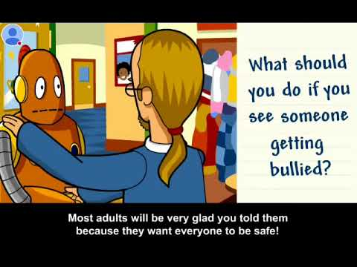
What is Bullying?

Slide 3
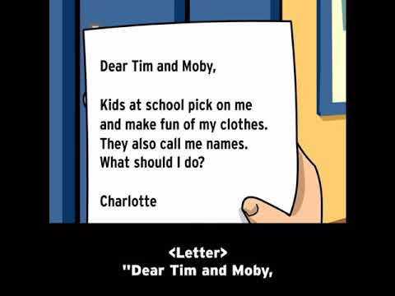
What is Bullying?

Slide 5
Rude Behavior
Accidentally saying or doing something hurtful
Examples:
Cutting in line
Bragging about making a team

Slide 6
Mean Behavior
Doing or saying something hurtful on purpose.
Examples:
Making fun of what someone looks like or what they are wearing.
Insulting someone’s intelligence or ability to do something.
Saying or doing something unkind after a fight with a friend.
Taking something that doesn’t belong to you.

Slide 7
Bullying Behavior
People who bully say or do something purposefully hurtful to others and they keep doing it again and again with no sense of guilt or shame.
Kids who bully have more power than the kids they pick on. This power may come from being older, stronger, or bigger in size, or it may come from getting several kids to gang up on one target, to make that target feel hurt and alone.

Slide 8
1
2
Power
Pattern
3
Purpose
The 3 P’s of Bullying
The person doing the actions has more power or influence that the target.
The cruelty happens over and over again.
It is done on purpose. There is nothing accidental or unplanned about it.

Slide 9
The Roles People Play In Situations Are Important for Us to Understand
Target
Bystander
Bully
Upstander
A person who watches a conflict or unacceptable behavior and just stands by. They don’t do anything to help the target.
The person who is being bullied.
The person who is doing the bullying.
A person who supports and stands up for someone else.

Slide 10
How to Respond and Help
If You Are Being Bullied
Be an Upstander
Try to stay calm.
Tell them to stop.
Say nothing back and walk away.
Spend more time with people who make you feel good about yourself.
Talk to a trusted adult.
Try to brush it off with humor.
Reach out to the target to see how they are feeling. Listen to what they have to say.
Inform a teacher, coach, counselor, parent or other trusted adult.
Encourage the target to not respond and to not retaliate.
Encourage the target to reach out to their
trusted adult.

Slide 11
Always
Be an
Upstander!

