Slide 1
BE A SUPERHERO!
Stand up against Cyberbullying!

Slide 2
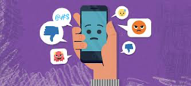
Lesson Objectives
Define what is cyberbullying.
Understand the roles that people play in a cyberbullying situation.
Identify strategies for dealing with cyberbullying and ways they can be an upstander for those being bullied.
How can empathy help?

Slide 3
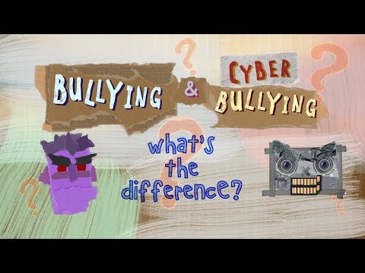
What is Cyberbullying?
Cyberbullying is bullying that takes place using electronic resources.

Slide 4
How is Cyberbullying Different from Bullying?
Can be difficult and sometimes impossible to trace.
Cyberbullying can happen 24 hours a day, 7 days a week.
The bullying messages or images can be posted or sent anonymously.

Slide 5
The Roles People Play in Situations are Important to Understand
Target
Bystander
Bully
Upstander
A person who watches a conflict or unacceptable behavior and just stands by. They don’t do anything to help.
The person who is being bullied.
The person who is doing the bullying.
A person who supports and stands up for someone else.

Slide 6
What Can I Do?
Sometimes people say and do things online that can hurt others.
We need to be kind online and stand up to bullies - that’s called being an Upstander. You might remember the term “Upstander” from other bullying lessons you’ve had.
You can be an Upstander in person AND online!

Slide 7
How to Respond and Help
Ways to Respond if You are Being Cyberbullied | Ways to Be an Upstander
Ignore the messages Block the bully (which makes them unable to talk to you anymore) Use reporting tools (telling a site or app about the bullying behavior) Take screenshots of messages to show an adult Tell a trusted adult Talk to a friend about how you are feeling. | Reach out to the target to see how they are feeling. Listen to what they have to say. Inform a teacher, coach, counselor, parent or other trusted adult. Encourage the target to not respond and to not retaliate. Encourage the target to reach out to their trusted adult.

Slide 8
Show Empathy
What does empathy have to do with cyberbullying??
To have empathy you imagine the feelings that someone else is experiencing.
Would you want things said about you online? Would it hurt your feelings?

Slide 9
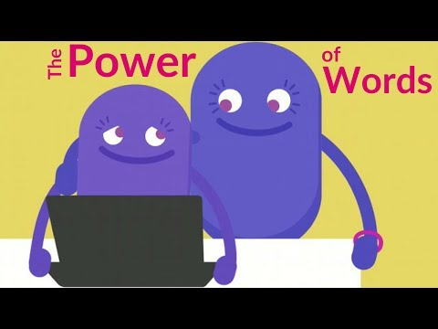
Always Remember the Power of Your Words

Slide 10
Other Ideas for
Stopping Cyberbullying
Be an upstander, don’t sit by and watch things happen.
Talk to a trusted adult.
Talk with your friends and come up with ways to stop Cyberbullying.
Create posters or other media sources to get the word out about Cyberbullying.

Slide 11
It’s Cool To Be Kind!

