Slide 1
Strategies for calm
A Calm-Down/Mindful Lesson
2nd Grade
School Counselor-Aaliyah Green, M.Ed

Slide 2
Lesson Goals
Objectives
Participants will:
be able to identify situations in which their emotions lead them down a path to harmful, inappropriate behavior;
be able to identify alternatives to that behavior;
learn calming down strategies; and,
work together to set up a place in the classroom/ or Home where they can modify their behavior and feel better as a result.

Slide 3
What do feelings Look Like
This Photo by Unknown Author is licensed under CC BY-NC-ND

Slide 4
Feelings & Emotions…
Take a look at these emotions……..Inside Out video
What does upset or anger look like in your body??

Slide 5
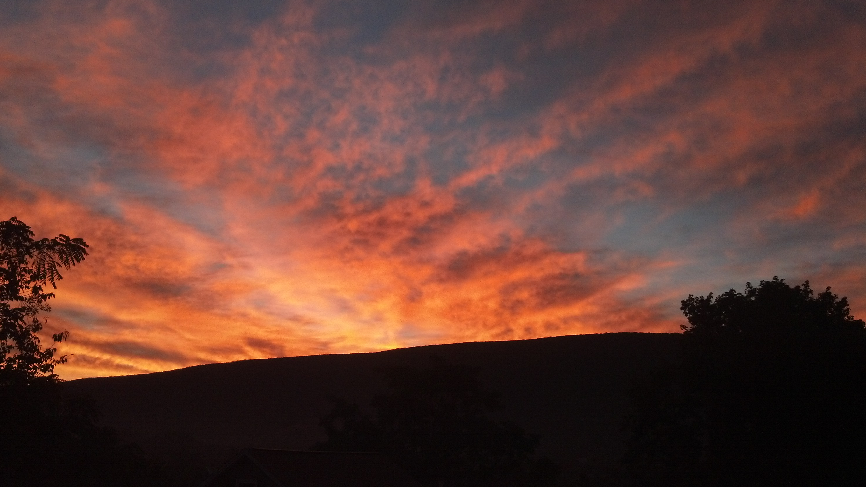
CALM DOWN STRATEGIES
Let’s learn some strategies for calming down and create a way to help us calm down in our Home & classroom when we are having difficult feelings that might get in the way of our learning or productive behaviors.
This Photo by Unknown Author is licensed under CC BY-NC-ND

Slide 6
Quick Check-In
There are ways to calm down when you’re feeling upset or angry that rely on mechanisms built into our bodies. Deep breathing, stretching, and tensing and releasing our muscles all help to bring calming.
How relaxed do you feel on a scale of 1 to 10 (10 being VERY relaxed and 1 being VERY tense).?????????
This Photo by Unknown Author is licensed under CC BY

Slide 7
Calm Down Strategy #1:
Deep Breathing: A fun way to learn deep breathing is to pretend to blow up a balloon. Participants can hold their hands together in front of their mouths. On the count of five (1, 2, 3, 4, 5) they will blow all their air out and expand their hands to simulate an imaginary balloon being blown up. Then for a count of five they will inhale. Hold their breath for a count of two. And then begin again to blow up their imaginary balloons. Do this as quietly as possible.
Balloon Breathing

Slide 8
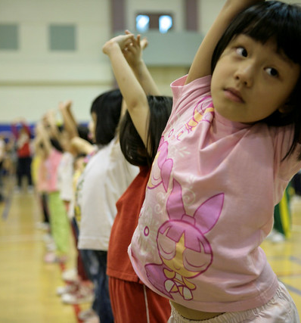
Calm Down Strategy #2
Stretching: Have participants reach towards the sky and extend upwards on their toes, stretching their entire body. Hold this stretch for the count of 5 and then release. Shake your body before stretching again.
This Photo by Unknown Author is licensed under CC BY

Slide 9
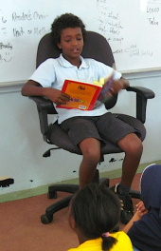
Calming Strategy #3
Tense and Release: While seated, have participants raise their shoulders and clench their fists, holding the tension for a count of five.
Tense and Release practice
This Photo by Unknown Author is licensed under CC BY-NC

Slide 10
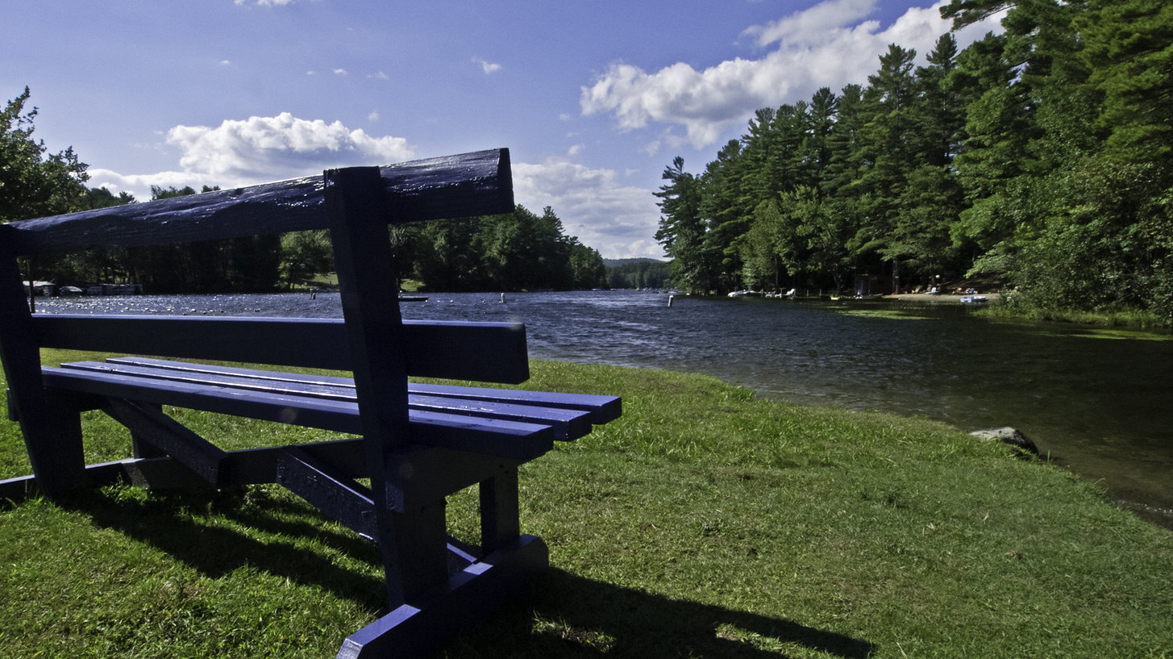
Let’s Brainstorm
Please complete the sentence, "A special place that I find peaceful is. . .”
Where do you find peace?
This Photo by Unknown Author is licensed under CC BY-SA-NC

Slide 11
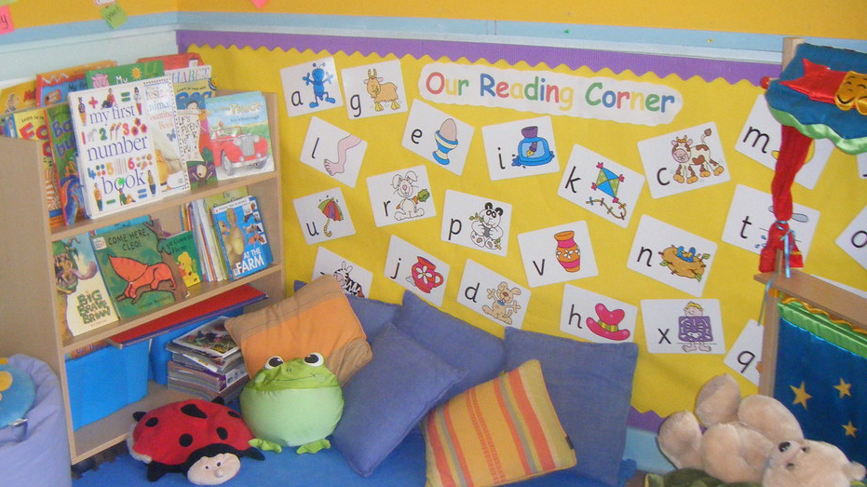
Things for your Peace Place
A Blanket
Comfy pillows
Books to read
Can you think of anything else?
This Photo by Unknown Author is licensed under CC BY-SA-NC

