Slide 1
How to Be Bully Free

Slide 2
What is bullying?
Tell an adult at home or your school counselor what you think bullying is.

Slide 3
What is bullying?
Bullying is when someone is mean or hurtful to another person on purpose many times.

Slide 4
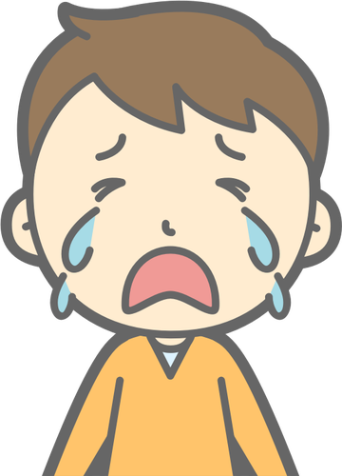
Forms of Bullying
Bullying can be….
Verbal
Using words to hurt other people.
For example:
name calling, teasing, and using bad words
Physical
Using your body to hurt other people.
For example:
hitting, kicking, biting, pushing
Excluding
Leaving people out on purpose.
For example:
not letting someone play with you or your group
Cyber
Bullying online.
For example:
bullying on apps, over text, or by email

Slide 5
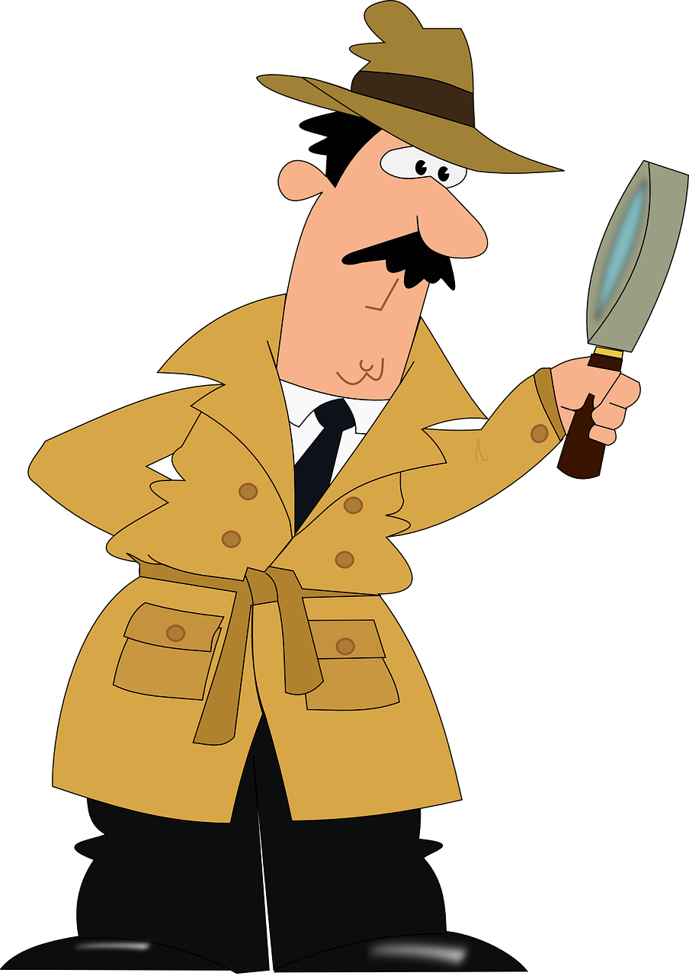
Recognize
The first step to stopping bullying is to notice or recognize that it is happening.
We can use the
3 O’s as clues to recognize if something is bullying or not!

Slide 6
The 3 O’s of Recognizing Bullying
Is it….
Over and Over?
On Purpose?
One Sided?

Slide 7
The 3 O’s of Recognizing Bullying
Over and Over
Has this happened many times over and over or only one time?
If it has happened over and over it might be bullying.
If the mean behavior has only happened once it is considered rude or a conflict but it is not bullying.

Slide 8
Try it out!
Read the situation below and decide if this is bullying or not.
Jasmine stuck her tongue out at Micah. Today was the first time she had ever done this.
Is this bullying?
Yes or No

Slide 9
Try it out!
The correct answer is NO.
This is NOT bullying because it only happened one time.
This is rude and a conflict but it is NOT bullying.
Remember, bullying is Over and Over.

Slide 10
Try it out!
Read the situation below and decide if this is bullying or not.
George sticks his tongue out at Ximena every day.
Is this bullying?
Yes or No

Slide 11
Try it out!
The correct answer is YES.
This might be bullying because it is happening Over and Over.

Slide 12
The 3 O’s of Recognizing Bullying
On Purpose
Is the person doing this by accident or on purpose?
If this is happening on purpose it might be bullying.
If the mean behavior is not on purpose it is considered rude or a conflict but it is not bullying.

Slide 13
Try it out!
Read the situation below and decide if this is bullying or not.
Eunice accidentally steps on Jeremiah’s foot in the lunch line.
Is this bullying?
Yes or No

Slide 14
Try it out!
The correct answer is NO.
This is NOT bullying because it was on accident.
This is might be a conflict but it is NOT bullying.
Remember, bullying is On Purpose.

Slide 15
Try it out!
Read the situation below and decide if this is bullying or not.
Everyday at lunch Matthew calls Kim a name and shoves her.
Is this bullying?
Yes or No

Slide 16
Try it out!
The correct answer is YES.
This might be bullying because it is happening Over and Over and On Purpose.

Slide 17
The 3 O’s of Recognizing Bullying
One Sided
If a person is being mean to another person and that other person is not being mean back and can’t make the bullying stop, that is one sided.
If people are being mean to each other that is two sided.
If it is one sided it might be bullying.
If the mean behavior is happening by both people it is considered rude or a conflict but it is not bullying.

Slide 18
Try it out!
Read the situation below and decide if this is bullying or not.
Everyday at recess Tiana and Rachel call each other mean names.
Is this bullying?
Yes or No

Slide 19
Try it out!
The correct answer is NO.
This is NOT bullying because it is two sided. Both girls are being mean to each other.
This is might be a conflict but it is NOT bullying.
Remember, bullying is One Sided.

Slide 20
Try it out!
Read the situation below and decide if this is bullying or not.
Everyday in the library Matthew calls Mohammed names. Mohammed is not mean back to Matthew. He asks Matthew to stop.
Is this bullying?
Yes or No

Slide 21
Try it out!
The correct answer is YES.
This is One Sided because Mohammed is not being mean back.
This is bullying because it is happening:
Over and Over
On Purpose
and is One Sided

Slide 22
What can you do about bullying?
If you Recognize bullying
be sure to Report it to a trusted adult.
It is important to Report any bullying you know of to a trusted adult so that the adult can help make the bullying stop!

Slide 23
Thanks for keeping our school bully free!
Go to the quiz for this module to share what you know!
Go to the discussion for this module and write the name of one trusted adult at home you would report bullying to and one trusted adult at school you would report bullying to.

