Slide 1
Mindfulness and Your Brain

Slide 2
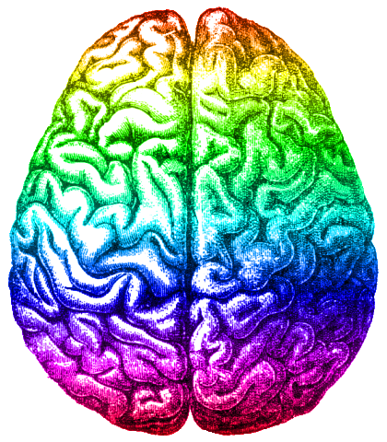
Your Brain
Your brain is a very important organ in your head!
Your brain controls everything you do.
Do 3 jumping jacks.
Your brain sent signals to your body to do those jumping jacks.

Slide 3
Write down or name as many feelings as you can!
Your brain also controls your feelings and how you respond to different situations.

Slide 4
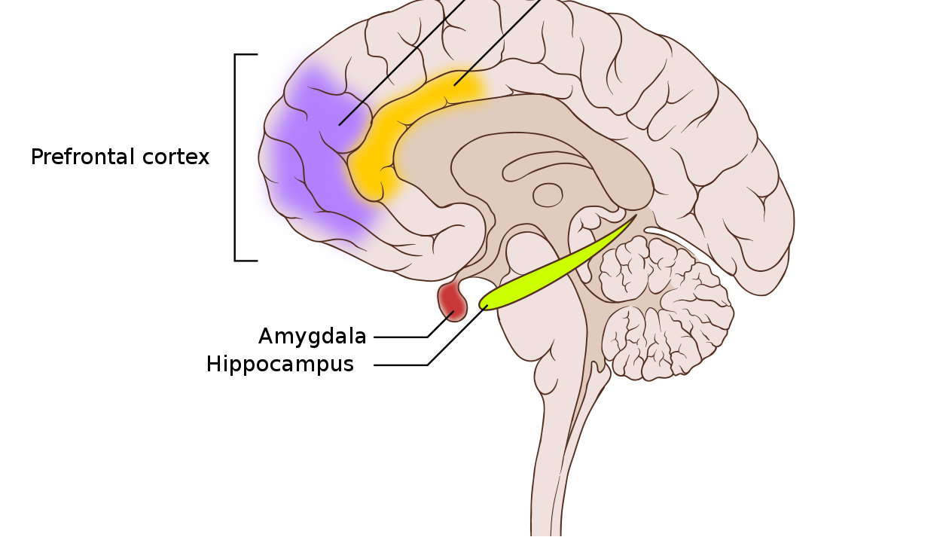
Parts of Your Brain
Different parts of your brain do different things

Slide 5
Parts of Your Brain
Let’s talk about your amygdala
Your amygdala is an important part of your brain.
Say “amygdala” out loud!
That’s a big word so we call it our “lizard brain.”

Slide 6
Parts of Your Brain
Your lizard brain keeps you safe!
Think about it:
Let’s say a lizard is sitting on a rock and a group of people walk up to it.
What would the lizard do?

Slide 7
Parts of Your Brain
The lizard might…
Attack!
We call this
Fight
Run Away!
We call this
Flight
Stay Still!
We call this
Freeze

Slide 8
Parts of Your Brain
Your lizard brain (amygdala) is in charge of your
fight
flight
or freeze
response and keeps you safe.

Slide 9
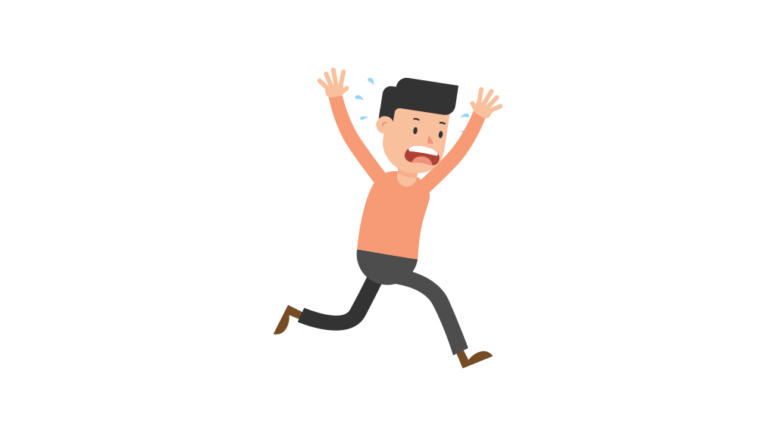
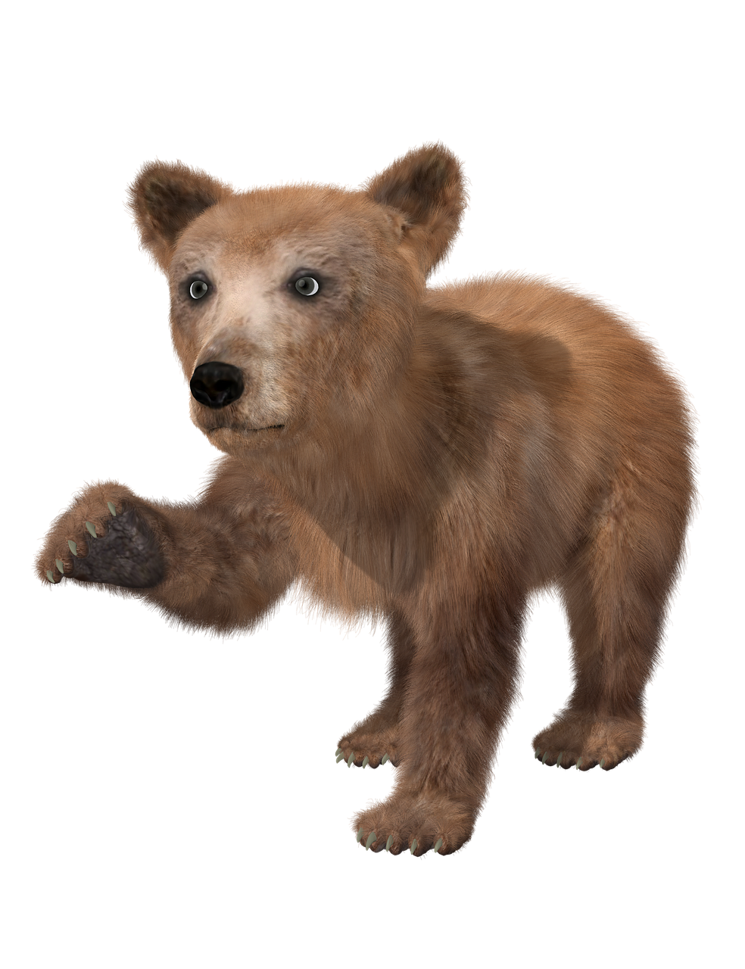
Parts of Your Brain
For example:
If you were camping and a bear walked up, your lizard brain (amygdala) would keep you safe by telling you to either:
fight
flight
or freeze

Slide 10
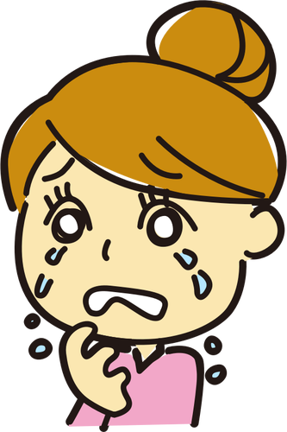
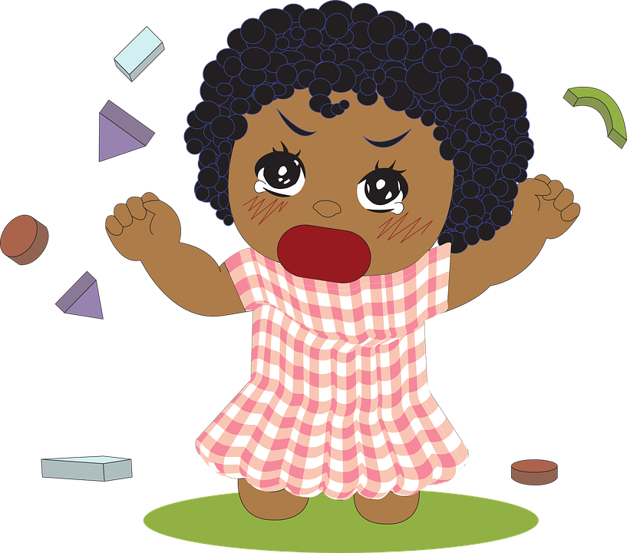
Parts of Your Brain
But sometimes our lizard brain (amygdala) thinks there is danger when there really is not.
For example:
If you feel very nervous on your first day of school.
If you get angry when you can’t play with a toy you want to.
If you are scared to fall asleep in the dark.
Think of a time when your lizard brain (amygdala) came out!

Slide 11
Parts of Your Brain
The good news is we have a prefrontal cortex!
This is another important
part of your brain.
Say “prefrontal cortex” out loud!
That’s a big word so we call it our “wizard brain.”

Slide 12
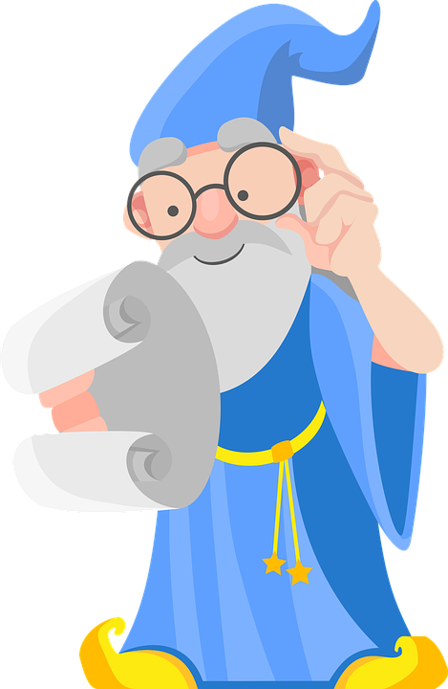
Parts of Your Brain
Your wizard brain (prefrontal cortex) is wise like a wizard!
When your wizard brain is in charge you are able to stay calm and make good choices.
Write down one thing that helps you stay calm.

Slide 13
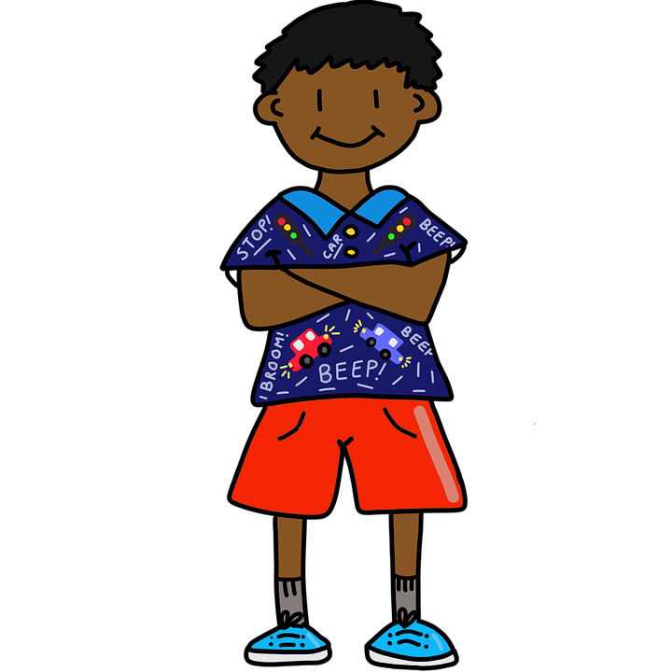
Brain and Body
Did you know that when you start to have big feelings your brain will send messages to your body?
It is important to notice what is going on in your body and listen to what it is saying.

Slide 14
Brain and Body
For example:
Your heart might beat very fast when you are angry.
You might feel like you have butterflies in your stomach when you are worried.
You might feel hot when you become frustrated.

Slide 15
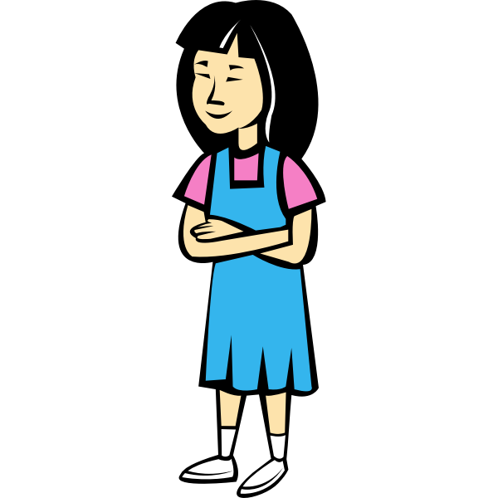
Mindfulness
When you pay attention to what is happening in your body you can notice when your lizard brain starts to come out.
You can use mindfulness strategies to calm your lizard brain and put your wizard brain back in charge!

Slide 16
Mindfulness
Do at least two of the mindfulness activities posted in this module.
When you are done, post in the discussion which mindfulness activity you enjoyed most!

