Slide 1
How to Be a Distance Learner!

Slide 2
Distance Learning is New for Us All
Having school at home is
different than regular school.
This can be confusing
for your brain.

Slide 3
We Are In This Together!

Slide 4
Write or Draw A Picture
What are you excited for about distance learning at home?
What are you worried about with
distance learning at home?

Slide 5
Great Distance Learners:
Have a quiet space
Are respectful
Try their best
Take brain breaks
Talk about how they are feeling

Slide 6
A Quiet Space
It is important to do your distance learning in a quiet space of your home.

Slide 7
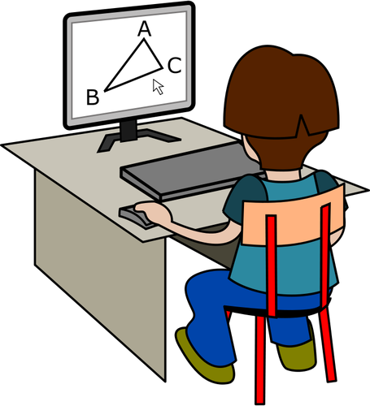
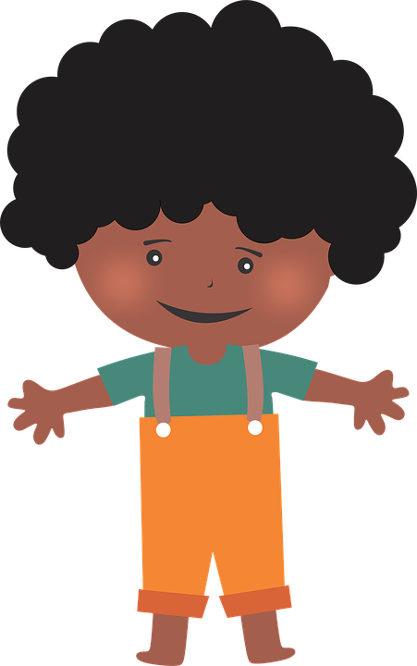
A Quiet Space
Your space might be…
A Desk
A Table
The Floor
As long as your space is quiet and comfortable you are ready for distance learning!

Slide 8
A Quiet Space
Draw a picture of your quiet distance learning space.

Slide 9
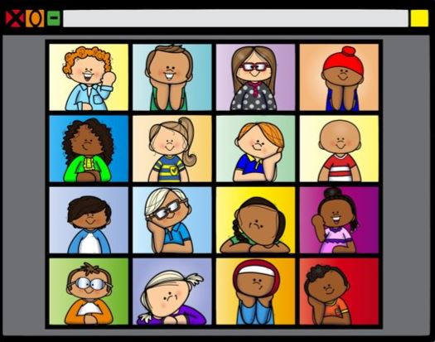
Be Respectful
When you are in your class meetings, it is important that you are being respectful.
The same rules that you have in your typical classroom are the rules you must abide by when you are in your virtual class meetings.

Slide 10
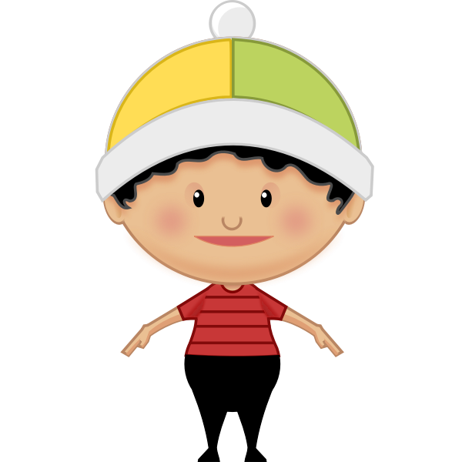
Be Respectful
Eyes
Watching the speaker
Ears
Listening
Mouth
Quiet
Until it is your turn
Body
Calm
Staying in one spot

Slide 11
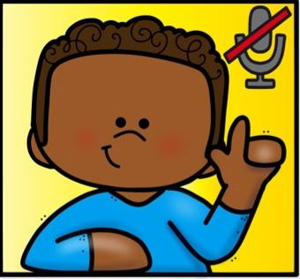
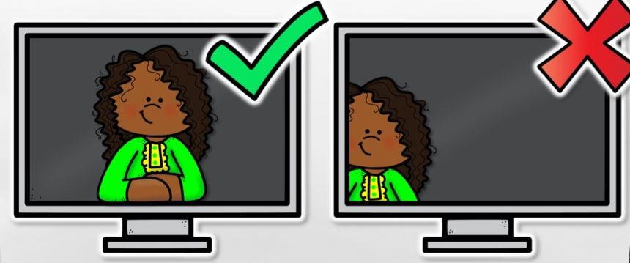
Be Respectful
Here are a few more tips!
When it is not your turn to talk be sure to press the mute button.
Try your best to have your whole face showing on the camera.

Slide 12
Try Your Best
Distance learning is new for everyone, even teachers!
Try your best and don’t give up!
If you need help with something that is okay! We are happy to help. All you have to do is ask!

Slide 13
Try Your Best
What does trying your best look like for you?

Slide 14
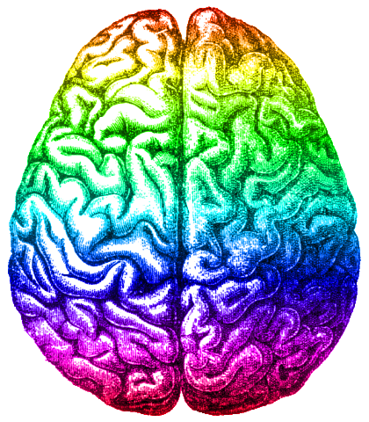
Take Brain Breaks
Too much time on a screen is not good for your brain.
Make sure you take breaks throughout the day!

Slide 15
Take Brain Breaks
Make sure you get fresh air everyday
Check out the Brain Break links in this module in Canvas for ideas!

Slide 16
Talk About Your Feelings
You will have many different feelings during distance learning.
It is very important that you talk to an adult about your feelings.
Who is an adult at home you can talk to about your feelings?
Who is an adult at school you can talk to about your feelings?

Slide 17
Talk About Your Feelings
Point to the face that matches how you are feeling right now!

Slide 18
Remember! Great Distance Learners:
Have a quiet space
Are respectful
Try their best
Take brain breaks
Talk about how they are feeling

Slide 19
You are Ready to Be a Distance Learner!

