Slide 1
Our Diverse Universe 1st Grade Counseling Lesson-PWCS

Slide 2
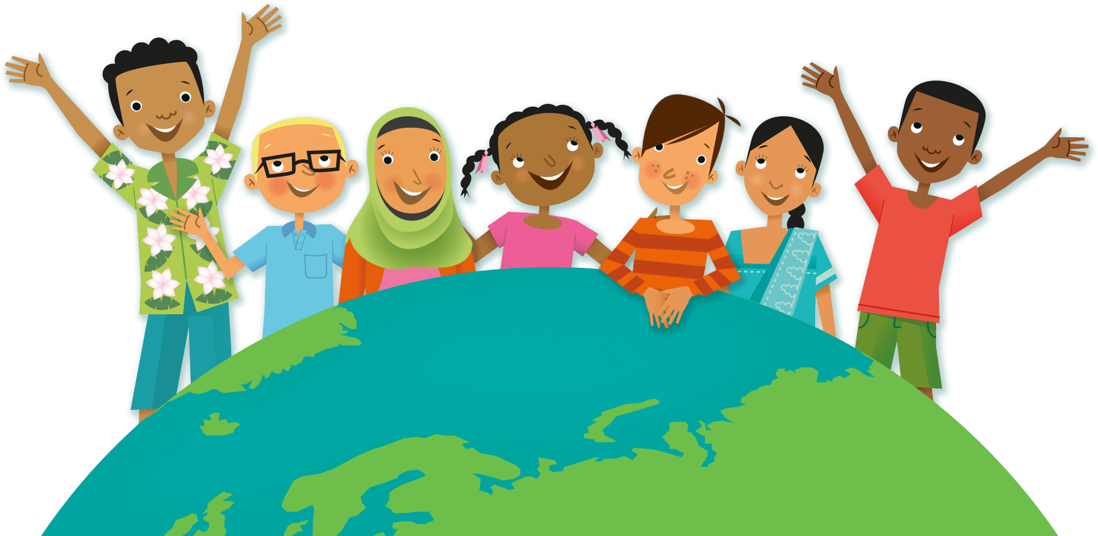
We are all different…and that is great!
People come in many different shapes, sizes, colors, and abilities.
No two people are exactly alike.
Why is it important that people are not
all the same?

Slide 3
The world would be so boring if we were all the same!
It is important that we are all different because we can learn and grow from each other!
Diverse is a big word for different! We live in a diverse world because there are many different people! No two are exactly alike.

Slide 4
Let’s Read About It!
Click here to read All Are Welcome Here
by Alexandra Penfold

Slide 5
Activity!
What you will need:
A piece of paper
Something to write with
Something to color with

Slide 6
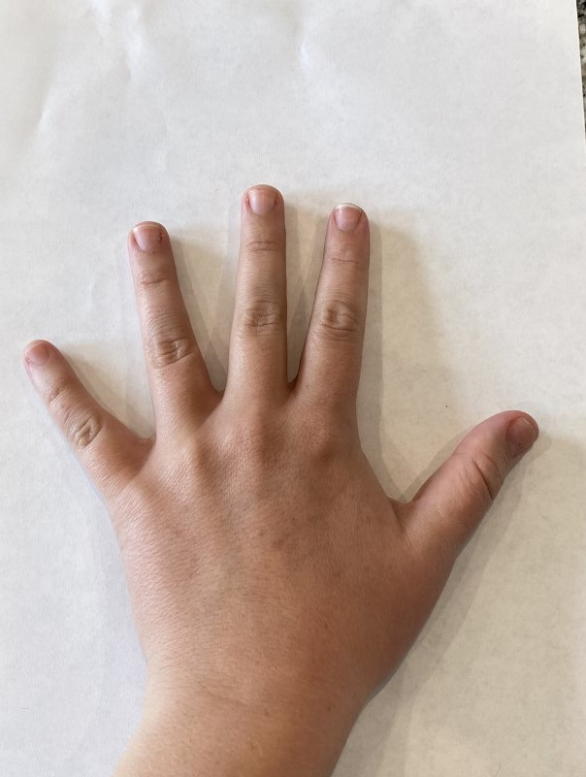
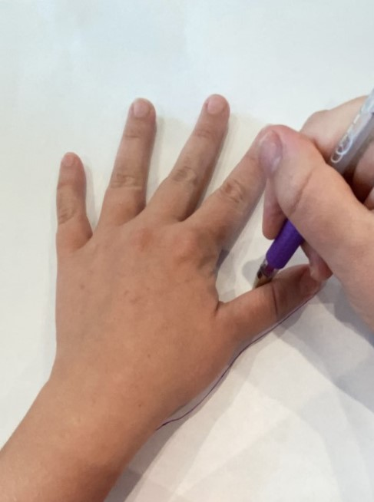
Activity!
Step 1: Place your hand
on your piece of paper.
Step 2: Use your other hand to
trace your hand with a pencil.

Slide 7
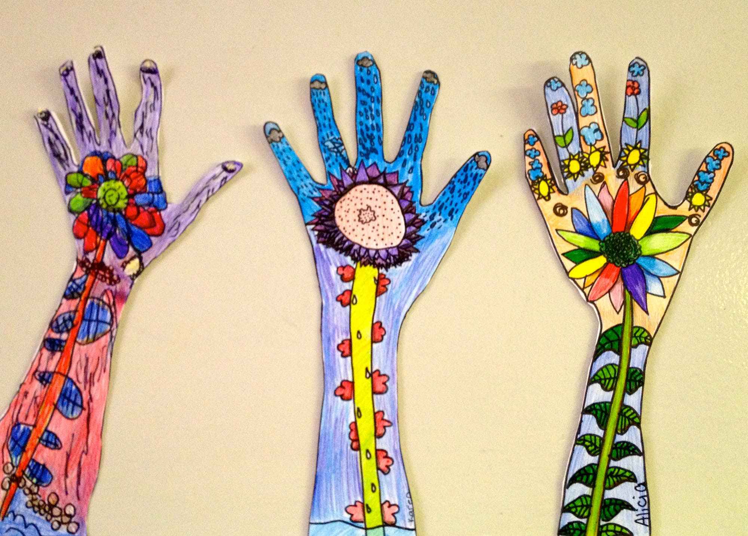
Activity!
Step 3: Decorate the inside of the hand you drew with things about you!
Be sure to include things that make you special.
For example: where you are from, your favorite food,
languages you speak, holidays you celebrate,
your family, abilities you have, and things you
like to do for fun.

Slide 8
Activity!
Step 4: Upload a picture of the hand you drew to this
module’s discussion. Be sure to write a sentence
about the wonderful things that make you who you
are!

Slide 9
Point Your Finger at the Right Way to Respond
Carly is eating a food you have never seen or smelled before.
Should you…
Yell, “Eww what is that?” and laugh?
Say, “I have never seen that food before and I’d like to learn about it. Do you mind if I ask a few questions?

Slide 10
That’s right! You should be polite and ask to learn more. Most people don’t mind having a nice conversation. It is never okay to make fun of someone because they are different or do things differently than you do.

Slide 11
Point Your Finger at the Right Way to Respond
Insert another scenario here.
Should you…
Choice 1
Choice 2

Slide 12
Questions to Think About
How are you the same as other people?
How are you different from other people?
How can you spread love to people who may not be the same as you?

