Slide 1
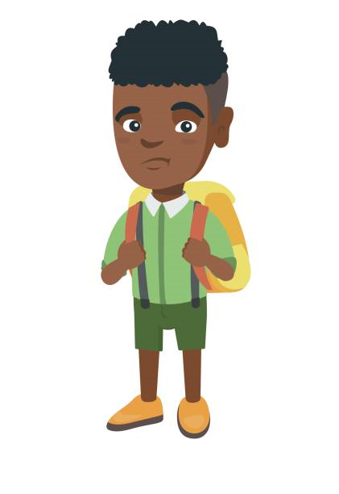
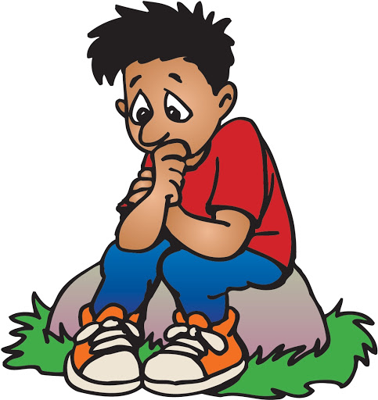
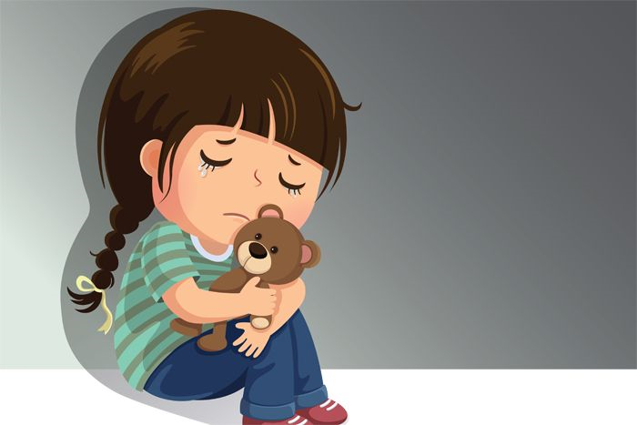
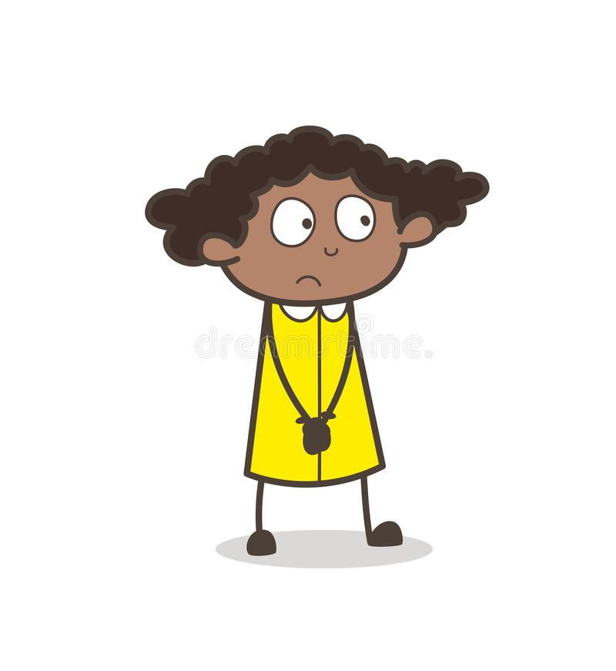
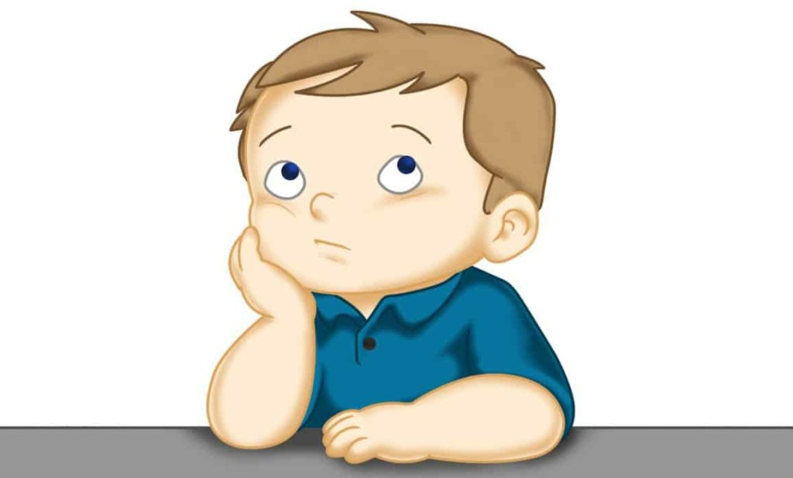
Managing Worry
1St Grade

Slide 2
Learning Objectives
I can name two coping skills that I can use when I feel worried.
I can name two times that I should use coping skills.

Slide 3
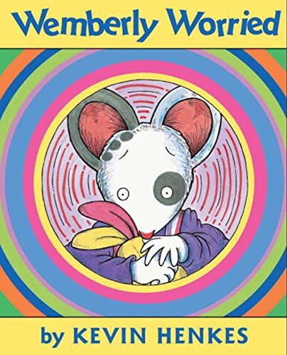
Listen to the story Wemberly Worried by Kevin Henkes.
Click on the book
Click on the orange box to see a Second Step video of a student who finds himself feeling worried (Play Part 1)

Slide 4
Discussion Questions
What words best describe Wemberly?
What are some things that Wemberly worried about?
How does Wemberly change at the end of the story?
Why do you think that Wemberly changes and stops worrying?
Why do you think the author uses the words "worry, worry, worry" often throughout the story?
Which character helped Wemberly change or feel better? How is this character like Wemberly?
How are you like Wemberly?

Slide 5
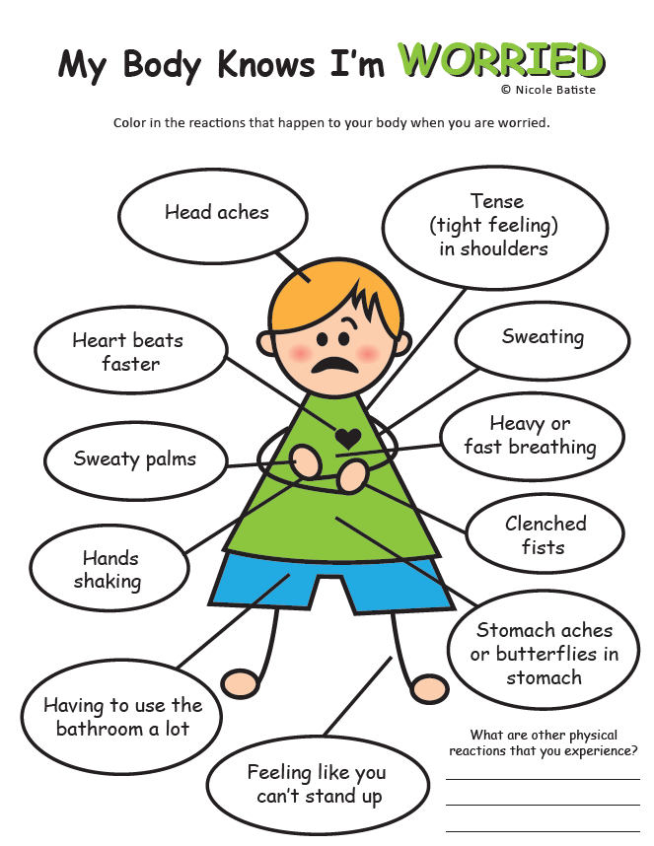
When we worry, it can make our body feel different. How does your body feel when you worry?

Slide 6
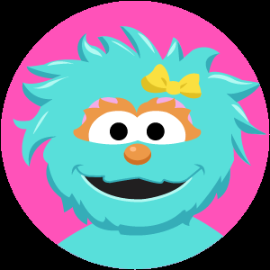
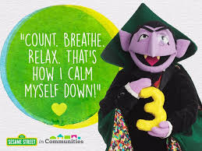
Coping Skills Coping skills are things we can do to make us feel better when we have big emotions like worry, fear, anger or sadness.
Breathing
Counting
Positive Self-Talk
Belly Breathe with Rosita
Click on the picture below:
Count, Breathe, Relax with the Count
Click on the picture below:
Positive Self Talk
Click on the picture below to see a student learn about positive self-talk:
You can also talk to any grown up you trust when you are feeling worried.
Who is someone you can talk to?

Slide 7
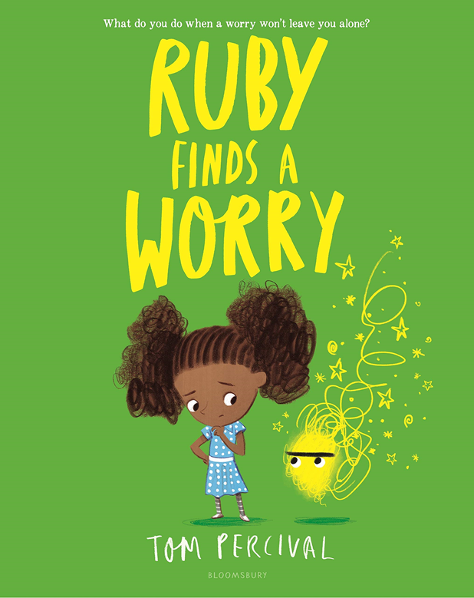
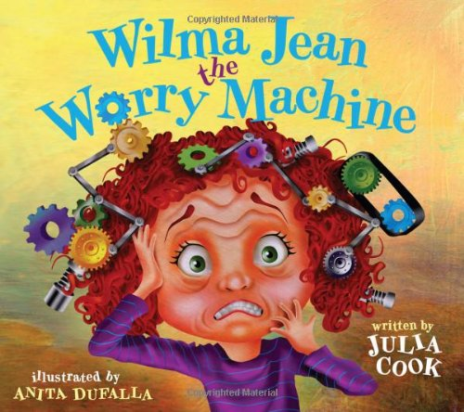
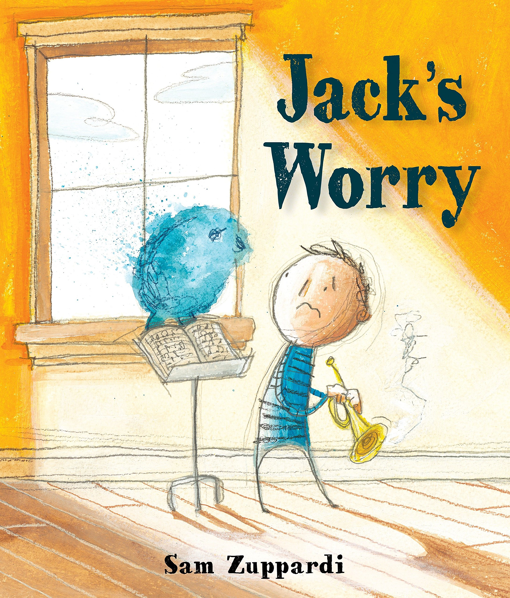
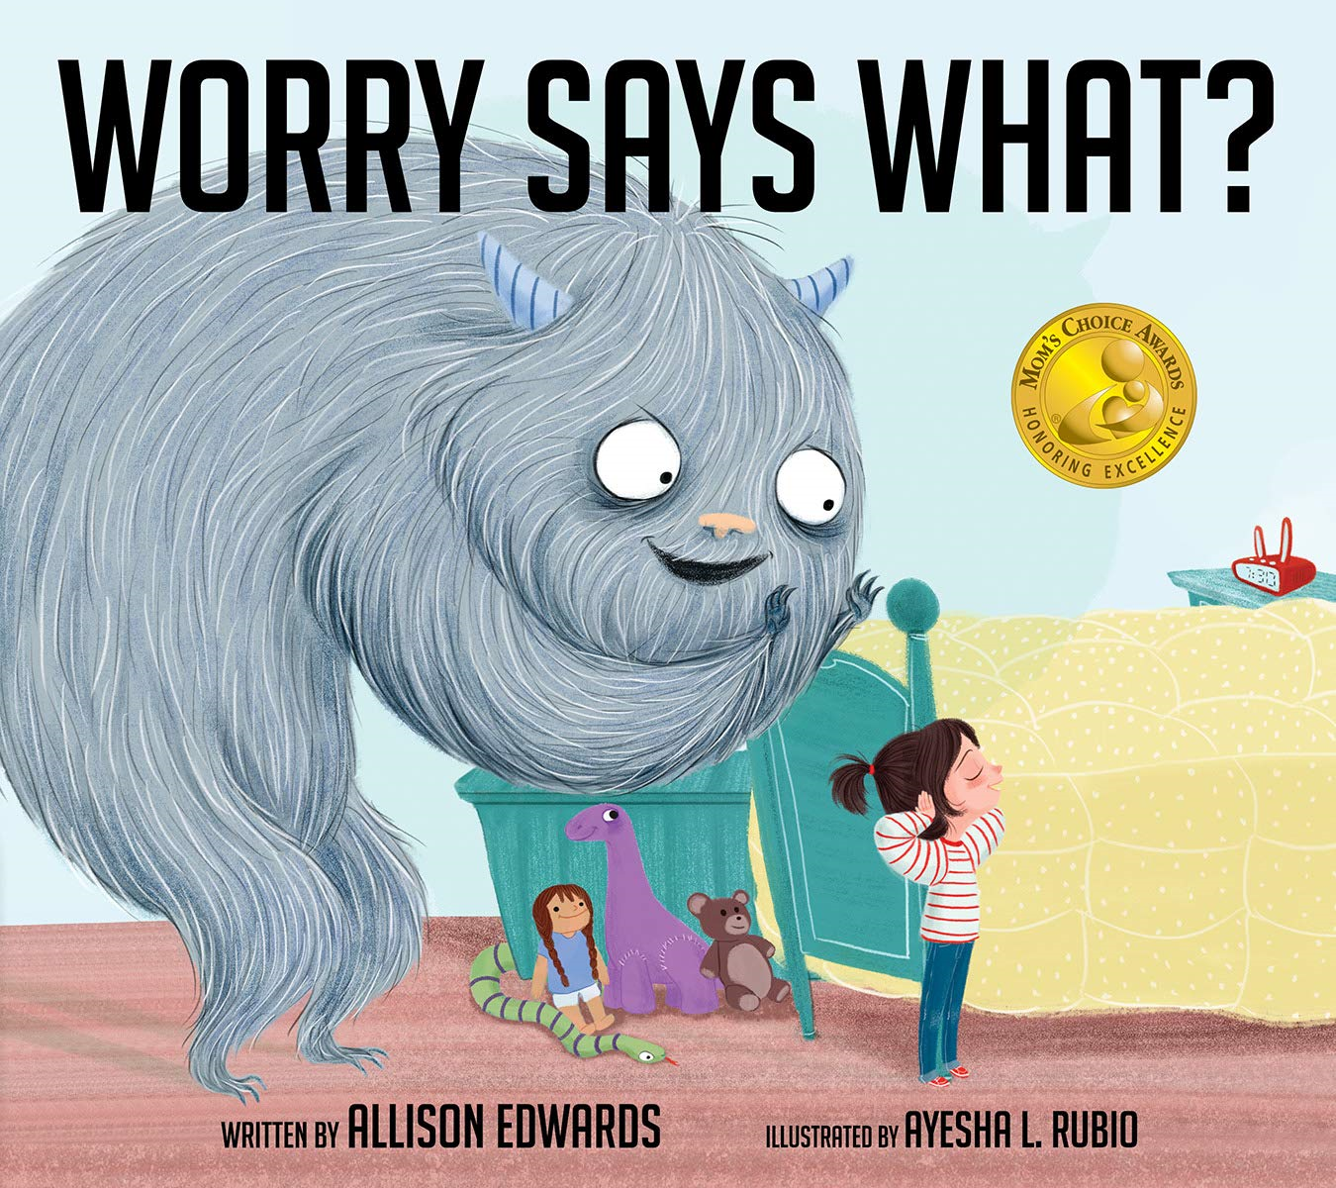
Other Resources
Click on the book to hear the story.
Here are some links to other stories about worry and examples of coping skills you can use.
Belly Breathing Song:
https://safeYouTube.net/w/0IVH
Positive Affirmations (Self-Talk) Song: https://safeYouTube.net/w/MyXH
Rainbow Breath (Go Noodle): https://safeYouTube.net/w/H1XH
Keep Calm - Breathing: https://safeshare.tv/x/ss5e94ad270a451
Relaxed Breathing: https://safeYouTube.net/w/RLyI
Square Breathing: https://safeYouTube.net/w/1MyI
Click here and then Play Part 2 to see the student use his coping skills.

