Slide 1
Self- Control
1st Grade Lesson-PWCS

Slide 2
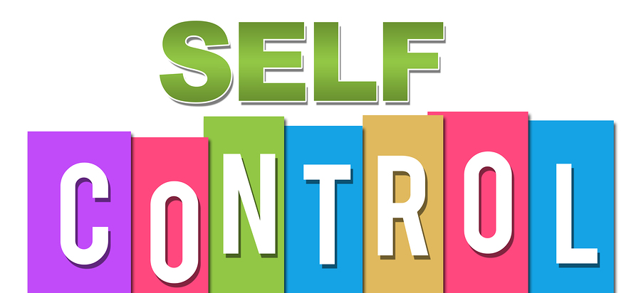
Today we are going to learn what self-control is and how to use it!

Slide 3
WHAT IS SELF-CONTROL?
What do you think?

Slide 4
self-control
Self-control means being in control of our actions and thinking about what we do before we do it.

Slide 5
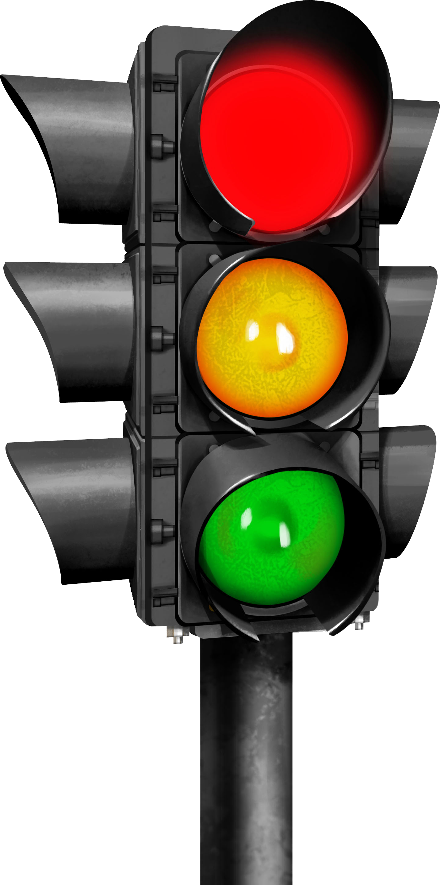
self-control
Using self-control is like a stop light.
We need to
stop, think, act!

Slide 6
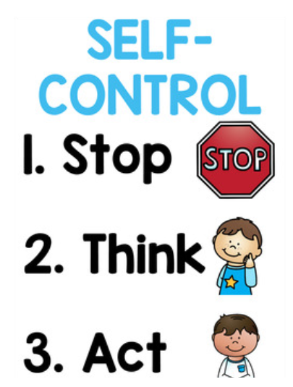

Slide 7
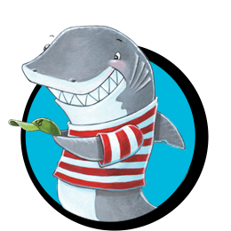
We are now going to watch a story about Clark the shark! Clark has a problem with self-control!

Slide 8
Click to hear Clark the shark!

Slide 9
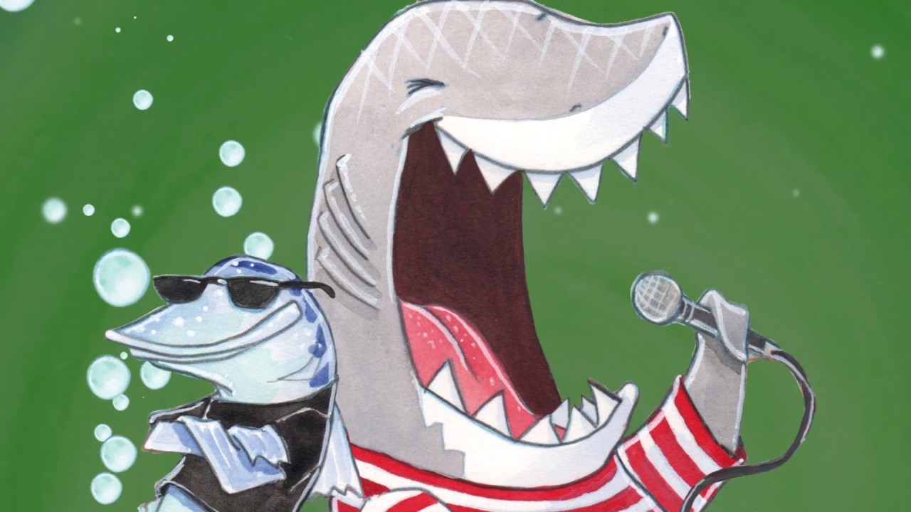
When did clark have trouble maintaining self-Control?

Slide 10
CLARK the SHARK
GAME
Move Clark in the next slides to show self-control.

Slide 11
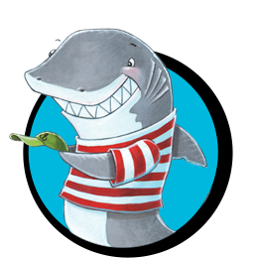
On the playground...
You say kind words and play with everyone.
You get easily upset and don't play with others.
What would Clark do to show
self-control?

Slide 12
In the Zoom meeting...
You make silly faces into your computer camera, trying to make friends laugh during Zoom meeting.
You do your best to focus in your Zoom meeting.
What would Clark do to show
self-control?

Slide 13
In the lunchroom...
You are talking to your friends so much that you don't have time to eat your lunch.
You finish your lunch and still talk to your friends.
What would Clark do to show
self-control?

Slide 14
In the classroom...
You raise your hand and wait to be called on, when you have something to say.
You raise your hand, but still call out the answer.
What would Clark do to show
self-control?

Slide 15
In the lunchroom...
You throw your trash away, at the appropriate time.
You throw your trash away, after the lunch lady told you not too.
What would Clark do to show
self-control?

Slide 16
On the playground...
You ignore your teacher and keep playing on the monkey bars.
You line up the first time your teacher asks.
What would Clark do to show
self-control?

Slide 17
In the Zoom meeting...
You raise your hand on Zoom and wait to be called on by your teacher.
You raise your hand on zoom, but you unmute yourself and blurt out the answer.
What would Clark do to show
self-control?

Slide 18
In the classroom...
You talk to your classmate, while you are supposed to be reading to self.
You pick a good spot in the classroom to read to self.
What would Clark do to show
self-control?

Slide 19
In the lunchroom...
You only talk to your friends at your table.
You yell across the table to tell your friend something.
What would Clark do to show
self-control?

Slide 20
On the playground...
You bump into your classmate by accident and say you are sorry.
You bump into your classmate by accident and you walk away.
What would Clark do to show
self-control?

Slide 21
In the classroom...
You listen to your classmates when they are talking.
You do not pay attention, while your classmate is giving a presentation.
What would Clark do to show
self-control?

Slide 22
In the lunchroom...
You take a bite of your friend's cookie, when there are not looking.
You only eat your own food.
What would Clark do to show
self-control?

Slide 23
On the playground...
You exclude others at recess.
You include others at recess.
What would Clark do to show
self-control?

Slide 24
In the classroom...
You take all the glue sticks from your table and will not share with anyone.
You take the only glue stick at your table and put it back after you are done.
What would Clark do to show
self-control?

Slide 25
Answer the following question in the discussion post in Canvas! Talk about a time it was really hard to "show self-Control" with virtual learning.

