Slide 1
How to be a problem solver!
1st Grade Lesson on Conflict Resolution

Slide 2
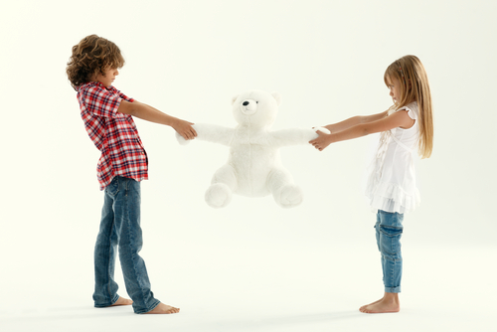
What is Conflict?

Slide 3
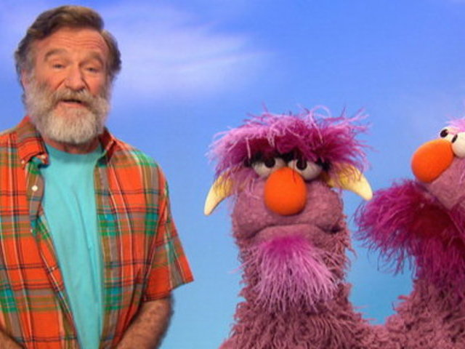
Let's watch this video
https://www.youtube.com/watch?v=Gl3e-OUnavQ

Slide 4
Conflict is a big word for.....
Problem or
a disagreement

Slide 5
CONFLICT
Conflict is a word used to describe when people are not getting along.

Slide 6
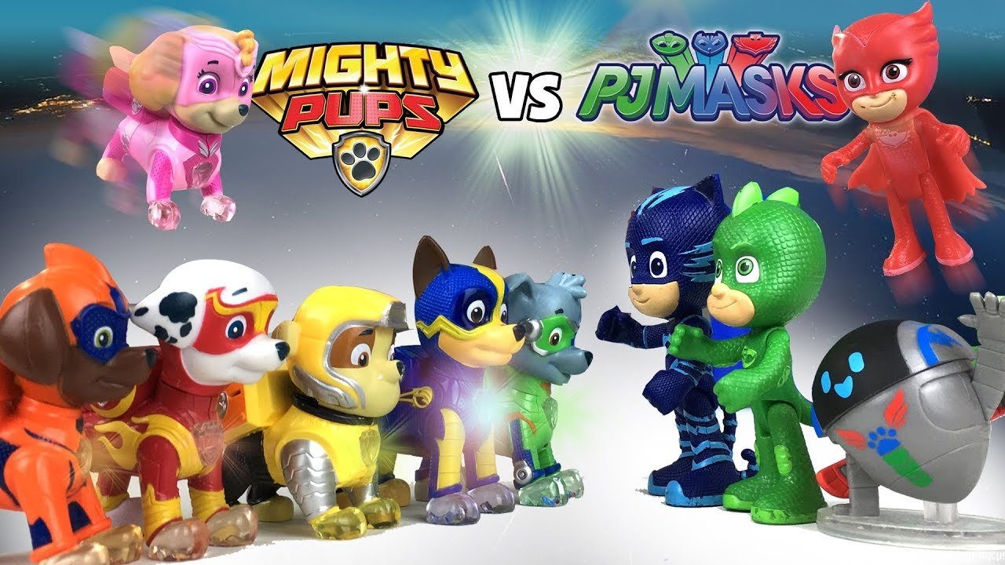
A conflict could be....
A disagreement
For example: two students could disagree about what tv show is the BEST!!!

Slide 7
A conflict could be....
A rude moment
For example: Someone saying I am the best math student in the whole class because I always get the answers correct.

Slide 8
A conflict could be....
A mean moment
For example: a friend could make fun of your new haircut.

Slide 9
How to be a problem solver
Try some of these "idea" to resolve your conflict

Slide 12
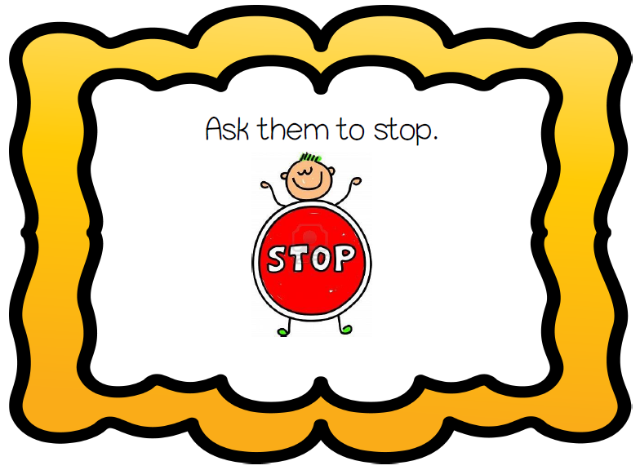

Slide 17
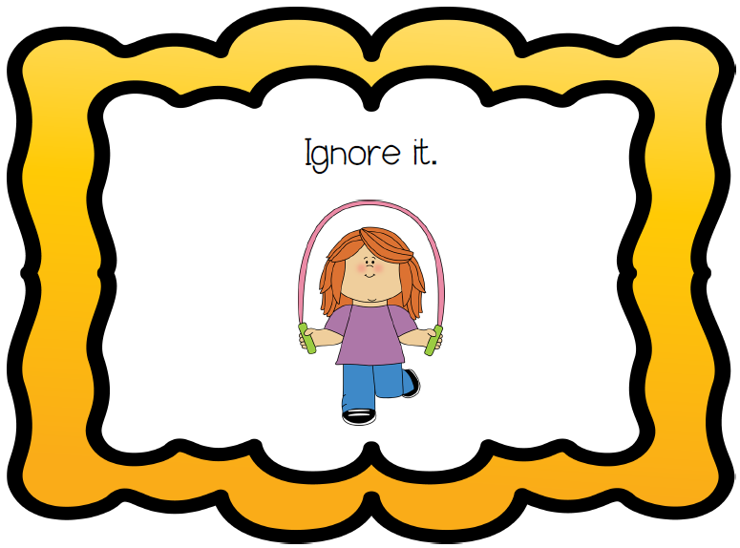

Slide 18
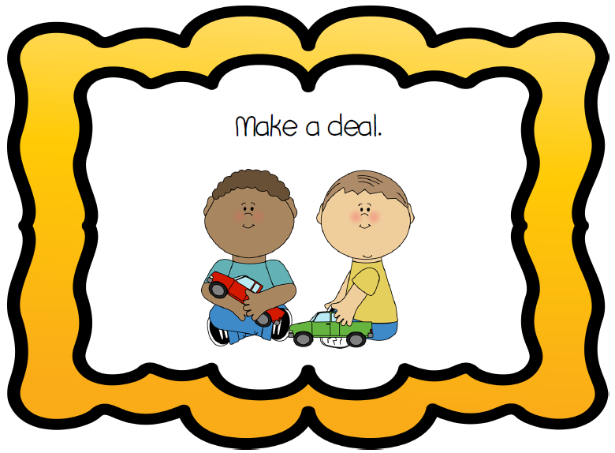

Slide 21
Situations
Be A Problem Solver

Slide 22
Be A Problem Solver!
Another student sat in the seat you wanted to use at lunch.
WHAT COULD YOU DO TO SOLVE THIS PROBLEM?

Slide 24
Be A Problem Solver!
On the playground someone took the last piece of equipment you wanted.
WHAT COULD YOU DO TO SOLVE THIS PROBLEM?

Slide 26
Be A Problem Solver!
Someone is tapping a pencil and distracting you.
WHAT COULD YOU DO TO SOLVE THIS PROBLEM?

Slide 28
Be A Problem Solver!
You are waiting in line to get some water and someone walks right in front of you in line.
WHAT COULD YOU DO TO SOLVE THIS PROBLEM?

Slide 30
Be A Problem Solver!
Your classmate walked past your seat and knocked your papers on the floor.
WHAT COULD YOU DO TO SOLVE THIS PROBLEM?

Slide 32
Be A Problem Solver!
Your classmate brings a small toy to school and only lets another student look at it.
WHAT COULD YOU DO TO SOLVE THIS PROBLEM?

Slide 34
Great job being a Problem Solver
Now, please go to the discussion post in your Canvas class and answer the following question.
What is the best way to solve a conflict with a neighborhood friend or your brother or sister?
Use one of your Problem Solver ideas!!!

