Slide 1
What is a School Counselor?
Intro Lesson

Slide 2
What is a
School Counselor?
What do you think?

Slide 3
Is a school counselor a kind of cat?
Noooooooo...

Slide 4
Is a school counselor a kind of fish?
Noooooooo...

Slide 5
Is a school counselor a kind of dog?
Noooooooo...

Slide 6
YES!
Is a school counselor a person?
YES, a school counselor is a person.

Slide 7
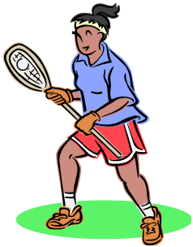
A school counselor is on the helping team at school.
Raise your hand, if you are on a team?

Slide 8
What do people who are on a team do together ?
Work together
Listen to each other
Plan together

Slide 9
A school counselor is a special helper who is on a team with your teacher, your parents, and other people who can help you learn.

Slide 10
Who are some other helpers in the school?

Slide 11
Who are some other helpers in the school?
Nurse
Bus Driver
Principal
Teacher
Who else can you think of???
Don’t forget to answer this question in the discussion post in Canvas!

Slide 12
School counselors are special helpers who are trained to help children solve problems.

Slide 13
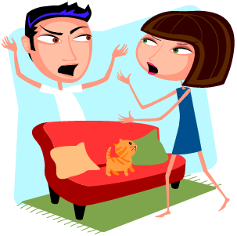
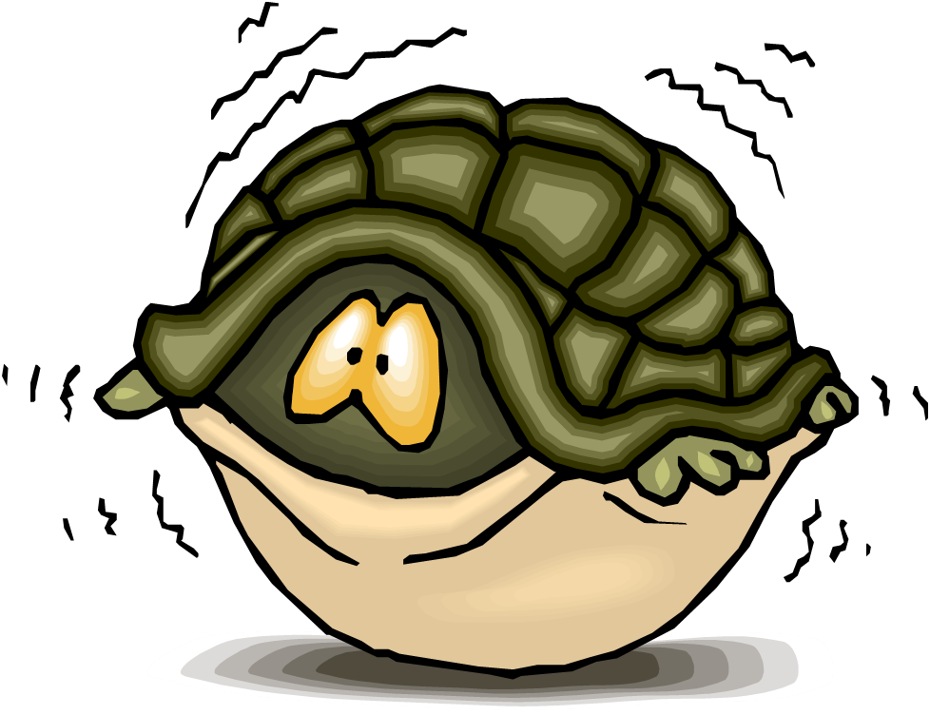
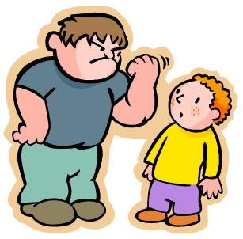
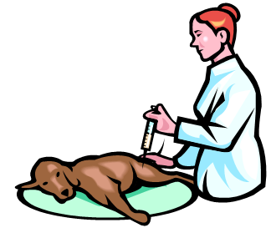
What kind of problems could a child talk to their school counselor about?
Managing anger
Feeling afraid
Illness
Making Friends
Cyberbullying
Pets that are sick
Dealing with a Bully
Learning

Slide 14
A school counselor listens to people who are sad.
Show me a sad face.
Now, wipes that sad face off with ​your hand.

Slide 15
A school counselor listens to people who are worried.
Show me a worried ​face.
Now, wipe off that worried face.

Slide 16
A school counselor listens to people who are angry.
Show me a angry face.
Now, erase that angry face.

Slide 17
A school counselor listens to people who are happy and excited.
Show me a happy and excited face.
Now, keep that ​happy face.

Slide 18
How do you get to visit the school counselor?
Sometimes your mom or dad call the school counselor and asks for an appointment.

Slide 19
How do you get to visit the school counselor?
Sometimes
your mom or dad might
e-mail the school counselor.

Slide 20
How do you get to visit the school counselor?
Sometimes your teacher may ask the school counselor to come talk to you.
School Counselor's Office

Slide 21
How do you get to visit the school counselor?
Sometimes YOU may ask your teacher to go see the school
counselor.

Slide 22
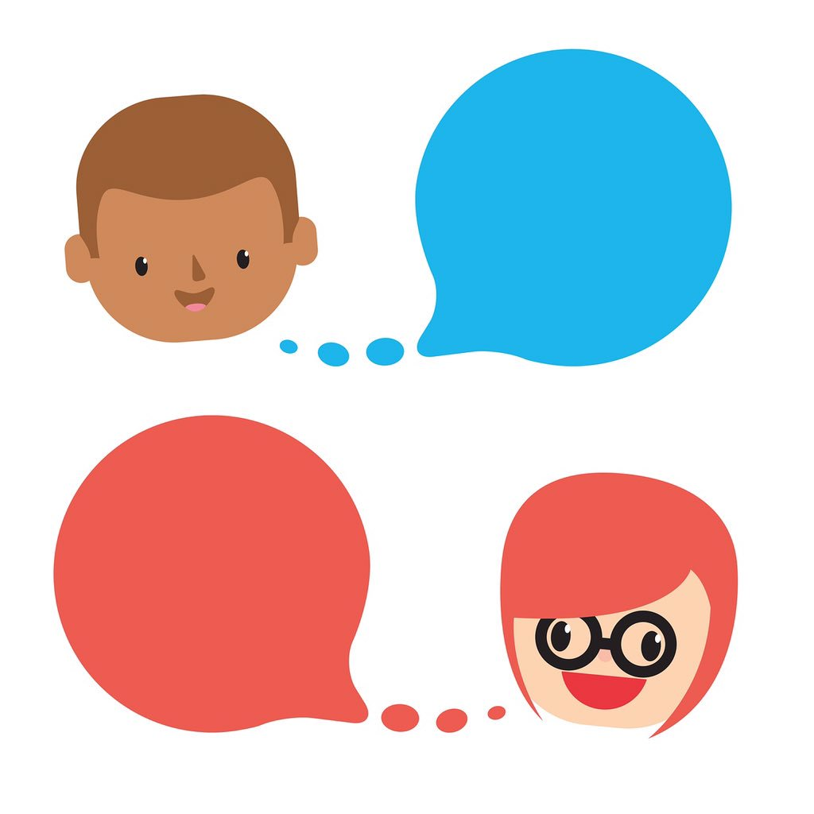
Talk
Some of the things you might do when you visit the
school counselor are...
Play Games
Draw

Slide 23
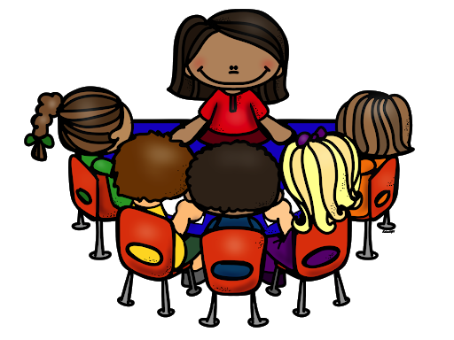
Small Group
School counselors run small groups with students on different topics.
We also meet with students individually!
Zoom Meeting

Slide 24
You are NOT in trouble when you
visit the school counselor.

Slide 25
Insert picture of "counselor/counselors"
Include counselor/counselors
names & grade levels
A school counselor is a helper that is here to support you!

Slide 26
Not THE END!
I will see you again soon.
I am so glad that I get to be your school counselor this year!
Tell your school counselor one thing
they do you not know you in discussion post in Canvas!
School
Counselors
ROCK!

