Slide 1
Introduction to the
School Counselor K-1st
Notes:
Greet students and introduce topic. Go over Energetic Counselor curriculum and how this came about.
(2 Minutes)

Slide 2
Learning Objectives
Identify the role of the school counselor.
Identify expectations during school counseling lessons.
Identify specific topics school counselors can address, in age-appropriate manner.
Identify basic emotions and the connection to the role of the school counselor.
Notes:
Go over objectives

Slide 3
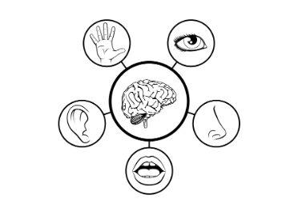
Lesson Expectations: 5 Senses
Eyes: On me!
Ears: Open and listening!
Lips: Zipped, closed, and quiet!
Hands: In your lap and to yourself!
Nose: Out of your neighbor’s business!
(As a class family, you do SUCH a good job taking care of others, during our lesson, you get to take a “break” and I will take care of everyone!)
Notes:
Go over expectations and provide examples.
Use the ones on this slide or insert your own classroom expectations on the previous slide.
(3 Minutes)

Slide 4
Agenda: What are we doing today?
*Confidentiality *Counseling passes *Story: Mrs. Joyce Gives the Best High Fives
*“Meet the Counselor” Activity Coloring Book
*Photo Office Tour
Notes:
Go over agenda for lesson and answer questions.
(3 minutes)

Slide 5
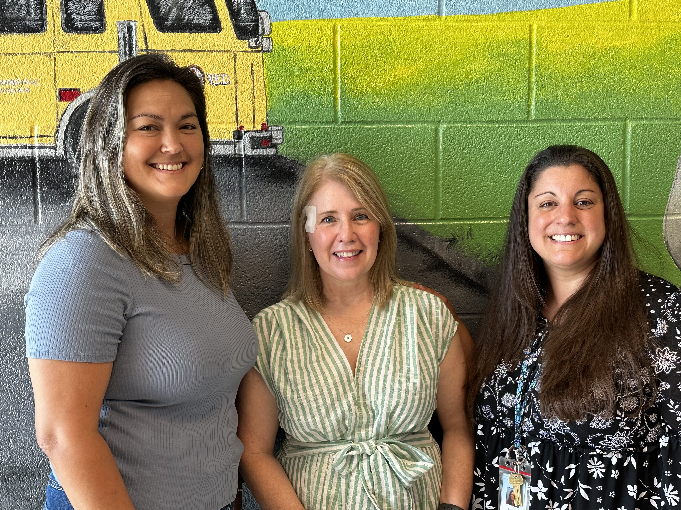
Meet Your School Counselors Ms. Song (1st & 5th), Ms. Kight (2nd & 4th ), & Ms. Payne (K & 3rd)
Notes:
Go over school counselors

Slide 6
Confidentiality
Notes:
Go over confidentiality

Slide 7
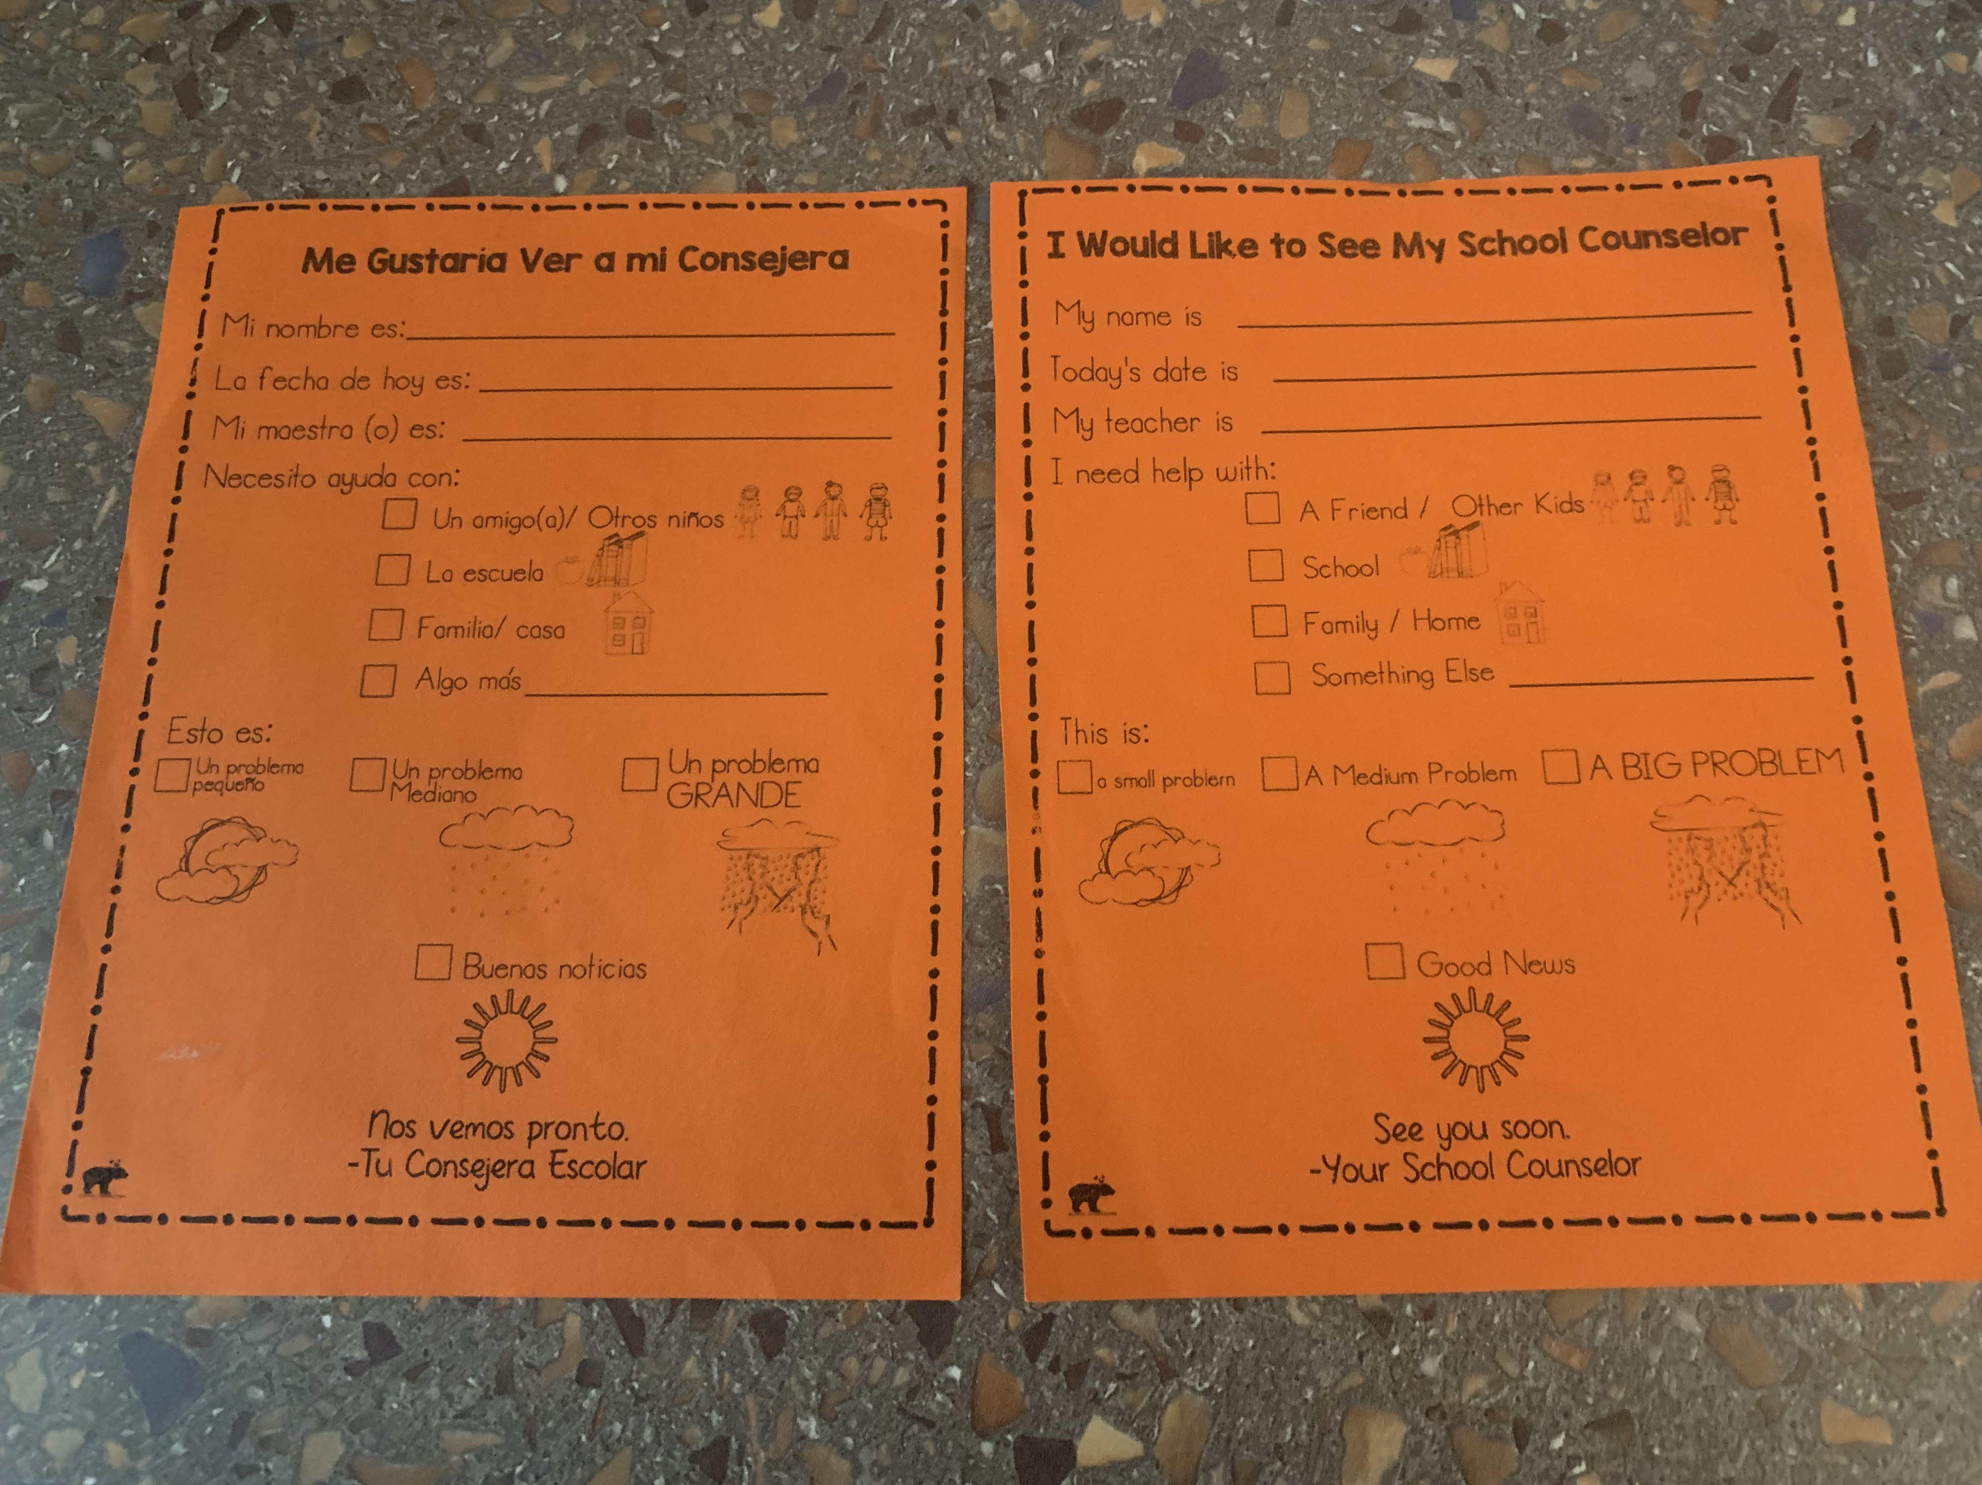
How do I make an appt. to talk with my School Counselor?
Please fill out a pass or ask your teacher if you need to speak with a counselor for a small problem, medium problem, or big problem.
Notes:
Go over how students can see their counselors. Also, go over weather metaphor for size of problem.

Slide 8
How do I make an appt. to talk with my School Counselor cont’d.?
School counseling self-referral form (pass) created by Whole Hearted School Counseling (Teachers Pay Teachers)
Notes:
Give credit to Whole Hearted School Counseling.

Slide 9
Story
Ms. Joyce Gives the Best High Fives
Notes:
Read story and stop to process/ simplify. The story has great content but can be a bit “wordy”. Feel free to read ahead of time and place sticky notes, throughout, to shorten/ simplify certain parts.
(15 Minutes)

Slide 10
Brain Break Time!

Slide 11
Activity
Are you an author?
Let’s make a BOOK!
Notes:
K-1 Intro Activity Coloring Book (10 Minutes)
Directions:
1) Go over directions for completion.
2) Complete activity together, as a class.
3) Walk around the room and talk with students while they color.
4) Read together, at the end, and have students follow along.

Slide 12
Activity
Notes:
Give time for students to work on activity.

Slide 13
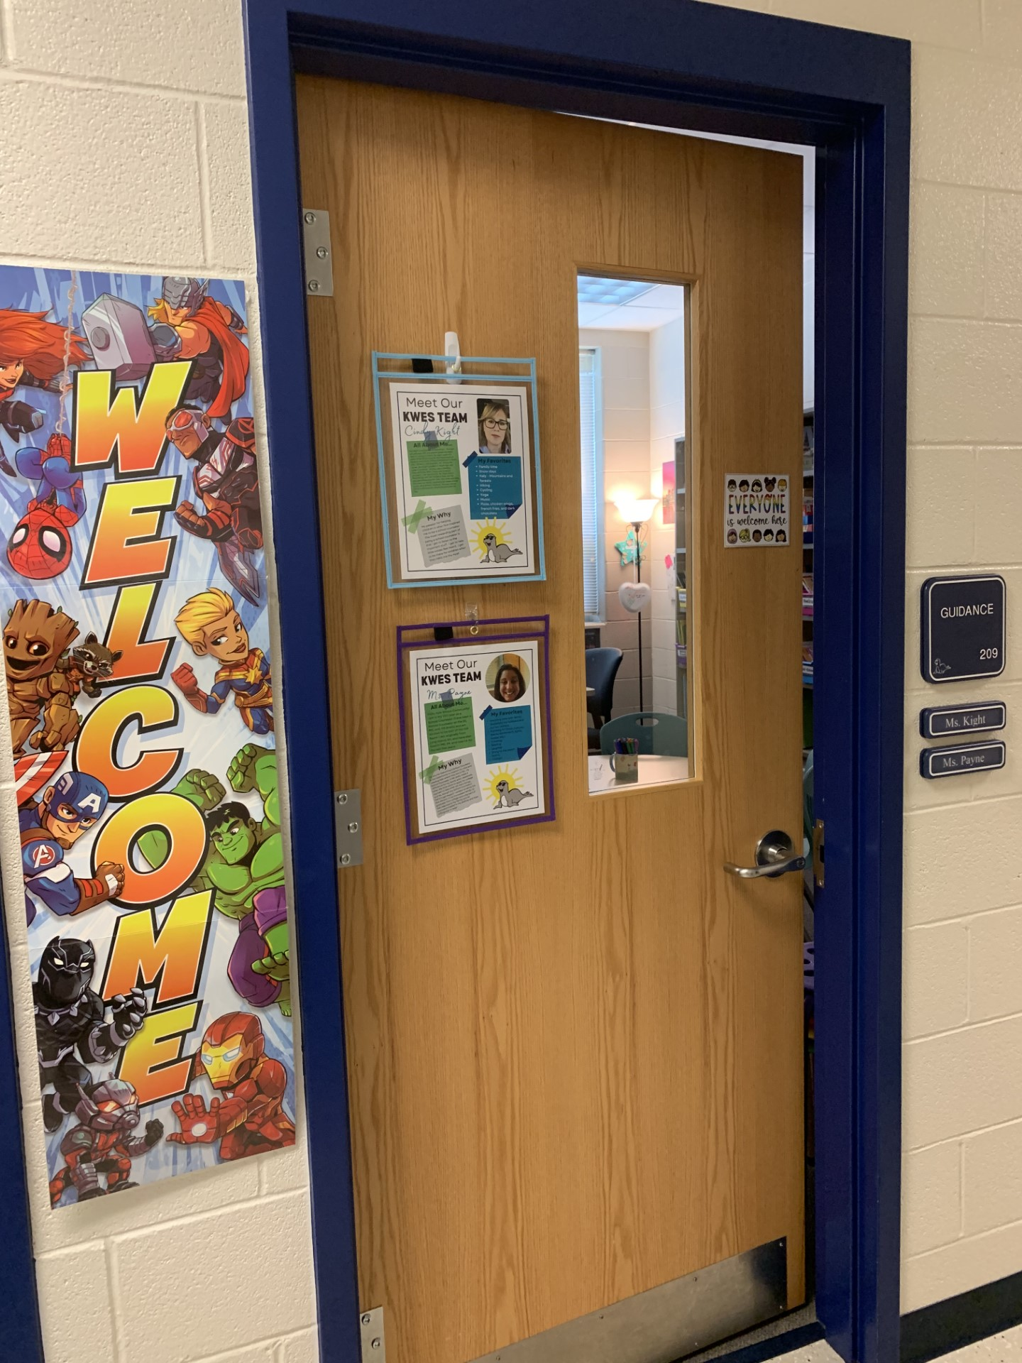
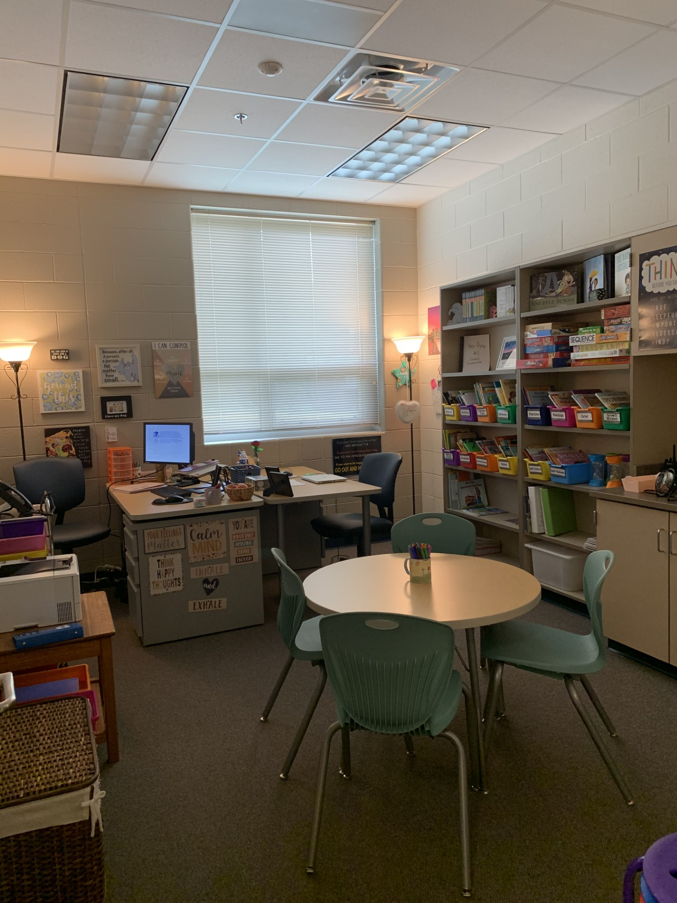
Come visit us in our spaces: Ms. Kight & Ms. Payne’s Office
(Photo Office Tour)
Notes:
Explain each photo and objects of interest.
(5 Minutes)

Slide 14
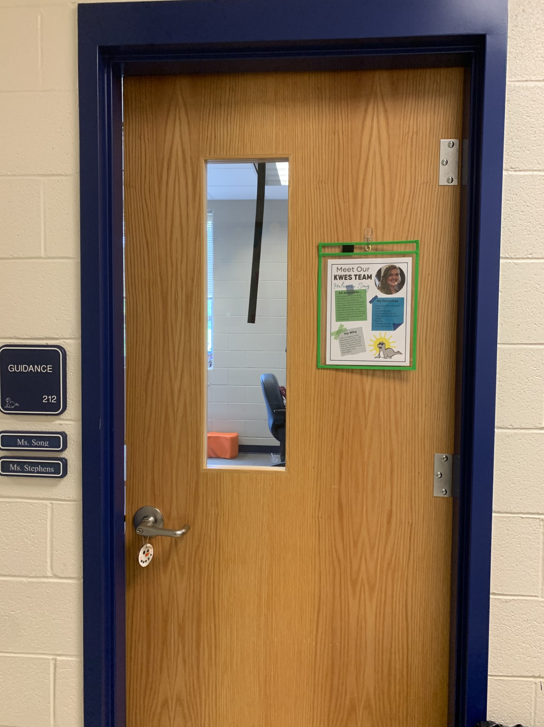
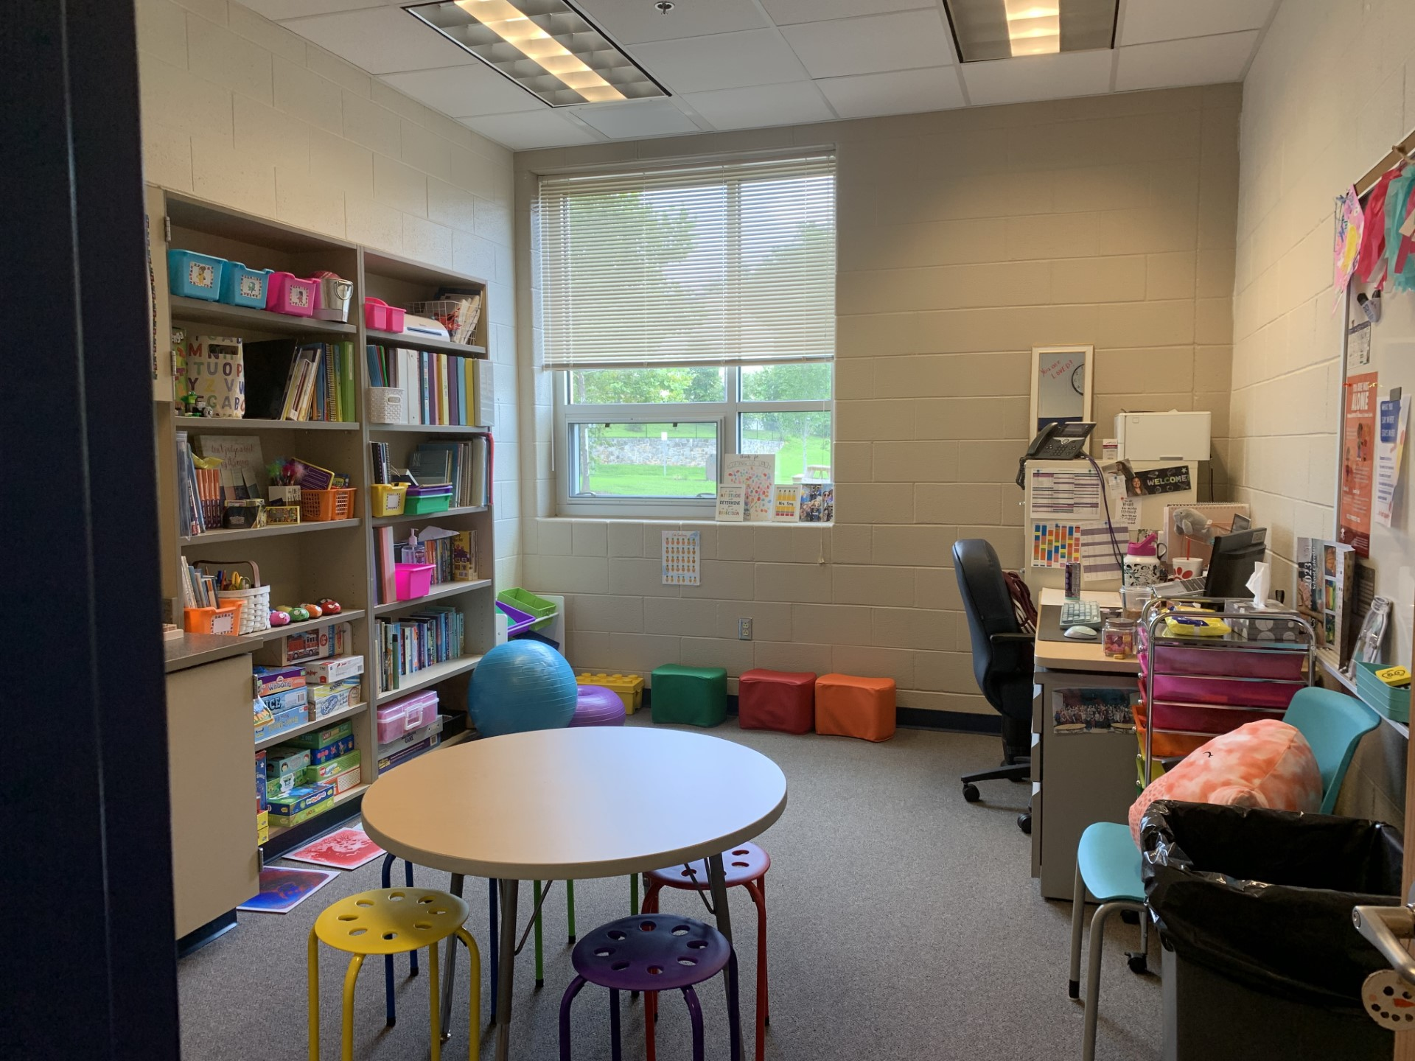
Come visit us in our spaces: Ms. Song’s Office
(Photo Office Tour)
Notes:
Explain each photo and objects of interest.
(5 Minutes)

Slide 15
What kinds of things does my school counselor talk to students about?
Family/ Home
Friends
School
Things you unsure of
Things you are proud of
Big Feelings
ANYTHING!
Notes:
Go over slide
(2 Minutes)

Slide 16
Closing
1) What was your favorite part of this lesson?
2) What will you remember about this lesson?
Notes:
Process/ Closing: (5 Minutes)
As time allows, have students share answers to the questions on the slide.
Encourage students to be your “newsletters and cheerleaders” and share their books with their families.
Encourage Students to share what they learned with their families.

Slide 17
Post-Test
Notes:
Give post-test.

