Slide 1
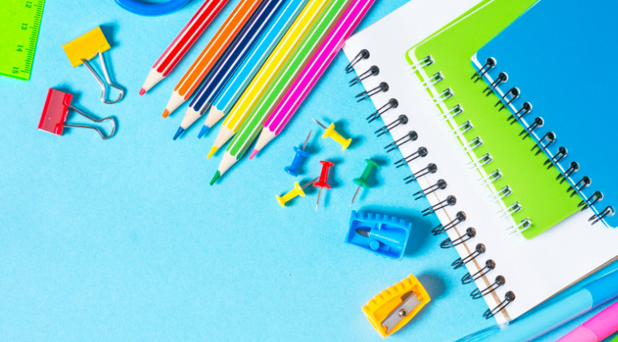
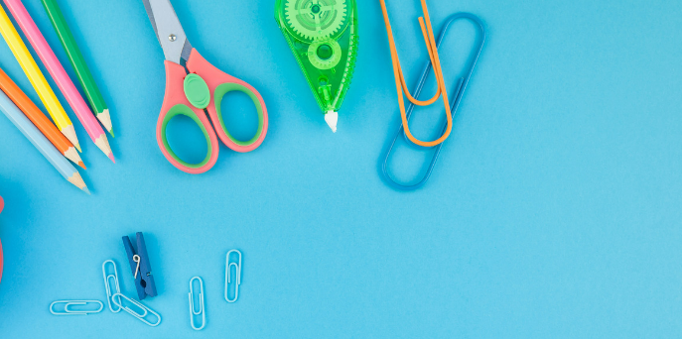
Introduction to the
School Counselor 2nd-3rd
Notes:
Greet students and introduce topic. Go over Energetic Counselor curriculum and how this came about.
(2 Minutes)

Slide 2
Learning Objectives
Identify the role of the school counselor.
Identify expectations during school counseling lessons.
Identify specific topics school counselors can address, in age-appropriate manner.
Identify basic emotions and the connection to the role of the school counselor.
Notes:
Go over objectives

Slide 3
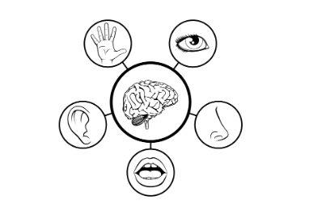
Lesson Expectations: 5 Senses (2nd)
Eyes: On me!
Ears: Open and listening!
Lips: Zipped, closed, and quiet!
Hands: In your lap and to yourself!
Nose: Out of your neighbor’s business!
(As a class family, you do SUCH a good job taking care of others, during our lesson, you get to take a “break” and I will take care of everyone!)
Notes:
2nd Grade
Go over expectations and provide examples.
Use the ones on this slide or insert your own classroom expectations on the previous slide.
(3 Minutes)

Slide 4
Lesson Expectations (3rd)
S: “Sitting Mountain” position! “Mountain Peak” (head) is high in the sky and “Mountain Valleys” (bottom and feet) are grounded.
L: Listening!
A: Attention! (This is different than listening.)
N: Nodding often to show engagement.
T: Not Talking unless I Tell you to and there will be Time for this!- Promise!
Notes:
3rd Grade
Go over expectations and provide examples.
Use the ones on this slide or insert your own classroom expectations on the previous slide.
(3 Minutes)

Slide 5
Agenda: What are we doing today?
*Confidentiality *Counseling passes *Story: Mrs. Joyce Gives the Best High Fives
*“Meet the Counselor” Activity Coloring Book
*Photo Office Tour
Notes:
Go over agenda for lesson and answer questions.
(3 minutes)

Slide 6
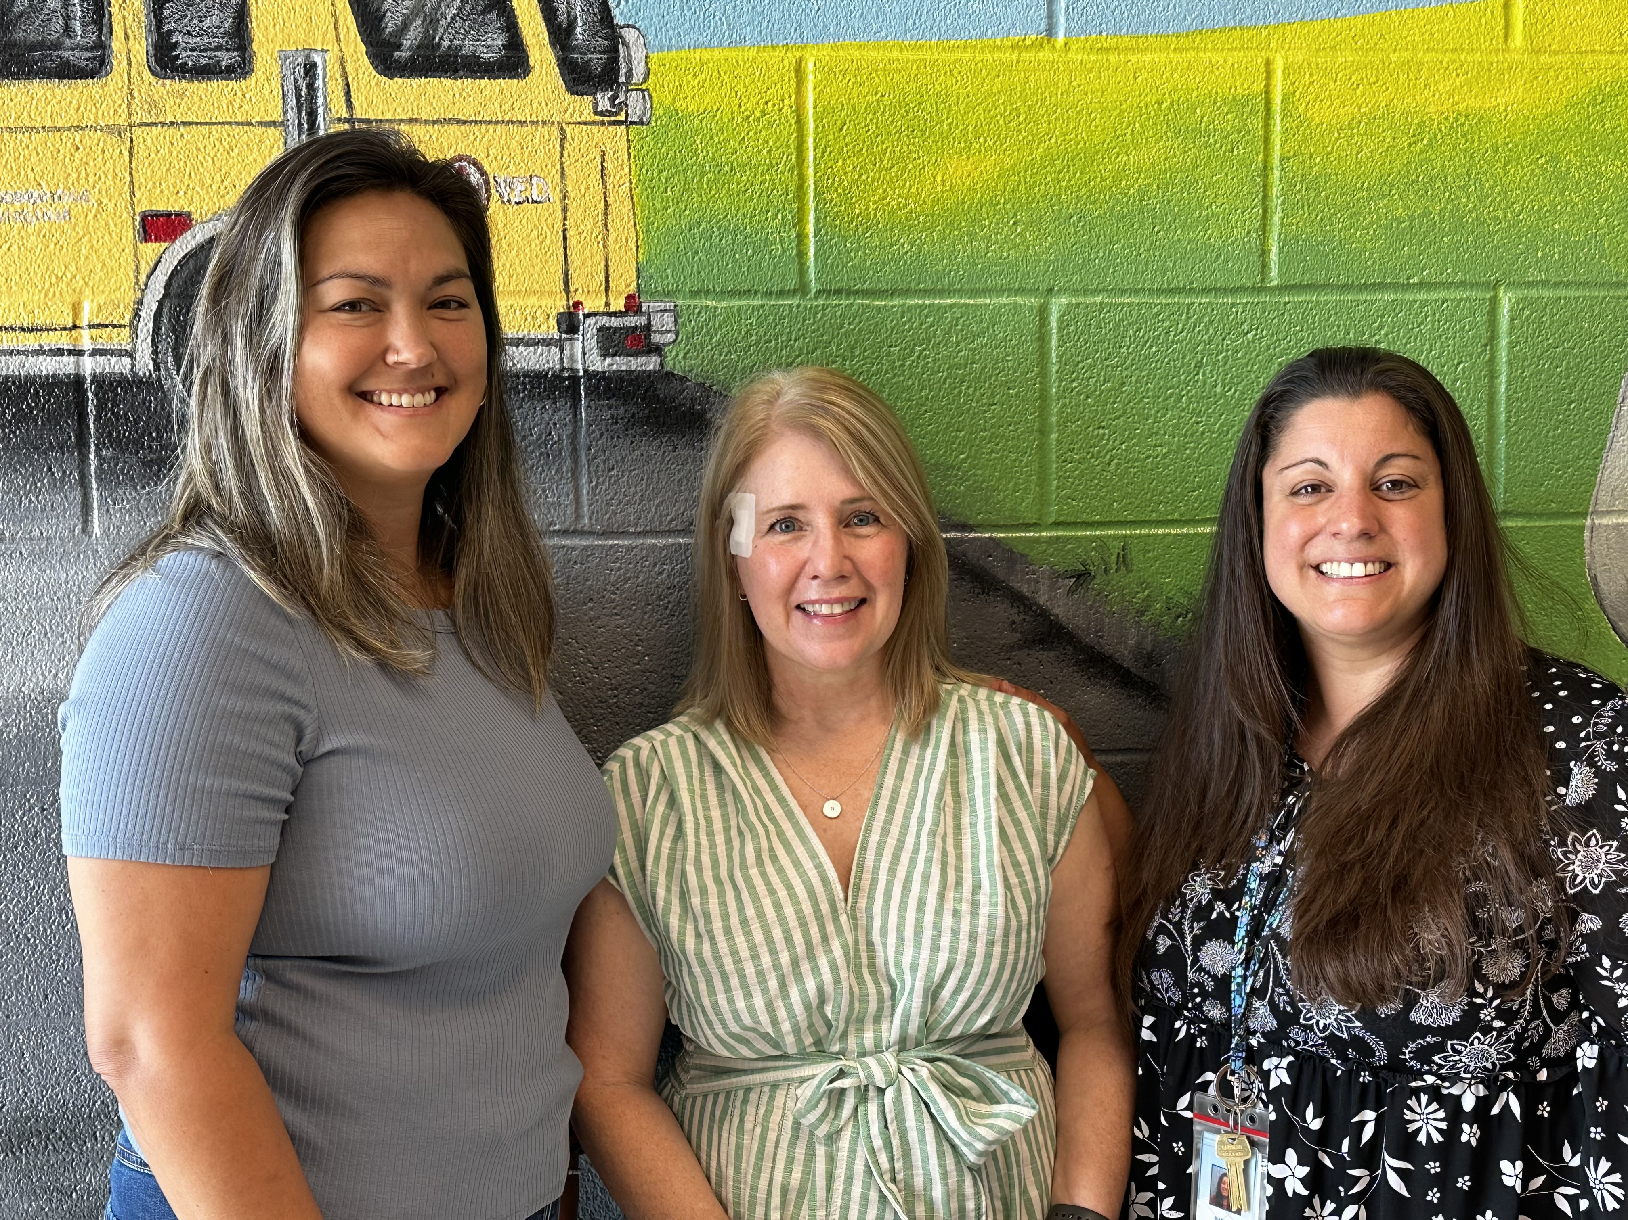
Meet Your School Counselors Ms. Song (1st & 5th), Ms. Kight (2nd & 4th ), & Ms. Payne (K & 3rd)
Notes:
Go over school counselors

Slide 7
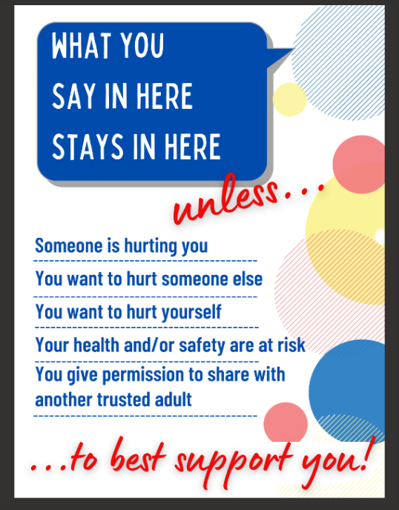
Confidentiality
Notes:
Go over confidentiality

Slide 8
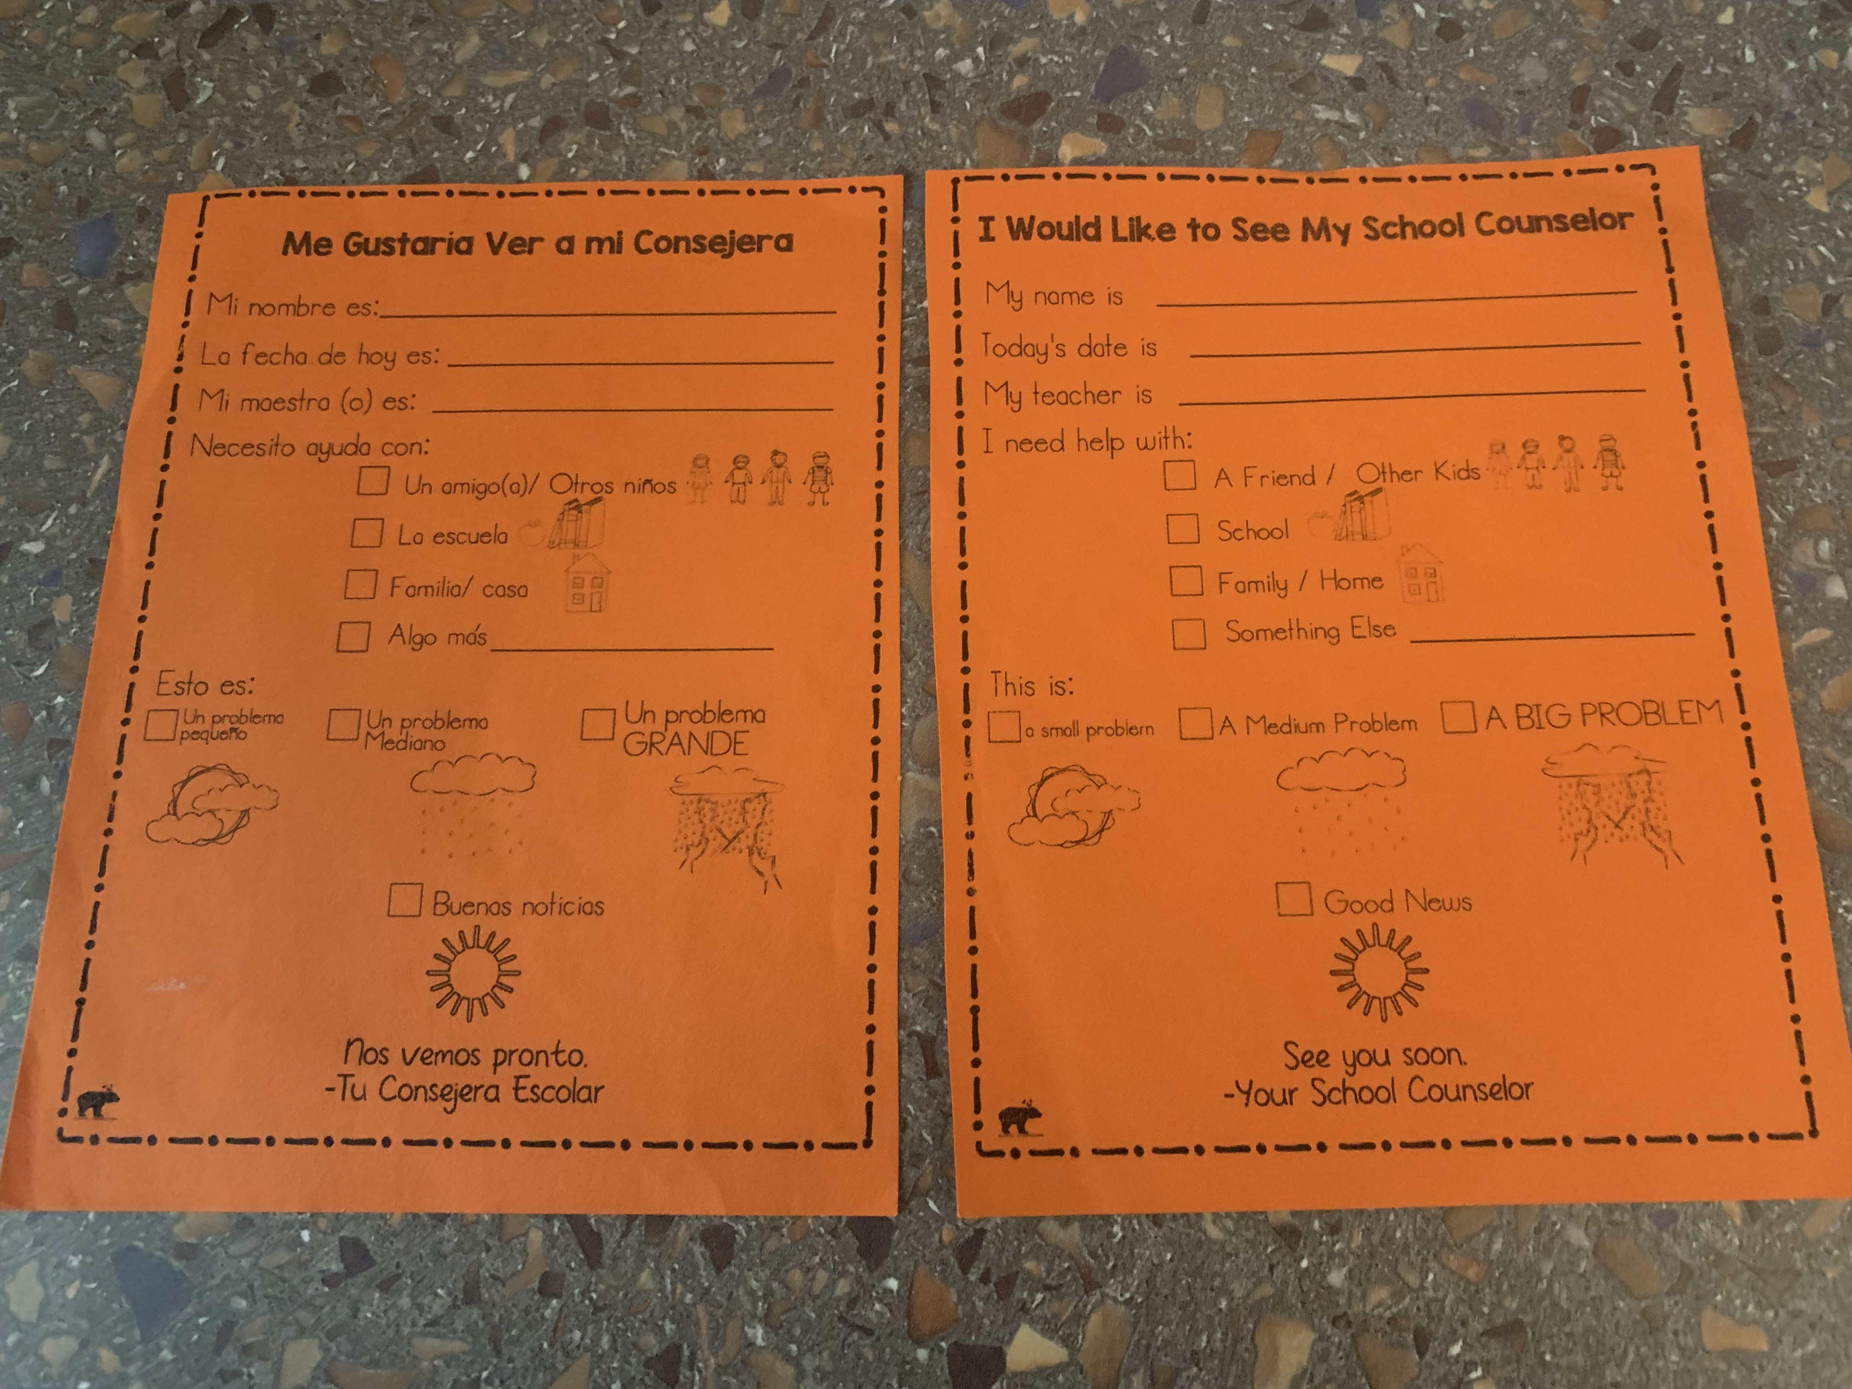
How do I make an appt. to talk with my School Counselor?
Please fill out a pass or ask your teacher if you need to speak with a counselor for a small problem, medium problem, or big problem.
Notes:
Go over how students can see their counselors. Also, go over weather metaphor for size of problem.

Slide 9
How do I make an appt. to talk with my School Counselor cont’d.?
School counseling self-referral form (pass) created by Whole Hearted School Counseling (Teachers Pay Teachers)
Notes:
Give credit to Whole Hearted School Counseling.

Slide 10
Story
Ms. Joyce Gives the Best High Fives
Notes:
Read story and stop to process/ simplify. The story has great content but can be a bit “wordy”. Feel free to read ahead of time and place sticky notes, throughout, to shorten/ simplify certain parts.
(15 Minutes)

Slide 11
Brain break! Using your paper or dry-erase board, silently doodle/draw.

Slide 12
Activity
“Make the Connection!”
With your group:
Choose a “reporter”.
Work with your group to “make the connection” to the role/ job of a school counselor.
If time allows, complete the activity sheet for the other items on the list. If you get stuck, don’t worry. We will go over each item together.
We will go over the answers.
Notes:
“Make a Connection Activity” (7 Minutes)
Directions: “I have a collection of items with me today. Each of these items has a connection to the School Counselor’s role/ job. I will split you into groups and assign an item to your group. You will work with your group to figure out the connection of your group’s item. If time allows, complete the activity sheet for the other items on the list. If you get stuck, don’t worry. We will go over each item together.”
Separate students into groups of 3-4. (An easy way to do this is to simply have them to count off.)
Once they are in their groups, have them work together on their group’s assigned item.
Share the “connections” (answers) with the class.

Slide 13
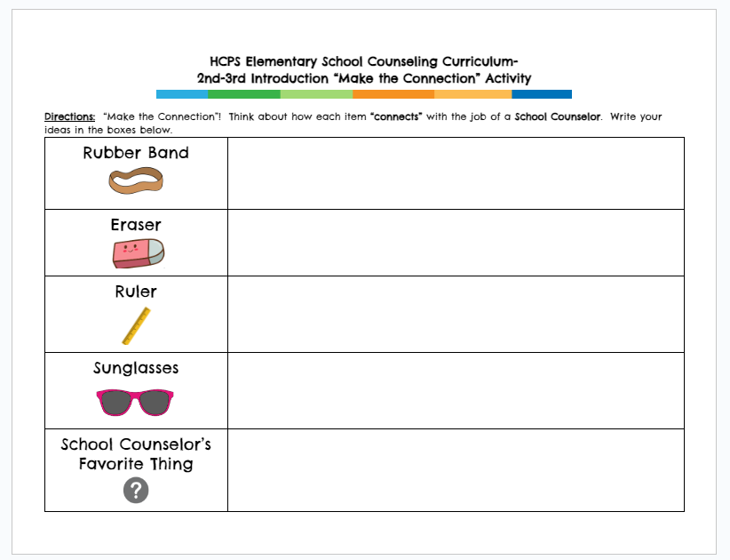
Activity
Notes:
Give time for students to work on activity.

Slide 14
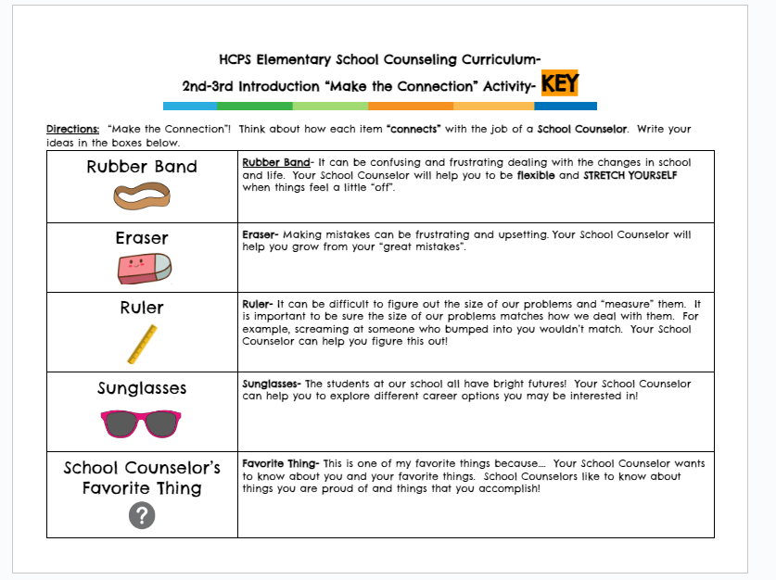
Activity Key (share after activity is completed, if applicable)
Notes:
Have the “reporter” share out what group came up with for their item.

Slide 15
Activity
“Make the Connection!”
Rubber Band- Key word(s): Flexible
It can be confusing and frustrating dealing with the changes life brings. Your School Counselor will help you to be flexible when things are tough.
Notes:
Go over slide
(1 Minute)

Slide 16
Activity
“Make the Connection!”
Eraser- Key word(s): Mistakes
Making mistakes can be frustrating and upsetting. Your School Counselor will help you grow from your “great mistakes”.
Notes:
Go over slide
(1 Minute)

Slide 17
Activity
“Make the Connection!”
Ruler- Key word(s): Measure your problem.
It can be difficult to figure out the size of our problems and measure them. It is important to be sure the size of our problems matches how we deal with them. For example, screaming at someone who bumped into you wouldn’t match. Your School Counselor can help you figure this out!
Notes:
Go over slide
(1 Minute)

Slide 18
Activity
“Make the Connection!”
Sunglasses- Key word(s): Bright futures
The students at our school all have bright futures! Your School Counselor can help you to explore different career options you may be interested in!
Notes:
Go over slide
(1 Minute)

Slide 19
Activity
“Make the Connection!”
Favorite Thing- Key word(s): __________
This is one of my favorite things because…. Your School Counselor wants to know about you and your favorite things. School Counselors like to know about things you are proud of and things that you accomplish!
Notes:
Go over slide
(1 Minute)

Slide 20
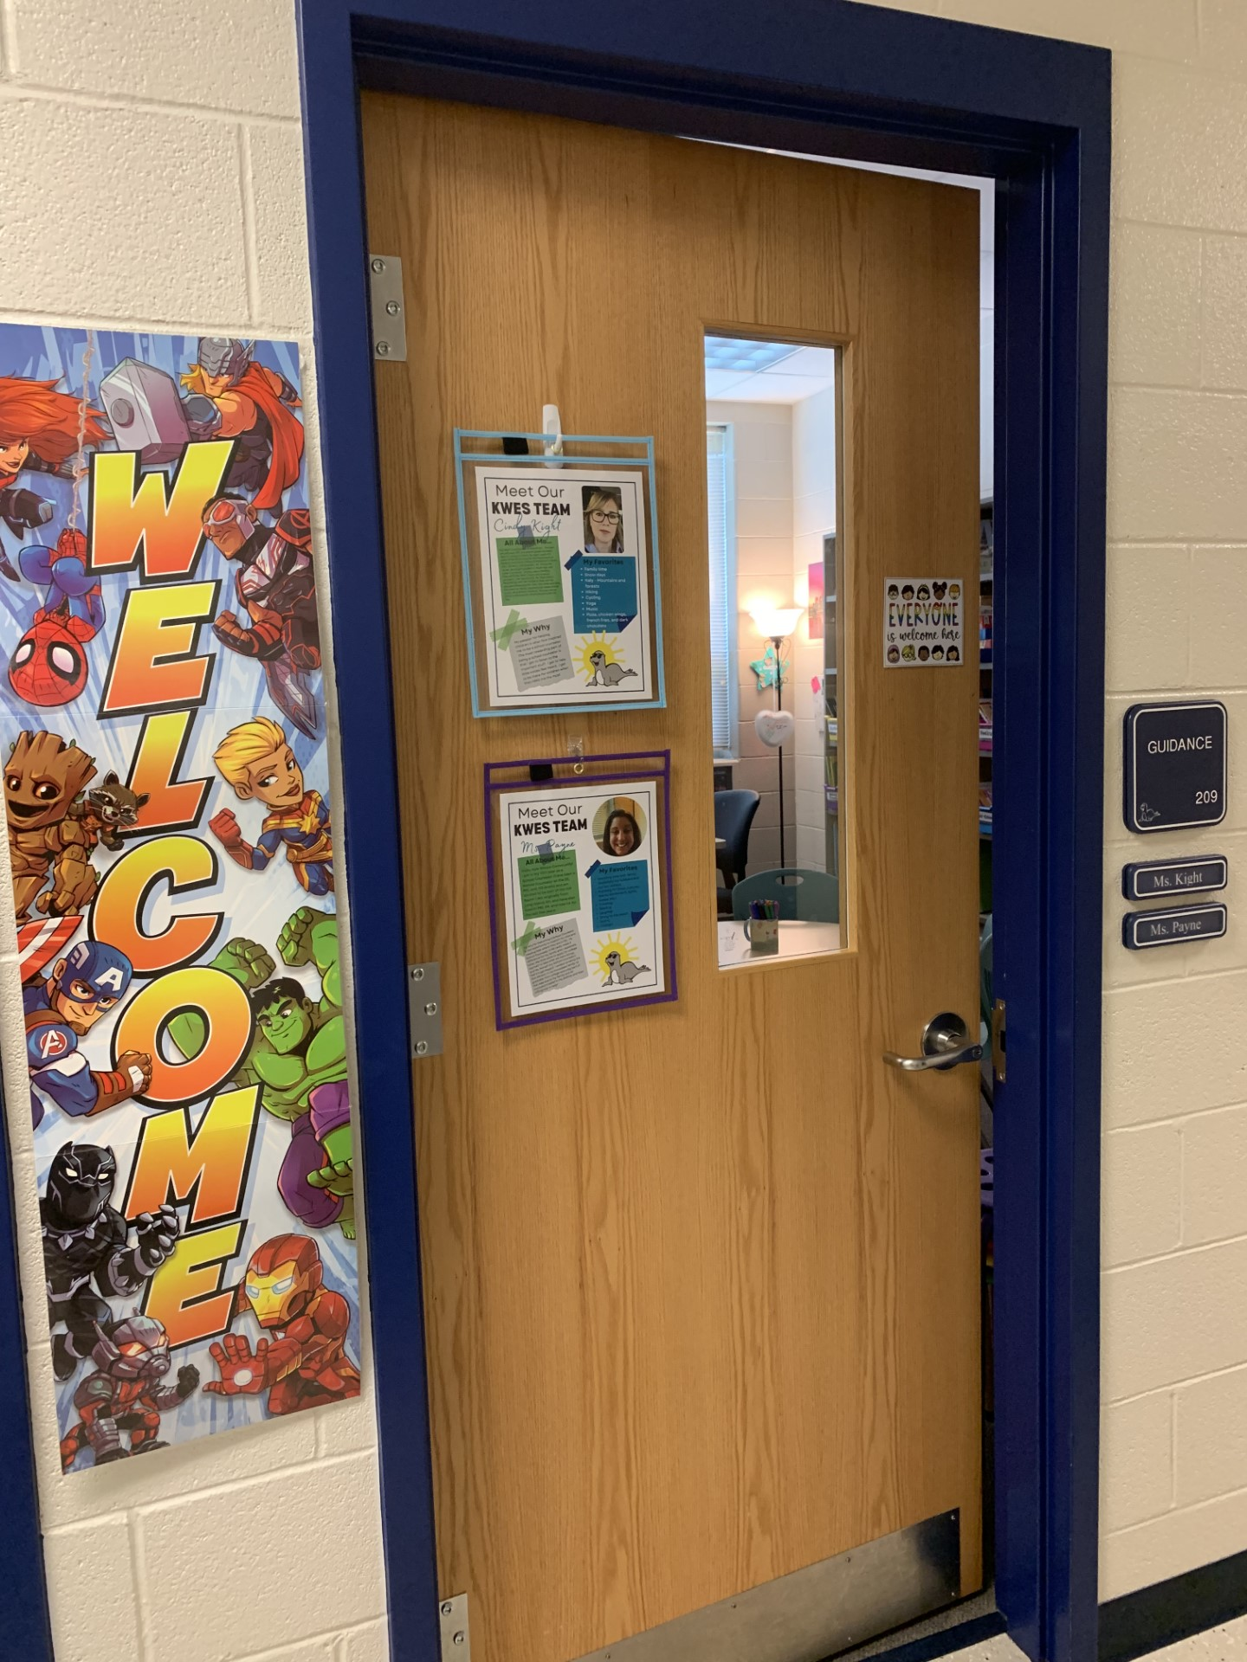
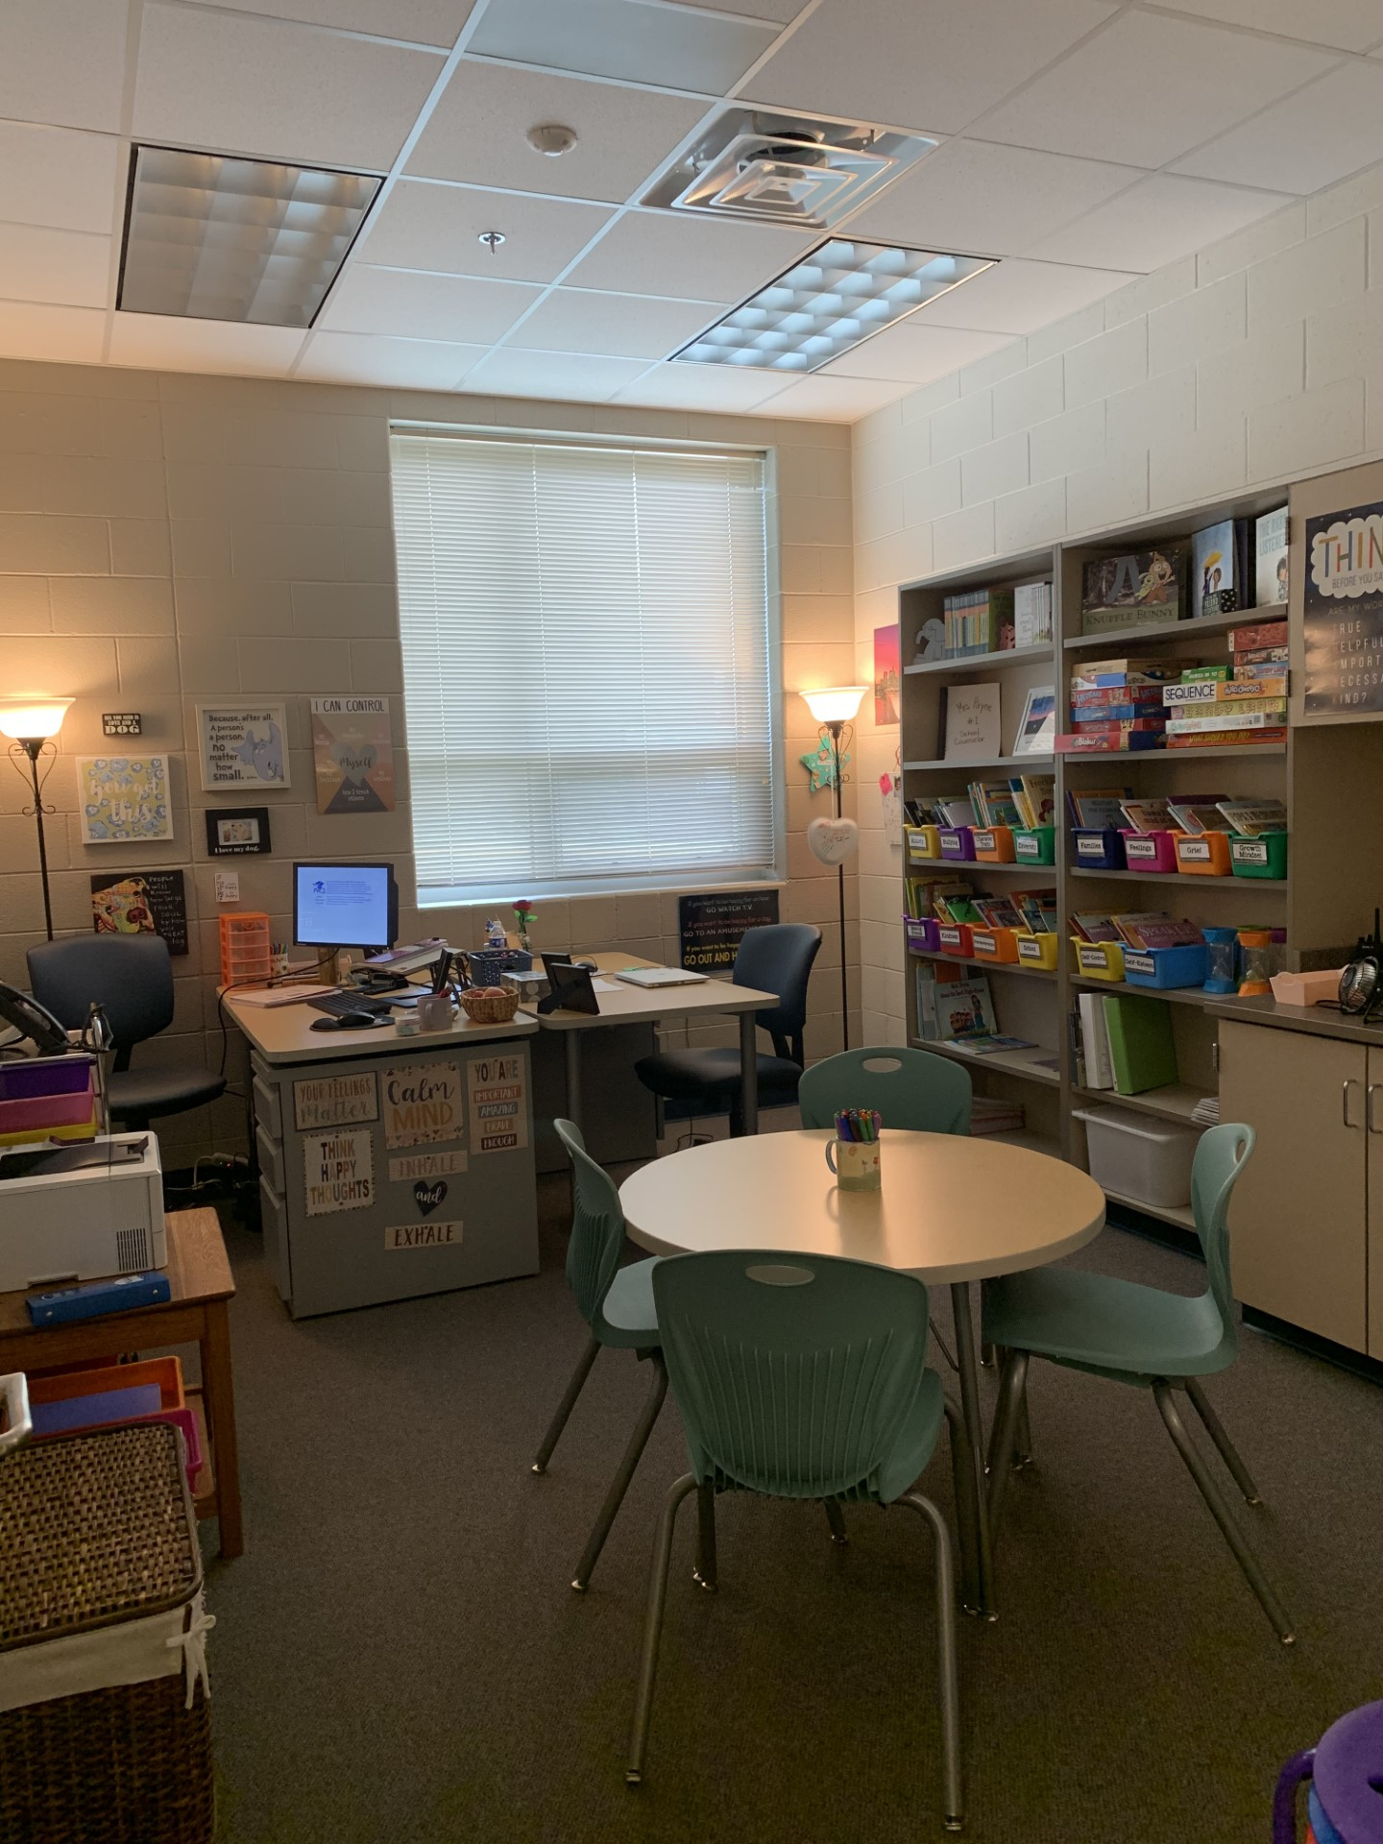
Come visit us in our spaces: Ms. Kight & Ms. Payne’s Office
(Photo Office Tour)
Notes:
Explain each photo and objects of interest.
(5 Minutes)

Slide 21
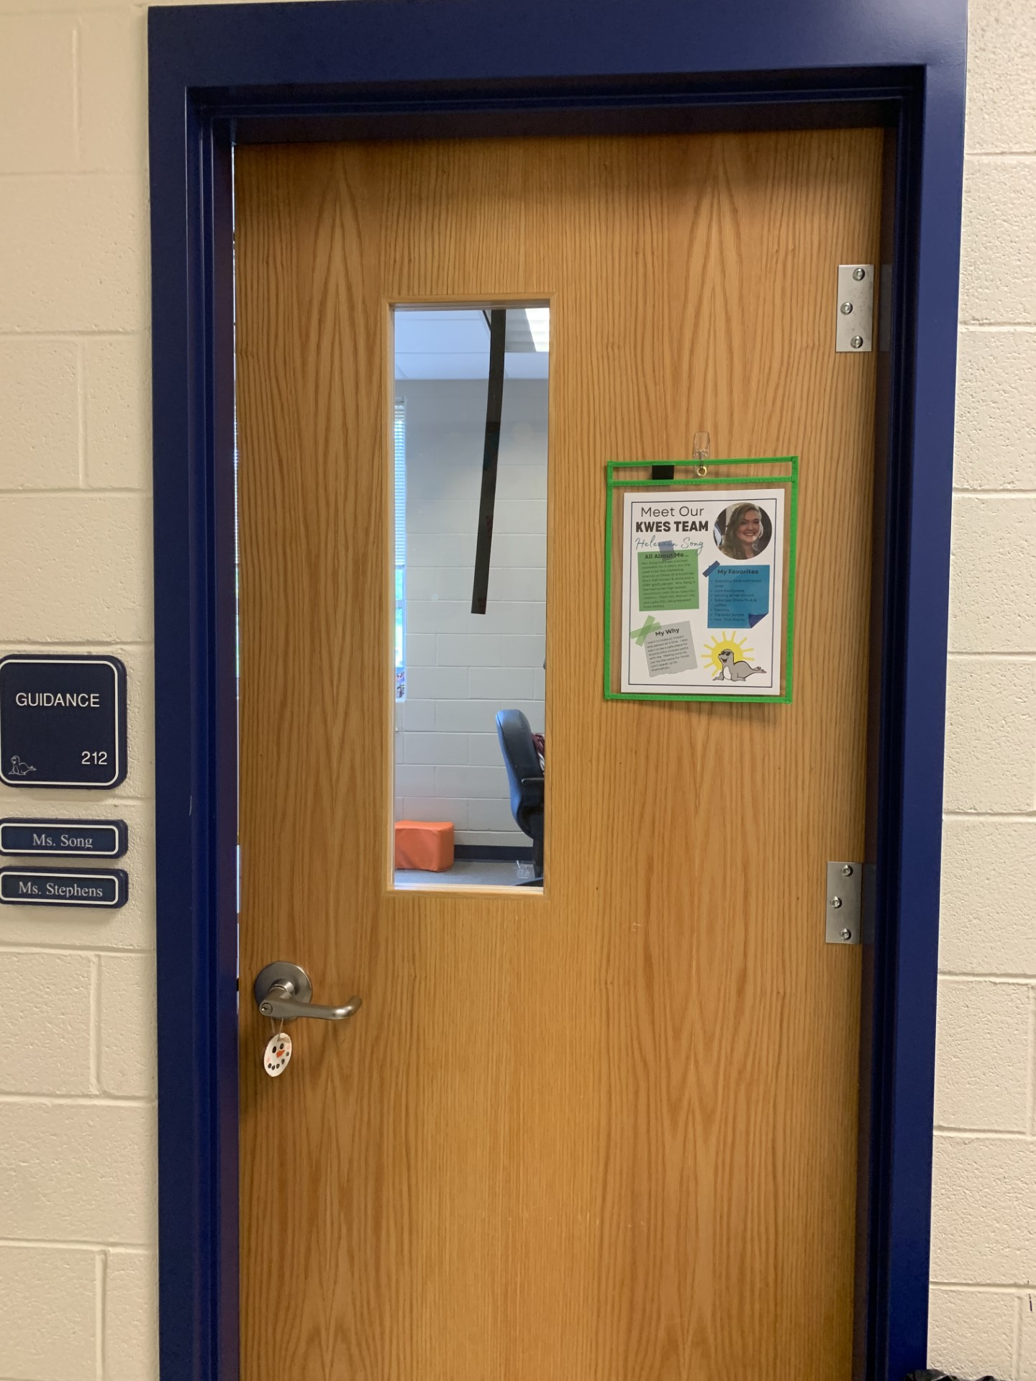
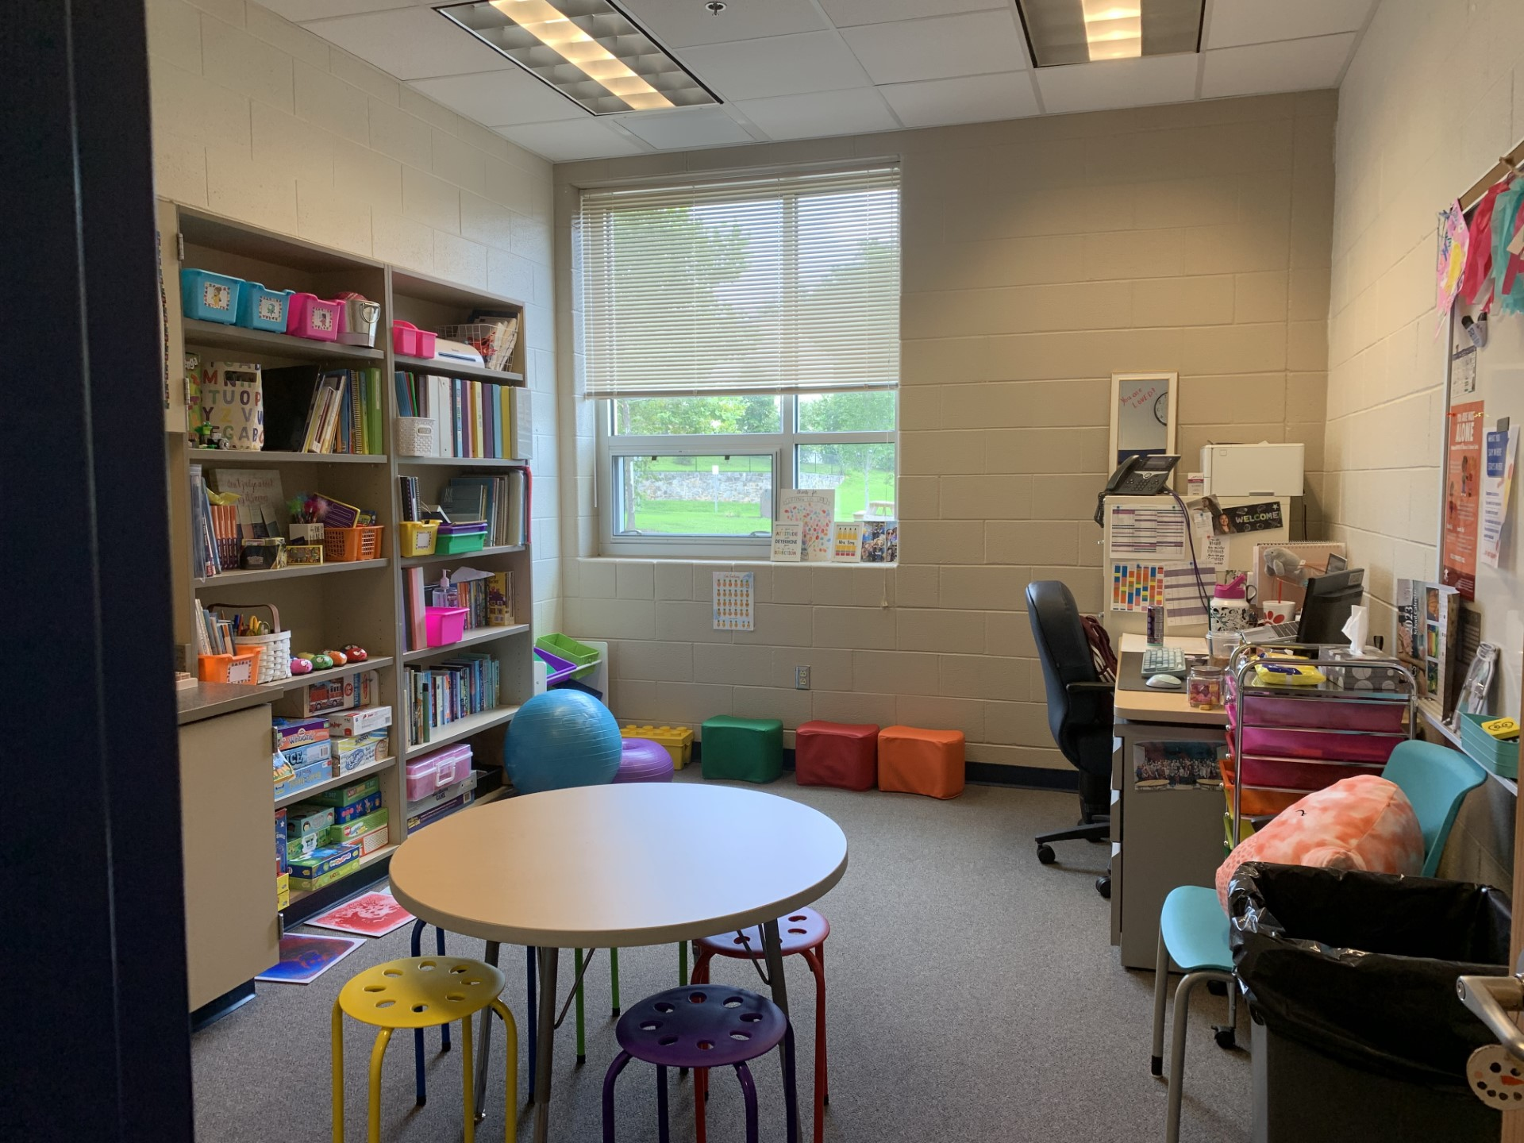
Come visit us in our spaces: Ms. Song’s Office
(Photo Office Tour)
Notes:
Explain each photo and objects of interest.
(5 Minutes)

Slide 22
What kinds of things does my school counselor talk to students about?
Friends
Family/ Home
School
Things you unsure of
Things you are proud of
Big Feelings
ANYTHING!
Notes:
Go over slide
(2 Minutes)

Slide 23
Closing
1) What was your favorite part of this lesson?
2) What will you remember about this lesson?
Notes:
Process/ Closing: (5 Minutes)
As time allows, have students share answers to the questions on the slide.
Encourage Students to share what they learned with their families.

Slide 24
Post-Test
Notes:
Give post-test.

