Slide 1
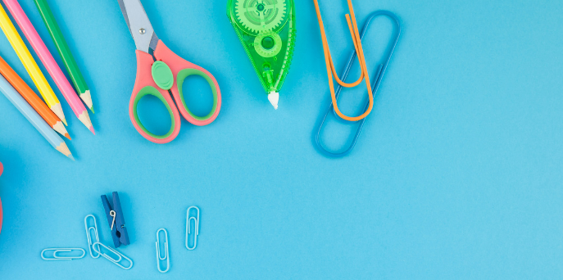
Introduction to the
School Counselor Grades 4-5
Notes:
Greet students and introduce topic. Go over EC curriculum and how this came about.
(2 Minutes)

Slide 2
Learning Objectives
Identify the role of the school counselor.
Identify expectations during school counseling lessons.
Identify specific topics school counselors can address, in age-appropriate manner.
Identify basic emotions and the connection to the role of the school counselor.
Notes:
Go over objectives.

Slide 3
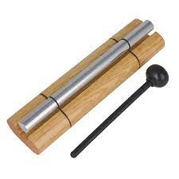
Lesson Expectations
S: “Sitting Mountain” position! “Mountain Peak” (head) is high in the sky and “Mountain Valleys” (bottom and feet) are grounded.
L: Listening!
A: Attention! (This is different than listening.)
N: Nodding often to show engagement.
T: Not Talking unless I Tell you to and there will be Time for this!- Promise!
Notes:
Go over expectations and provide examples.
Use the ones on this slide or insert your own classroom expectations on the previous slide.
(3 Minutes)

Slide 4
Agenda: What are we doing today?
*Confidentiality *Counseling Passes *I Can Do Hard Things By: Gabi Garcia *School Counselor “Scoot” *Photo Office Tour
Notes:
Go over agenda for lesson and answer questions.
(3 minutes)

Slide 5
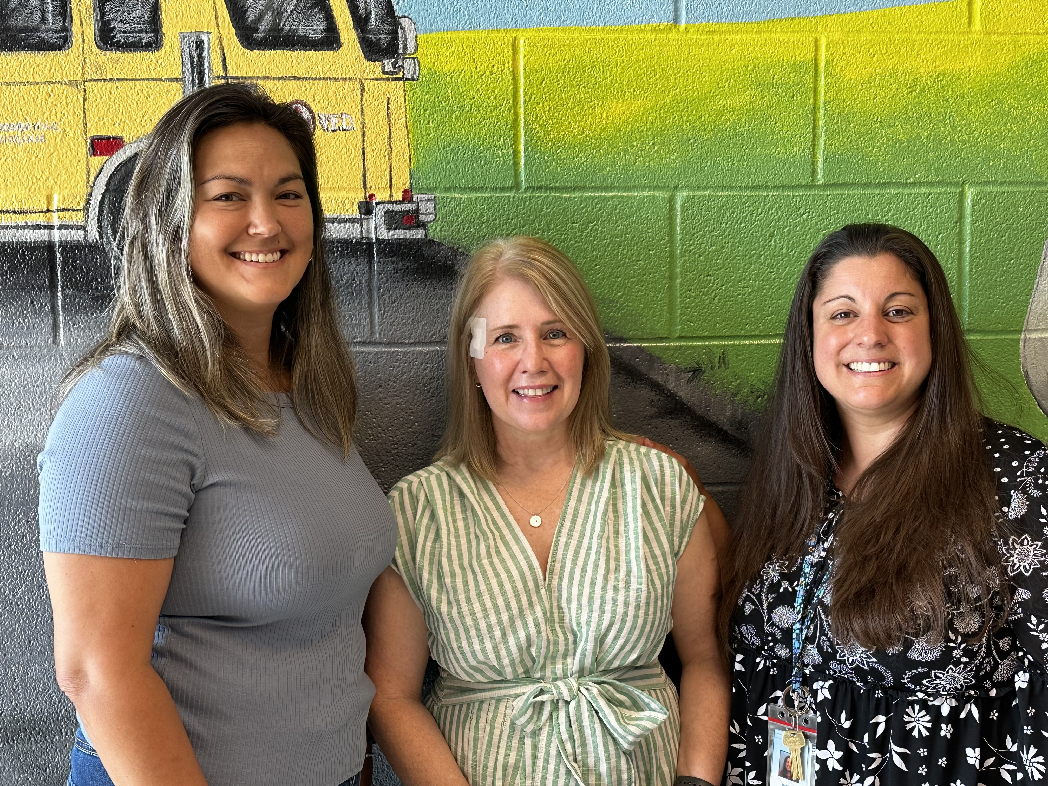
Meet Your School Counselors Ms. Song (1st & 5th), Ms. Kight (2nd & 4th ), & Ms. Payne (K & 3rd)
Notes:
Go over school counselors

Slide 6
Confidentiality
Notes:
Go over confidentiality

Slide 7
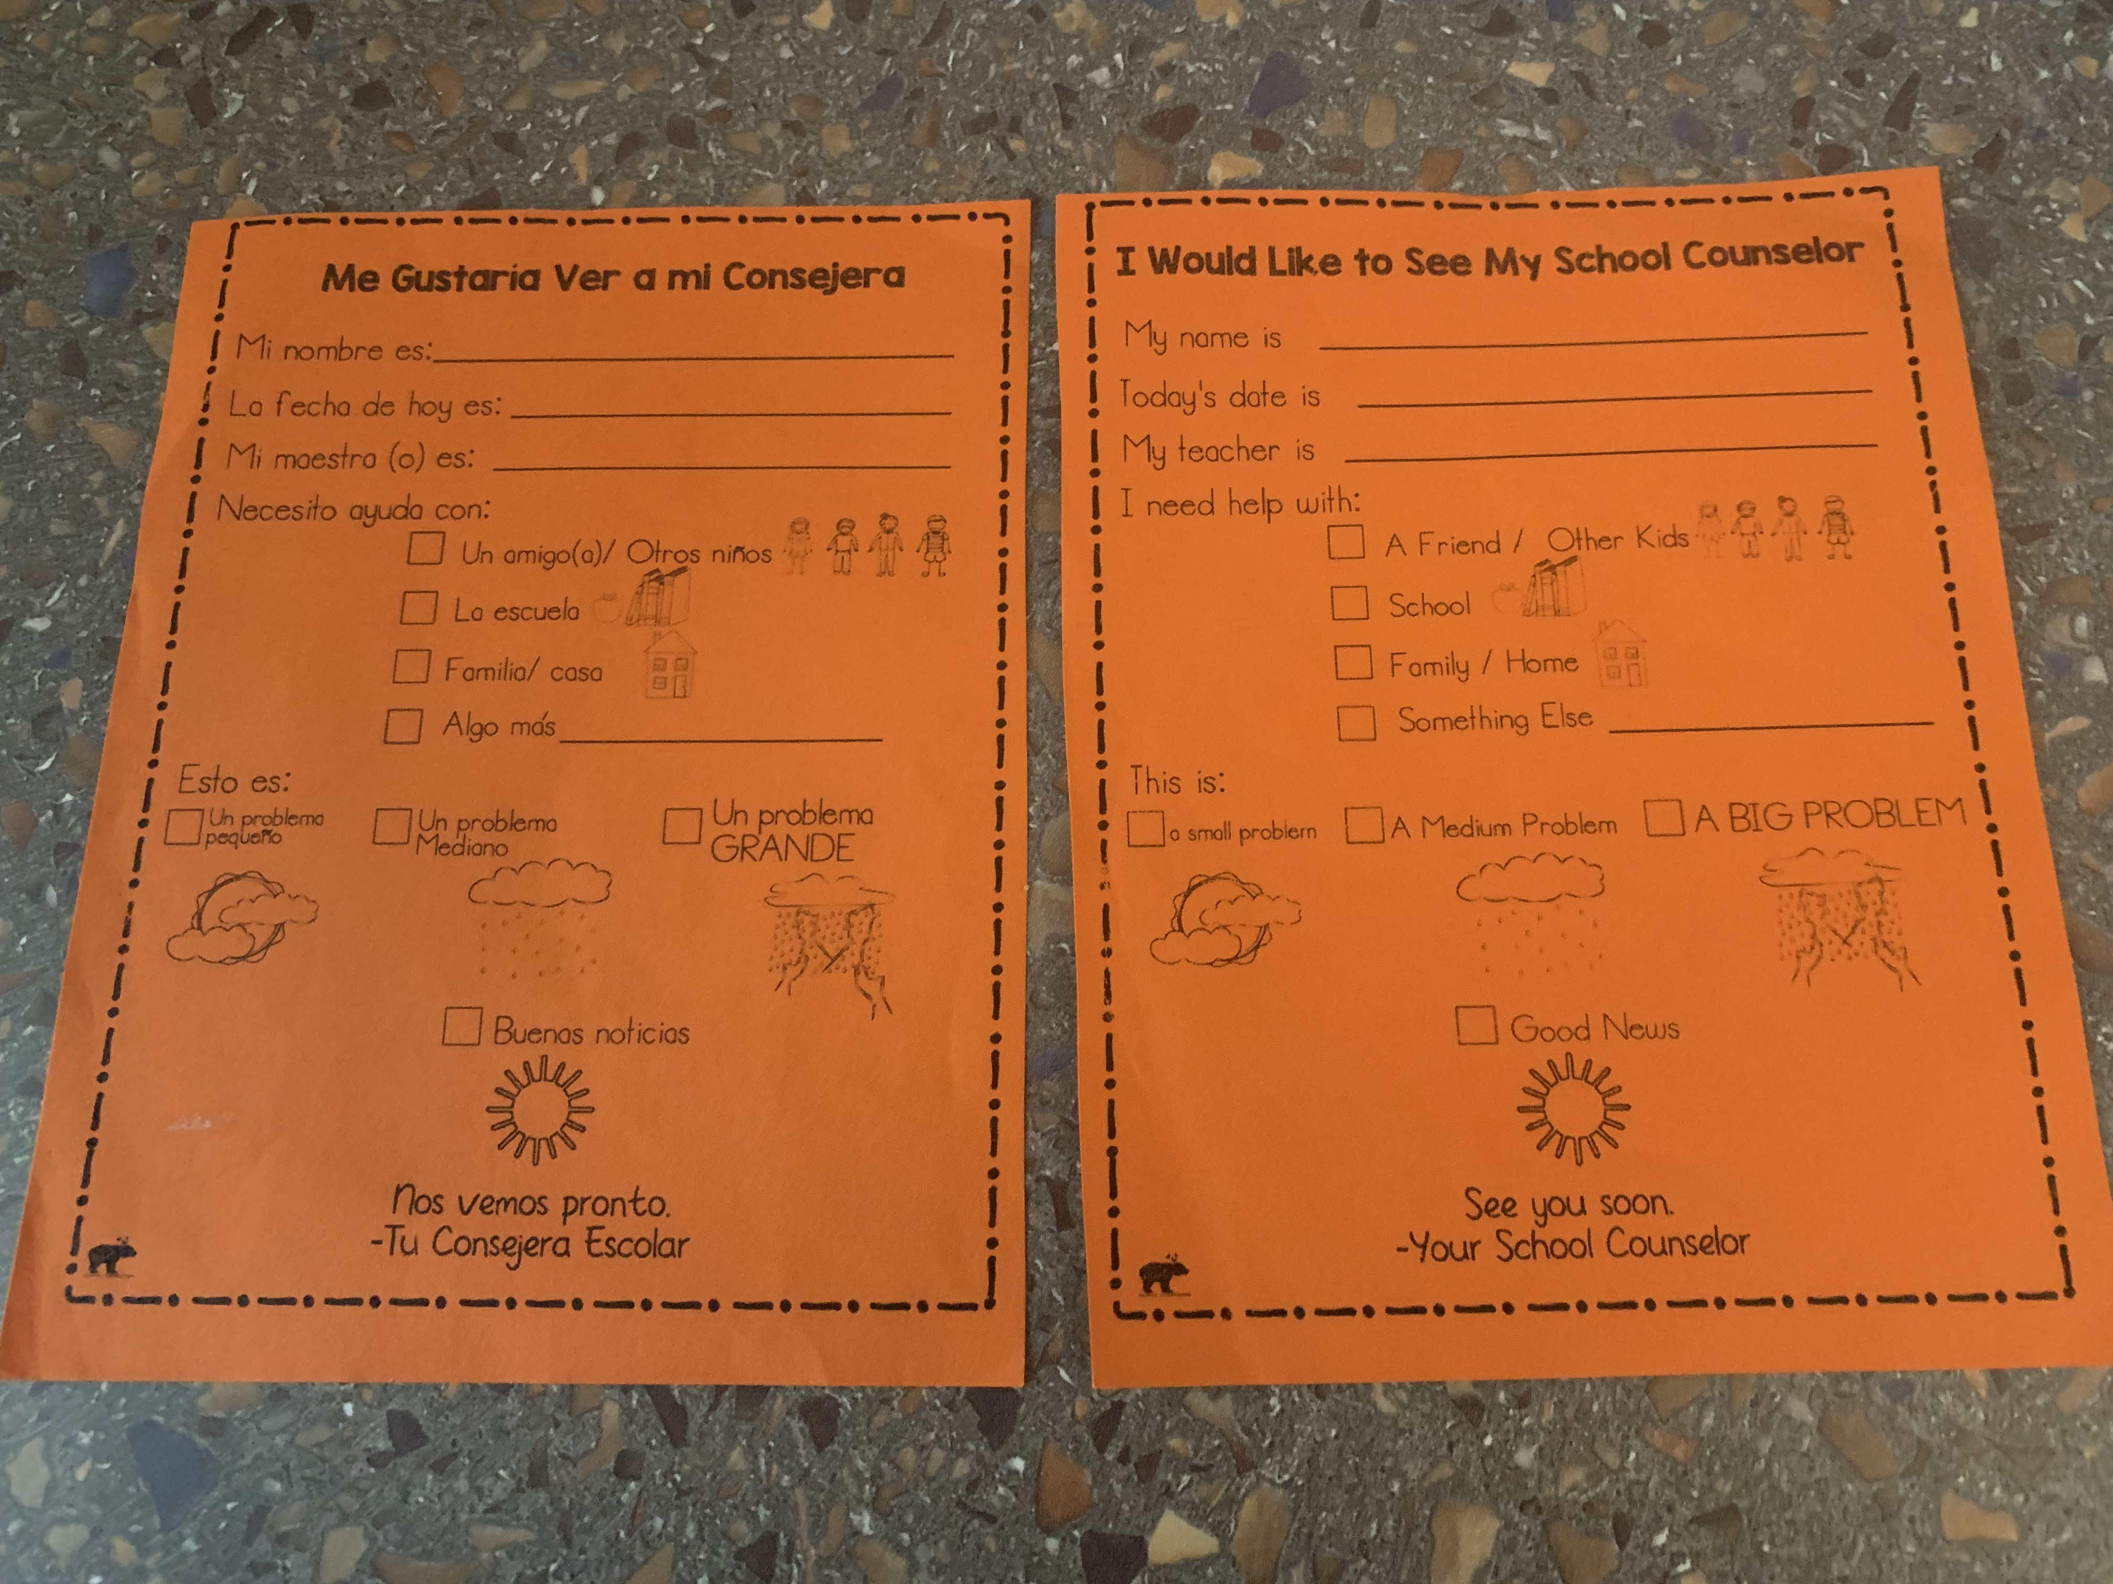
How do I make an appt. to talk with my School Counselor?
Please fill out a pass or ask your teacher if you need to speak with a counselor for a small problem, medium problem, or big problem.
Notes:
Go over how students can see their counselors. Also, go over weather metaphor for size of problem.

Slide 8
How do I make an appt. to talk with my School Counselor cont’d.?
School counseling self-referral form (pass) created by Whole Hearted School Counseling (Teachers Pay Teachers)

Slide 9
Story
I Can Do Hard Things
By: Gabi Garcia
(Book and Discussion)
Discussion:
What was “hard” that you learned to do last year?
What feelings do you experience when something is hard?
What advice would you give another student trying to do something hard?
Notes:
(10 Minutes)
Read story and stop to process. (5 Minutes) Tip: Use a visual classroom timer for class/ small group discussion time.
Share the discussion questions and have students discuss as a small group/ in partners. (You can assign partners or have them count off. (2.5 Minutes)
Have students discuss/ share as a class. (2.5 Minutes)

Slide 10
Activity
School Counselor “Scoot” Game
Directions:
You will each have a card placed on your desk. This card stays on your desk. Please don’t move it.
You will start at your desk and answer the question on your desk. Record the answer on your answer grid. Then, you will move to the next desk. Don’t forget to take your answer grid with you!
You will keep going, in order, until you have visited each desk and answered each question.
Example: If you start at #5, you will go from #5- #30 and then #1-#4.
Notes:
School Counselor “Scoot” Game (17 Minutes)
Directions: Directions:
Each student will receive a card on your desk. This card stays on your desk. Don’t move it.
You will start at your desk and answer the question on your desk. Record the answer on your answer grid. Then, you will move to the next desk. Don’t forget to take your answer grid with you!
You will keep going in order until you have visited each desk/ answered each question.
Example: If you start at #5, you will go from #5- #30 and then #1-#4.

Slide 11
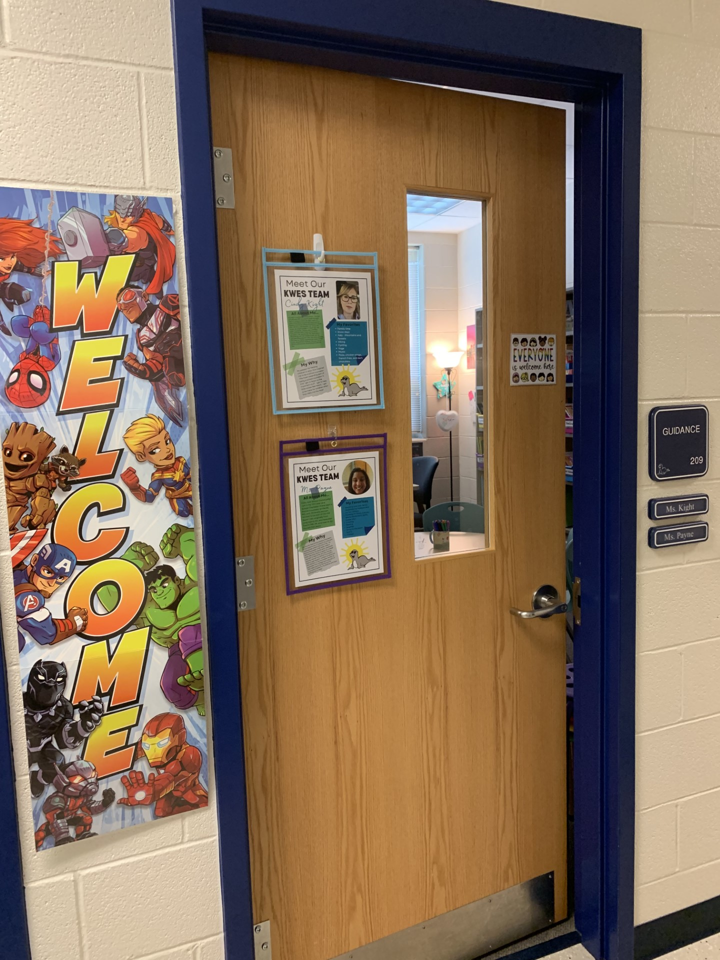
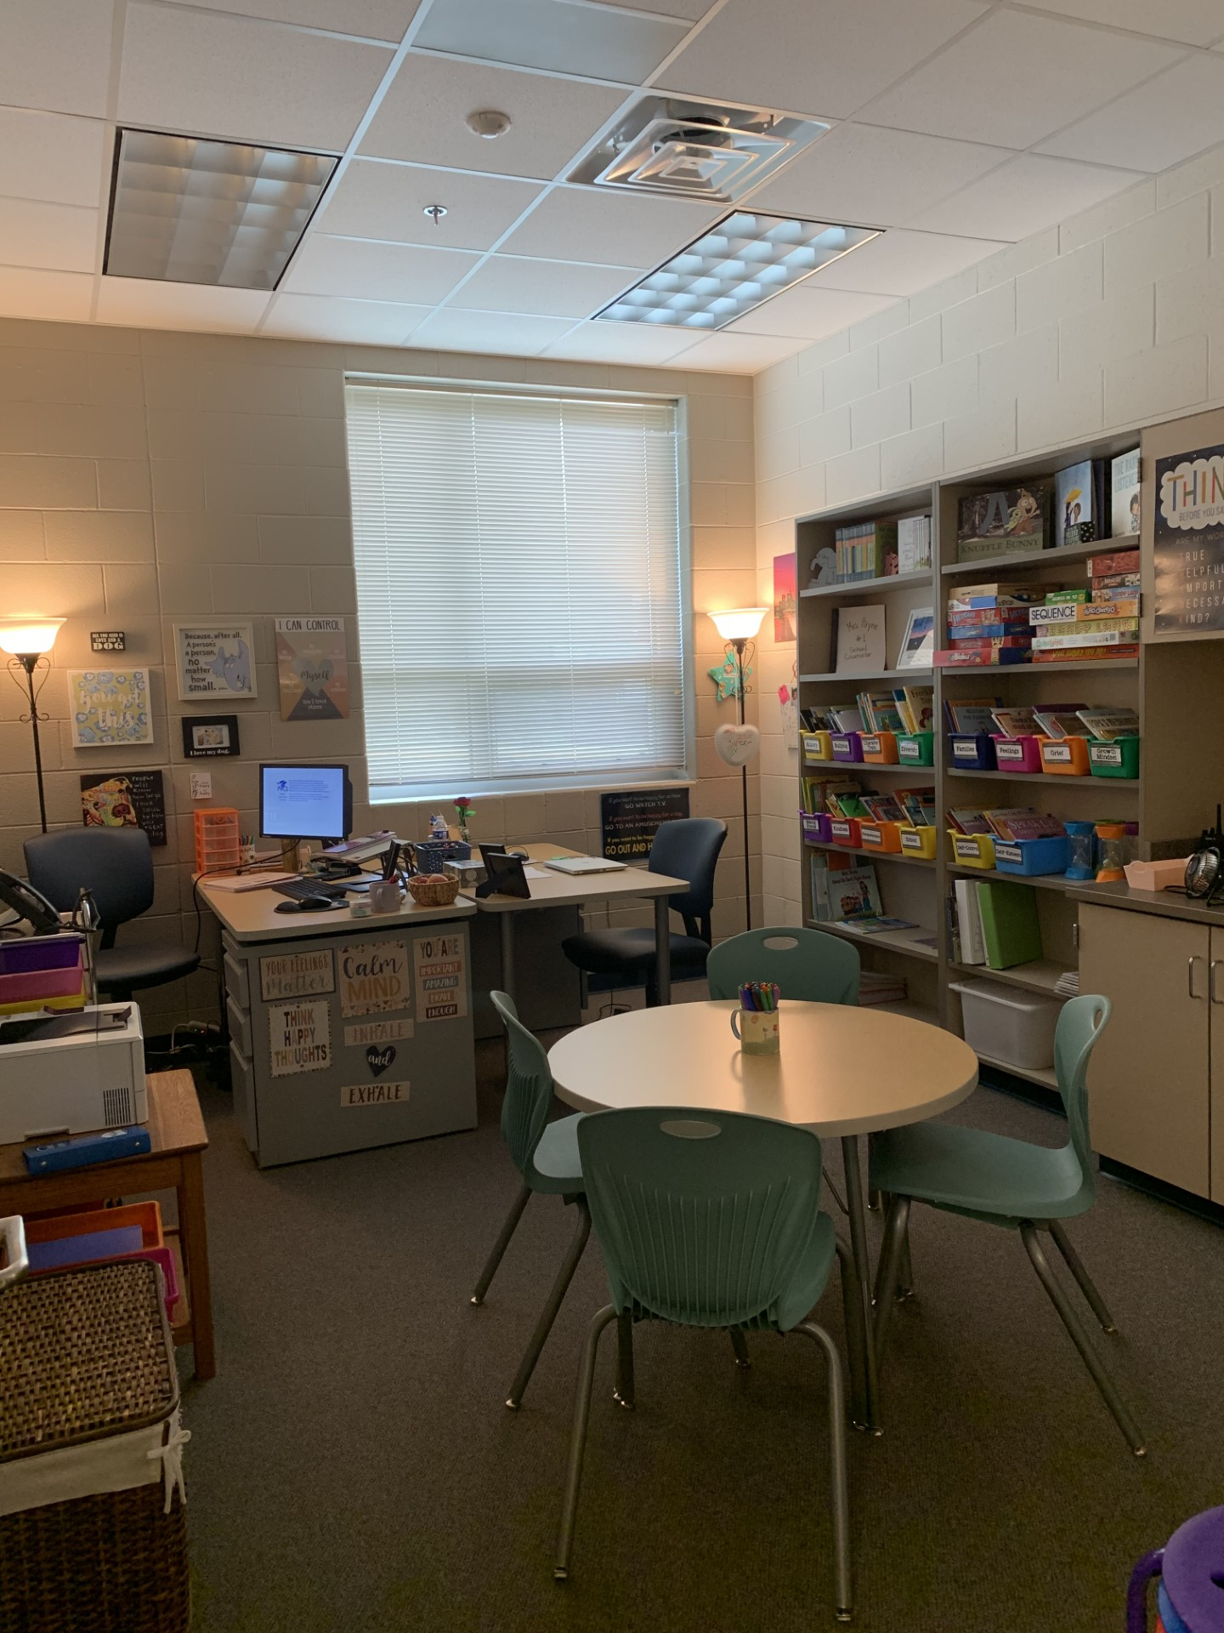
Come visit us in our spaces: Ms. Kight & Ms. Payne’s Office
(Photo Office Tour)
Notes:
Explain each photo and objects of interest.
(5 Minutes)

Slide 12
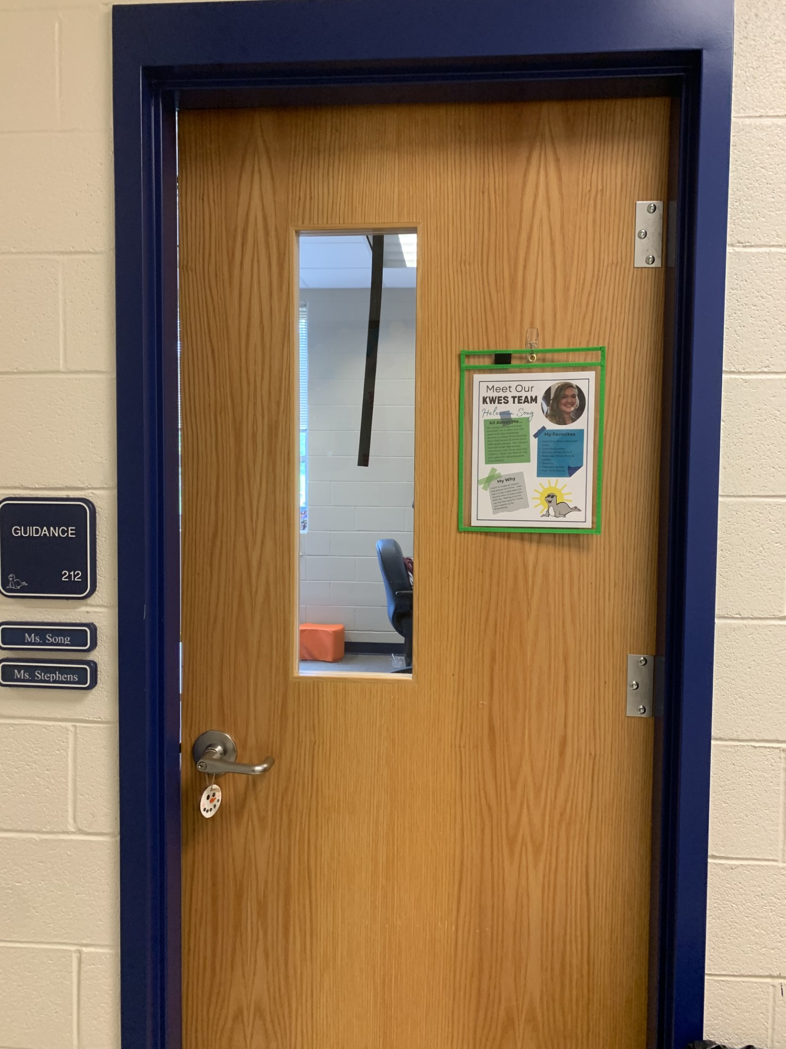
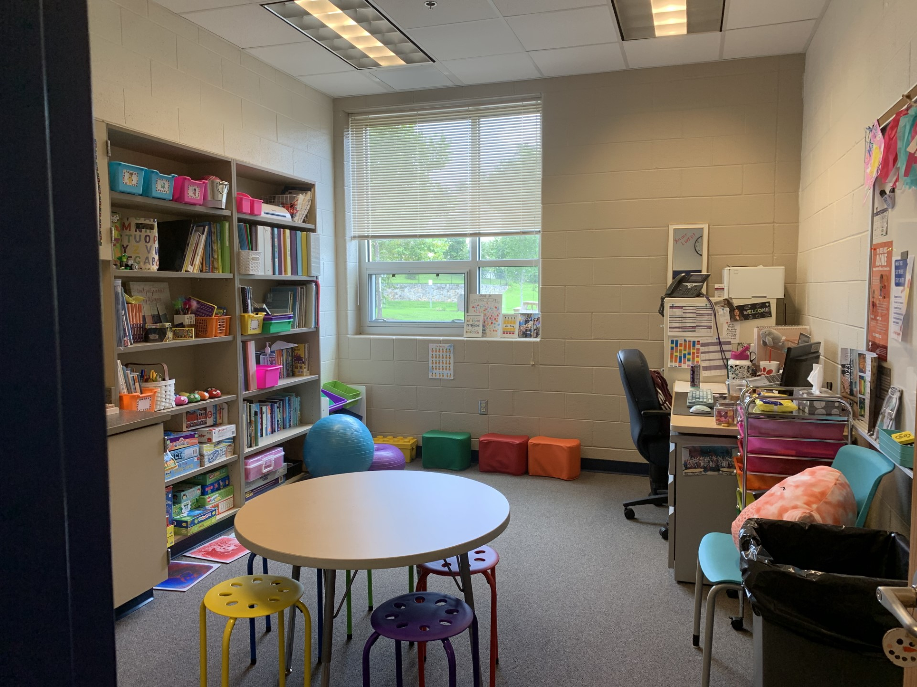
Come visit us in our spaces: Ms. Song’s Office
(Photo Office Tour)
Notes:
Explain each photo and objects of interest.
(5 Minutes)

Slide 13
What kinds of things does my school counselor talk to students about?
Family/ Home
School
Friends
Things you’re unsure of
Things you are proud of
Big Feelings
ANYTHING!
Careers
Notes:
Go over slide
(2 Minutes)

Slide 14
Closing
1) What was your favorite part of this lesson?
2) What will you remember about this lesson?
Notes:
Process/ Closing: (5 Minutes)
As time allows, have students share answers to the questions on the slide.
Encourage students to be your “newsletters and cheerleaders” and share their books with their families.
Encourage Students to share what they learned with their families.

Slide 15
Post-Test
Notes:
Give post-test.

