Slide 1
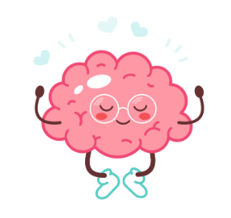
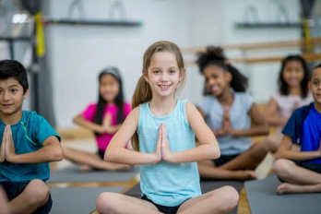
Coping Skills Unit K-1st
Notes:
Unit Cover Slide

Slide 2
Learning Objectives
Students will learn age appropriate terms and concepts related to the parts of the brain that control various functions.
Students will make relevant connections between their body and mind (feelings/ emotions).
Notes:
Go over objectives

Slide 3
Agenda: What are we doing today?
Introduction:
Agenda
Expectations
Video: “Just Breathe”
Story/ Video: My Body Sends a Signal
Activity: Brain Coloring Sheet
Close
Notes:
Go over agenda for lesson and answer questions.
(3 minutes)

Slide 4
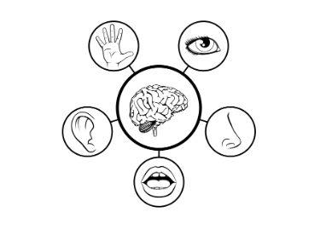
Lesson Expectations: 5 Senses
Eyes: On me!
Ears: Open and listening!
Lips: Zipped, closed, and quiet!
Hands: In your lap and to yourself!
Nose: Out of your neighbor’s business!
(As a class family, you do SUCH a good job taking care of others, during our lesson, you get to take a “break” and I will take care of everyone!)
Notes:
Go over expectations and provide examples.
Use the ones on this slide or insert your own classroom expectations on the previous slide.
(3 Minutes)

Slide 5
Coping Skills Unit
Lesson #1: The Amygdala
Notes:
Greet students and introduce topic.
(2 Minutes)

Slide 6
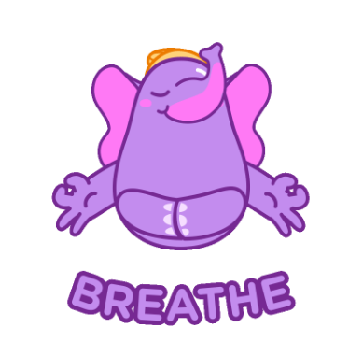
Introduction: “Just Breathe” Video
Notes:
Play video to introduce topic/ concept-Click “Breathe” picture to show video (5 Minutes)

Slide 7
Story
Today, we will be learning about our feelings and emotions. Our feelings and emotions are controlled by a part of our brain called THE AMYGDALA. Let’s practice saying that word! It’s tricky!
Notes:
(15 Minutes) Read story and stop to process.

Slide 8
Brain Break Time!
Notes:
Brain Break

Slide 9
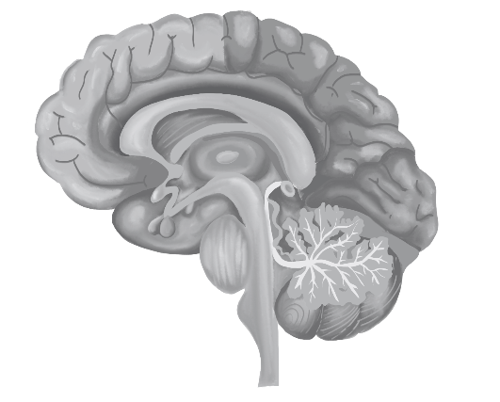
Activity: Brain Coloring Sheet
Notes:
Brain Coloring Sheet (10 Minutes)
Directions: Your brain can do AMAZING things! Make it colorful and circle the AMYGDALA or “Security Guard'' part of the brain. It is the small oval- shape in the center. This is the part of our braIn that controls feelings and emotions.

Slide 10
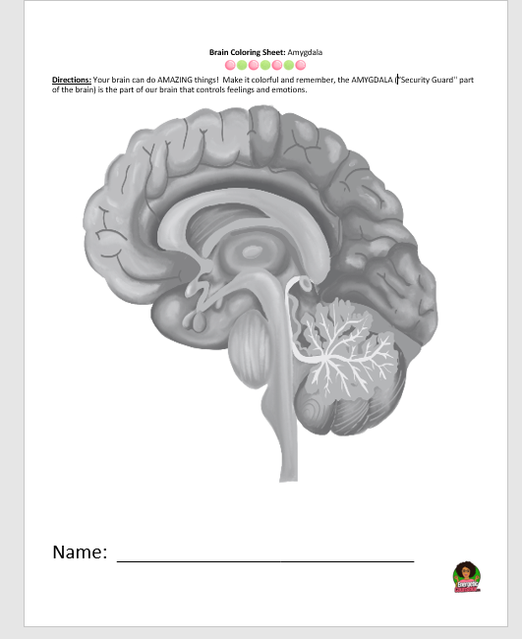
Activity: Brain Coloring Sheet
Notes:
Give time for students to work on activity.

Slide 11
Closing
1) What was your favorite part of this lesson?
2) What will you remember about this lesson?
3) What are some coping skills you can use when feeling sad/mad?
Notes:
Process/ Closing: (5 Minutes)
As time allows, have students share answers to the questions on the slide.
Encourage students to be your “newsletters and cheerleaders” and share their coloring page with their families.
Encourage Students to share what they learned with their families.

Slide 12
Post-Test
Notes:
Give post-test.

Slide 13
End of Lesson
This Photo by Unknown Author is licensed under CC BY-SA

Slide 14
Coping Skills Unit
Lesson #2: Relaxation Stations
Notes:
Greet students and introduce topic.
(2 Minutes)

Slide 15
Agenda: What are we doing today?
Introduction:
Agenda
Expectations
Relaxation Stations
Station #1: Play Doh
Station #2: Calm Coloring
Station #3: “Worry Monsters”
Close
Notes:
Go over agenda for lesson and answer questions.
(3 minutes)

Slide 16
Lesson Expectations
Notes:
Go over expectations and provide examples.
Use this slide to insert your own classroom expectations or use the ones on the next slide.
(3 Minutes)

Slide 17
Lesson Expectations: 5 Senses
Eyes: On me!
Ears: Open and listening!
Lips: Zipped, closed, and quiet!
Hands: In your lap and to yourself!
Nose: Out of your neighbor’s business!
(As a class family, you do SUCH a good job taking care of others, during our lesson, you get to take a “break” and I will take care of everyone!)
Notes:
Go over expectations and provide examples.
Use the ones on this slide or insert your own classroom expectations on the previous slide.
(3 Minutes)

Slide 18
Activity: Relaxation Stations
Station #1: Play Doh- Relax with the soft, squishy, smooth feeling of play dough.
Station #2: Mindful Coloring- Choose a “Calm Coloring Sheet” to color.
Station #3: “Worry Monsters”- Make a “Monster” to gobble up your worries!
Notes:
Directions: (36 Minutes- Explain 3 Minutes; Transition 3 Minutes; Stations 30 Minutes)
Worry Monster Visual Mindful Coloring Sheets
Explain that each student will visit all three stations. Divide the class into three groups.
Explain to students that they have 10 minutes in each station with one minute to transition between stations.
Encourage them to leave stations “as is” and not try to clean up before moving on to the next station. (This wastes time.) At the beginning of each rotation, be sure each group is clear about which station they will be visiting next. Station Signs may be helpful to use.
(30 Minutes)

Slide 19
Closing
1) What was your favorite part of this lesson?
2) What will you remember about this lesson?
Notes:
Process/ Closing: (3 Minutes)
As time allows, have students share answers to the questions on the slide.
Encourage students to be your “newsletters and cheerleaders” and share their books with their families.
Encourage Students to share what they learned with their families.

Slide 20
Coping Skills Unit
Lesson #3: Stress First Aid Kits
Notes:
Greet students and introduce topic.
(2 Minutes)

Slide 21
Agenda: What are we doing today?
Introduction:
Agenda
Expectations
Story/ Video: Ruby Finds a Worry
Discussion:
What kinds of things make you feel stressed/ worried?
What kinds of things help you to feel better?
Activity: Stress First Aid Kit
Close
Notes:
Go over agenda for lesson and answer questions.
(3 minutes)

Slide 22
Lesson Expectations
Notes:
Go over expectations and provide examples.
Use this slide to insert your own classroom expectations or use the ones on the next slide.
(3 Minutes)

Slide 23
Lesson Expectations: 5 Senses
Eyes: On me!
Ears: Open and listening!
Lips: Zipped, closed, and quiet!
Hands: In your lap and to yourself!
Nose: Out of your neighbor’s business!
(As a class family, you do SUCH a good job taking care of others, during our lesson, you get to take a “break” and I will take care of everyone!)
Notes:
Go over expectations and provide examples.
Use the ones on this slide or insert your own classroom expectations on the previous slide.
(3 Minutes)

Slide 24
Story
What kinds of things make you feel stressed/ worried?
What kinds of things help you to feel better?
Notes:
(10 Minutes) Read story and stop to process.
Discussion: Allow students to share answers to the questions in the box.
Explain that they will be doing a craft to help them remember helpful ways to deal with stress and worries.

Slide 25
Activity: Stress First Aid Kit
Notes:
Stress First Aid Kit (20 Minutes)
Directions:
Have students write their name in the top box.
Have students circle or identify things that help them to feel “calm” or “peaceful” when they are worried or stressed. Allow students to use the blank box to draw/ create their own coping skill/ strategy.
Have students cut the name out and they can place on the front of an envelope. The envelope can be colored red (or any color you wish!). Construction paper can also be folded in half and stapled/ glued/ taped around the edges to create an “envelope” or “pocket”. The squares can be cut out and any ones that are relevant can be placed inside their “kit”. Any that do not apply can be discarded.

Slide 26
Closing
1) What was your favorite part of this lesson?
2) What will you remember about this lesson?
Notes:
Process/ Closing: (5 Minutes)
As time allows, have students share answers to the questions on the slide.
Encourage students to be your “newsletters and cheerleaders” and share their books with their families.
Encourage Students to share what they learned with their families.

