Slide 1
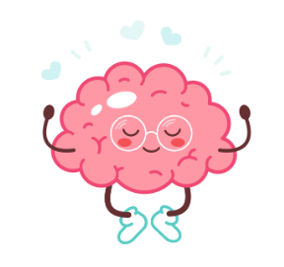
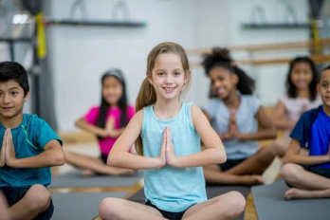
Coping Skills Unit 2nd-3rd
Notes:
Unit Cover Slide

Slide 2
Learning Objectives
Students will learn age appropriate terms and concepts related to the parts of the brain that control various functions.
Students will make relevant connections between their body and mind (feelings/ emotions).
Notes:
Go over objectives

Slide 3
Agenda: What are we doing today?
Introduction:
Agenda
Expectations
Video: “Just Breathe”
Story/ Video: My Body Sends a Signal
Activity: Brain Parts Sort
Close
Notes:
Go over agenda for lesson and answer questions.
(3 minutes)

Slide 4
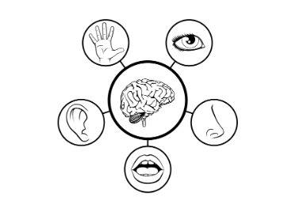
Lesson Expectations: 5 Senses
Eyes: On me!
Ears: Open and listening!
Lips: Zipped, closed, and quiet!
Hands: In your lap and to yourself!
Nose: Out of your neighbor’s business!
(As a class family, you do SUCH a good job taking care of others, during our lesson, you get to take a “break” and I will take care of everyone!)
Notes:
Go over expectations and provide examples.
Use the ones on this slide or insert your own classroom expectations on the previous slide.
(3 Minutes)

Slide 5
Lesson Expectations (3rd)
S: “Sitting Mountain” position! “Mountain Peak” (head) is high in the sky and “Mountain Valleys” (bottom and feet) are grounded.
L: Listening!
A: Attention! (This is different than listening.)
N: Nodding often to show engagement.
T: Not Talking unless I Tell you to and there will be Time for this!- Promise!
Notes:
3rd Grade
Go over expectations and provide examples.
Use the ones on this slide or insert your own classroom expectations on the previous slide.
(3 Minutes)

Slide 6
Coping Skills Unit
Lesson #1: The Amygdala
Notes:
Greet students and introduce topic.
(2 Minutes)

Slide 7
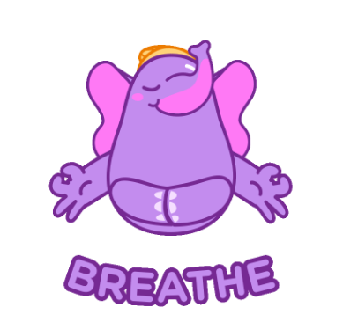
Introduction: “Just Breathe” Video
Notes:
Play video to introduce topic/ concept-Click “Breathe” picture to show video (5 Minutes)

Slide 8
Story
Today, we will be learning about our feelings and emotions. Our feelings and emotions are controlled by a part of our brain called THE AMYGDALA. Let’s practice saying that word! It’s tricky!
Notes:
(15 Minutes) Read story and stop to process.

Slide 9
Brain Break Time!
Notes:
Brain Break

Slide 10
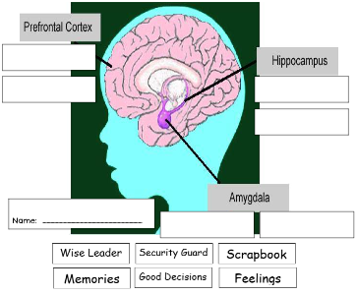
Activity: Brain Parts Sort
Notes:
Brain Parts Sort (10 Minutes)
Directions: There are many parts of the HUMAN BRAIN. For this activity, we will focus on THREE PARTS. Read the information at the top of the sheet CAREFULLY. Cut, paste, and label each area.

Slide 11
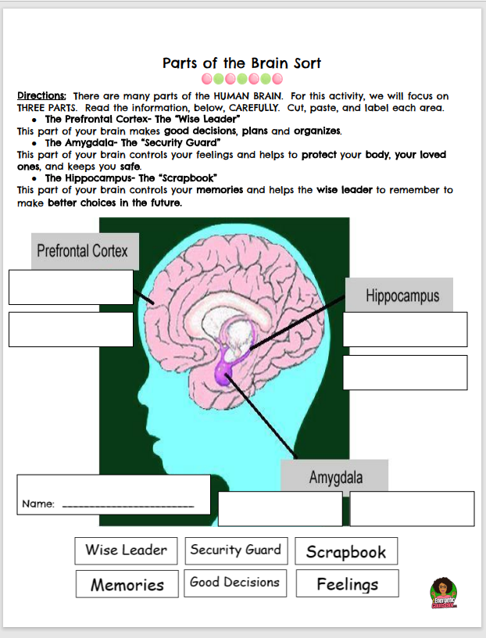
Activity: Brain Parts Sort
Notes:
Give time for students to work on activity.

Slide 12
Closing
1) What was your favorite part of this lesson?
2) What will you remember about this lesson?
3) What are some coping skills you can use to help regulate your emotions?
Notes:
Process/ Closing: (5 Minutes)
As time allows, have students share answers to the questions on the slide.
Encourage students to be your “newsletters and cheerleaders” and share their books with their families.
Encourage Students to share what they learned with their families.

Slide 13
Post-Test
Notes:
Give post-test.

Slide 14
End of Lesson
This Photo by Unknown Author is licensed under CC BY-SA

Slide 15
Coping Skills Unit
Lesson #2: Relaxation Stations
Notes:
Greet students and introduce topic.
(2 Minutes)

Slide 16
Agenda: What are we doing today?
Introduction:
Agenda
Expectations
Relaxation Stations
Station #1: Play Doh
Station #2: Calm Coloring
Station #3: “Worry Monsters”
Close
Notes:
Go over agenda for lesson and answer questions.
(3 minutes)

Slide 17
Lesson Expectations
Notes:
Go over expectations and provide examples.
Use this slide to insert your own classroom expectations or use the ones on the next slide.
(3 Minutes)

Slide 18
Lesson Expectations: 5 Senses
Eyes: On me!
Ears: Open and listening!
Lips: Zipped, closed, and quiet!
Hands: In your lap and to yourself!
Nose: Out of your neighbor’s business!
(As a class family, you do SUCH a good job taking care of others, during our lesson, you get to take a “break” and I will take care of everyone!)
Notes:
2nd Grade
Go over expectations and provide examples.
Use the ones on this slide or insert your own classroom expectations on the previous slide.
(3 Minutes)

Slide 19
Lesson Expectations
S: “Sitting Mountain” position! “Mountain Peak” (head) is high in the sky and “Mountain Valleys” (bottom and feet) are grounded.
L: Listening!
A: Attention! (This is different than listening.)
N: Nodding often to show engagement.
T: Not Talking unless I Tell you to and there will be Time for this!- Promise!
Notes:
3rd Grade
Go over expectations and provide examples.
Use the ones on this slide or insert your own classroom expectations on the previous slide.
(3 Minutes)

Slide 20
Activity: Relaxation Stations
Station #1: Play Doh- Relax with the soft, squishy, smooth feeling of play dough.
Station #2: Mindful Coloring- Choose a “Mindful Coloring Sheet” to color.
Station #3: “Worry Monsters”- Make a “Monster” to gobble up your worries!
Notes:
Directions: (36 Minutes- Explain 3 Minutes; Transition 3 Minutes; Stations 30 Minutes)
Worry Monster Visual Mindful Coloring Sheet
Explain that each student will visit all three stations. Divide the class into three groups.
Explain to students that they have 10 minutes in each station with one minute to transition between stations.
Encourage them to leave stations “as is” and not try to clean up before moving on to the next station. (This wastes time.) At the beginning of each rotation, be sure each group is clear about which station they will be visiting next. Station Signs may be helpful to use.
(30 Minutes)

Slide 21
Closing
1) What was your favorite part of this lesson?
2) What will you remember about this lesson?
Notes:
Process/ Closing: (5 Minutes)
As time allows, have students share answers to the questions on the slide.
Encourage students to be your “newsletters and cheerleaders” and share their books with their families.
Encourage Students to share what they learned with their families.

Slide 22
Coping Skills Unit
Lesson #3: Stress First Aid Kits
Notes:
Greet students and introduce topic.
(2 Minutes)

Slide 23
Agenda: What are we doing today?
Introduction:
Agenda
Expectations
Story/ Video: The What-Ifs
Discussion: What do you like to do to calm down?
Activity: Stress First Aid Kit
Close
Notes:
Go over agenda for lesson and answer questions.
(3 minutes)

Slide 24
Lesson Expectations
Notes:
Go over expectations and provide examples.
Use this slide to insert your own classroom expectations or use the ones on the next slide.
(3 Minutes)

Slide 25
Lesson Expectations: 5 Senses
Eyes: On me!
Ears: Open and listening!
Lips: Zipped, closed, and quiet!
Hands: In your lap and to yourself!
Nose: Out of your neighbor’s business!
(As a class family, you do SUCH a good job taking care of others, during our lesson, you get to take a “break” and I will take care of everyone!)
Notes:
2nd Grade
Go over expectations and provide examples.
Use the ones on this slide or insert your own classroom expectations on the previous slide.
(3 Minutes)

Slide 26
Lesson Expectations
S: “Sitting Mountain” position! “Mountain Peak” (head) is high in the sky and “Mountain Valleys” (bottom and feet) are grounded.
L: Listening!
A: Attention! (This is different than listening.)
N: Nodding often to show engagement.
T: Not Talking unless I Tell you to and there will be Time for this!- Promise!
Notes:
3rd Grade
Go over expectations and provide examples.
Use the ones on this slide or insert your own classroom expectations on the previous slide.
(3 Minutes)

Slide 27
Story
People who struggle with anxiety and stress often worry about the “what ifs”.
Can you think of a time you worried about the “what ifs”?
Notes:
(10 Minutes) Read story and stop to process.
Discussion: Allow students to share the question in the box.
Explain that they will be doing a craft to help them remember helpful ways to deal with stress and worries.

Slide 28
Activity: Stress First Aid Kit
Notes:
Stress First Aid Kit (20 Minutes)
Directions:
Have students write their name in the top box.
Have students circle or identify things that help them to feel “calm” or “peaceful” when they are worried or stressed. Allow students to use the blank box to draw/ create their own coping skill/ strategy.
Have students cut the name out and they can place on the front of an envelope. The envelope can be colored red (or any color you wish!). Construction paper can also be folded in half and stapled/ glued/ taped around the edges to create an “envelope” or “pocket”. The squares can be cut out and any ones that are relevant can be placed inside their “kit”. Any that do not apply can be discarded.

Slide 29
Closing
1) What was your favorite part of this lesson?
2) What will you remember about this lesson?
Notes:
Process/ Closing: (5 Minutes)
As time allows, have students share answers to the questions on the slide.
Encourage students to be your “newsletters and cheerleaders” and share their books with their families.
Encourage Students to share what they learned with their families.

