Slide 1
Medicine safety: K-2
Created By: School Counselors, Ms. Kight, Ms. Payne, and Ms. Song

Slide 2
Learning targets
Today we/I will be learning about what medicine safety means.
We will/I will do this by watching the Medicine Safety Public Service Announcement (PSA).
We’ll/I’ll know I am successful by being able to identify safe/healthy decisions (such as: how medicine can help and also hurt if not taken correctly, recognizing labels and their warnings, and asking adults before touching/taking medicine).

Slide 3
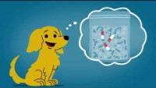
Medicine safety vide0

Slide 4
After talking with an adult about the video you watched, Please Reach out if you (or your family) have questions.
*A special thank you to the PWCS Student Services Department for providing the PSA*

