Slide 1
Academic Confidence Building Unit 2nd and 3rd
Notes:
Unit Cover Slide

Slide 2
Academic Confidence Building Unit
Lesson #1: “I Do”
Growth Mindset/ The Power of Yet
Notes:
Greet students and introduce topic.
(2 Minutes)

Slide 3
Learning Objectives
Students will build a basic foundation for developing a growth mindset.
Students will build and apply relevant connections between growth mindset and coping with daily challenges.
Notes:
Go over objectives and provide examples.
Use this slide to insert your own classroom expectations or use the ones on the next slide.
(3 Minutes)

Slide 4
Agenda: What are we doing today?
Introduction:
Agenda
Lesson Expectations
Story/ Video: Mojo- Growth Mindset
Discussion/ Skill/ Practice: “Ish”
Skill/Practice: Worksheet/ Activity- “My Ish Drawings”
Close
Notes:
Go over agenda for lesson and answer questions.
(3 minutes)

Slide 5
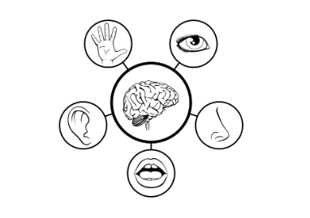
Lesson Expectations: 5 Senses
Eyes: On me!
Ears: Open and listening!
Lips: Zipped, closed, and quiet!
Hands: In your lap and to yourself!
Nose: Out of your neighbor’s business!
(As a class family, you do SUCH a good job taking care of others, during our lesson, you get to take a “break” and I will take care of everyone!)
Notes:
2nd Grade
Go over expectations and provide examples.
Use the ones on this slide or insert your own classroom expectations on the previous slide.
(3 Minutes)

Slide 6
Lesson Expectations
S: “Sitting Mountain” position! “Mountain Peak” (head) is high in the sky and “Mountain Valleys” (bottom and feet) are grounded.
L: Listening!
A: Attention! (This is different than listening.)
N: Nodding often to show engagement.
T: Not Talking unless I Tell you to and there will be Time for this!- Promise!
Notes:
3rd Grade
Go over expectations and provide examples.
Use the ones on this slide or insert your own classroom expectations on the previous slide.
(3 Minutes)

Slide 7
Introduction
What is GROWTH MINDSET?
Watch this short video to find out!
Notes:
What is Growth Mindset? (3 Minutes)

Slide 8
Story
Notes:
Read story and stop to process/ highlight key points. (5 Minutes)

Slide 9
Brain Break Time!
Notes:
Brain Break

Slide 10
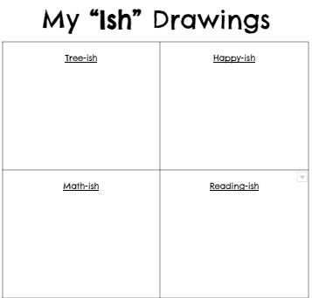
Activity: My “Ish” Drawings
Notes:
My "Ish" Drawings Activity (20 Minutes)
Directions: Decorate and create your own “ish” drawings like Ramon in the story!

Slide 11
Closing
1) What was your favorite part of this lesson?
2) What will you remember about this lesson?
Notes:
Process/ Closing: (5 Minutes)
As time allows, have students share answers to the questions on the slide.
Encourage students to be your “newsletters and cheerleaders” and share their books with their families.
Encourage Students to share what they learned with their families.

