Slide 1
Academic Confidence Building Unit 4th-5th
Notes:
Unit Cover Slide

Slide 2
Academic Confidence Building Unit
Lesson #1: “I Do”
Growth Mindset/ The Power of Yet
Notes:
Greet students and introduce topic.
(2 Minutes)

Slide 3
Learning Objectives
Students will build a basic foundation for developing a growth mindset.
Students will build and apply relevant connections between growth mindset and coping with daily challenges.
Notes:
Go over objectives and provide examples.
Use this slide to insert your own classroom expectations or use the ones on the next slide.
(3 Minutes)

Slide 4
Agenda: What are we doing today?
Introduction:
Agenda
Lesson Expectations
Story/ Video: Mojo- Growth Mindset
Discussion/ Skill/ Practice: The Most Magnificent Thing
Skill/Practice: Worksheet/ Activity- “Sinkin Thinkin”
Close
Notes:
Go over agenda for lesson and answer questions.
(3 minutes)

Slide 5
Lesson Expectations
S: “Sitting Mountain” position! “Mountain Peak” (head) is high in the sky and “Mountain Valleys” (bottom and feet) are grounded.
L: Listening!
A: Attention! (This is different than listening.)
N: Nodding often to show engagement.
T: Not Talking unless I Tell you to and there will be Time for this!- Promise!
Notes:
Go over expectations and provide examples.
Use the ones on this slide or insert your own classroom expectations on the previous slide.
(3 Minutes)

Slide 6
Introduction
What is GROWTH MINDSET?
Watch this short video to find out!
Notes:
What is Growth Mindset? (3 Minutes)

Slide 7
Story
Notes:
Read story and stop to process/ highlight key points. (5 Minutes)

Slide 8
Discussion
Have you ever been frustrated like the girl in the story? What happened?
What did the girl do to deal/ cope with her frustration?
How could you use what you learned from the story in your own life?
In school? Outside of school?
Notes:
Discussion: (5 Minutes)
Consider a quick wiggle/ movement break, if needed, prior to the last question.

Slide 9
Brain break! Using your paper or dry-erase board, silently doodle/draw.

Slide 10
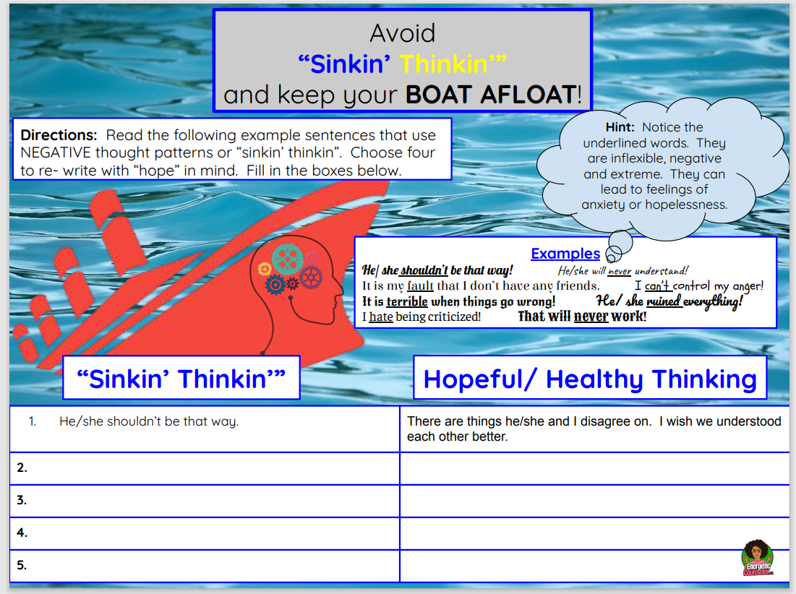
Activity: Sinkin’ Thinkin’
Notes:
Sinkin’ Thinkin’ (15 Minutes)
Directions: Read the following example sentences that use NEGATIVE thought patterns or “sinkin’ thinkin” that the girl in the story was struggling with. Choose four to re- write with a GROWTH MINDSET in mind.

Slide 11
Closing
1) What was your favorite part of this lesson?
2) What will you remember about this lesson?
Notes:
Process/ Closing: (5 Minutes)
As time allows, have students share answers to the questions on the slide.
Encourage students to be your “newsletters and cheerleaders” and share their books with their families.
Encourage Students to share what they learned with their families.

