Slide 1

SMART Goals
Fifth grade VA Wizard ACPP lesson

Slide 2

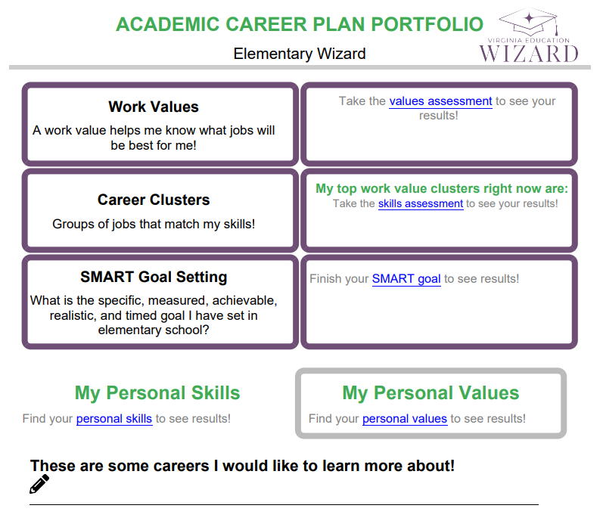
What is an Academic Career Plan Portfolio?
You are the author, and you get to:
Record your interests.
Explore careers.
Better know yourself through values, skills, and goals.
Notes:
Optional slide – your students will most likely be very familiar with VA Wizard by the 5th grade, but they are here if you feel they are needed or helpful

Slide 3
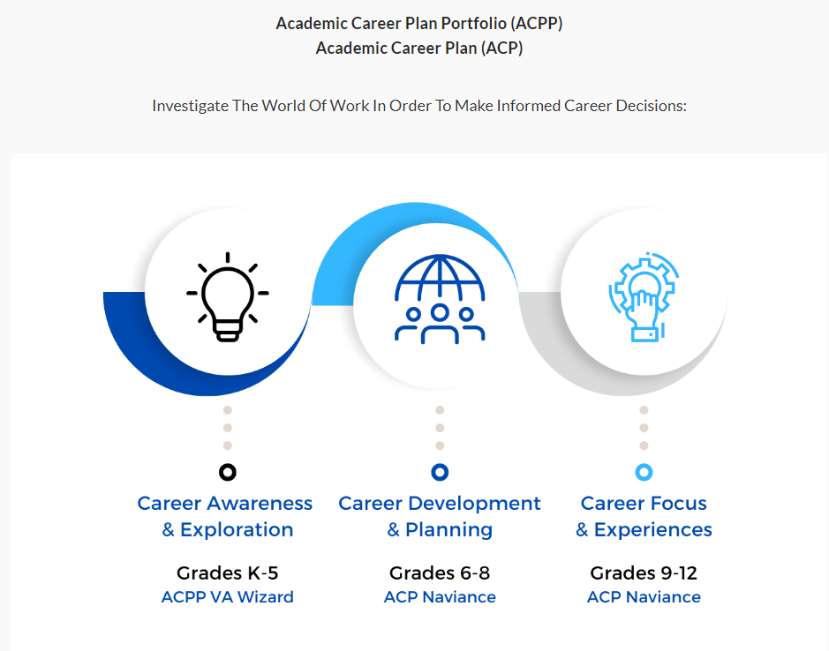
Elementary Middle High
Notes:
Optional slide – your students will most likely be very familiar with VA Wizard by the 5th grade, but they are here if you feel they are needed or helpful

Slide 4

What is VA Wizard?
VIDEO VA Wizard intro (stop at 2.24 min mark)
Notes:
Optional slide – your students will most likely be very familiar with VA Wizard by the 5th grade, but they are here if you feel they are needed or helpful

Slide 5
Learning Objectives
ASCA Mindsets and Behaviors
  B-LS 7. Long- and short-term academic, career and social/emotional goals
Student will be able to:
  Set a personalized goal with all the components of a SMART goal.

Slide 6


Class Poll:
What do you think is the most important step toward achieving a goal?
A: Having a goal that I really want to achieve.
B: Writing down my goal.
C: Finding a goal that is realistic for me.
D: Knowing the next step toward my goal.
Notes:
Ask students by a show of hands – A, B, C, D. Tell students that the correct answer is B. While all of these things are important and helpful to reaching a goal. The most important of all, which will help you be most likely to achieve it is B – putting your goal in writing.

Slide 7

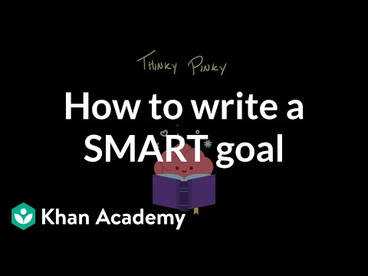
SMART Goal – VA Wizard Thinky Pinky

Slide 8
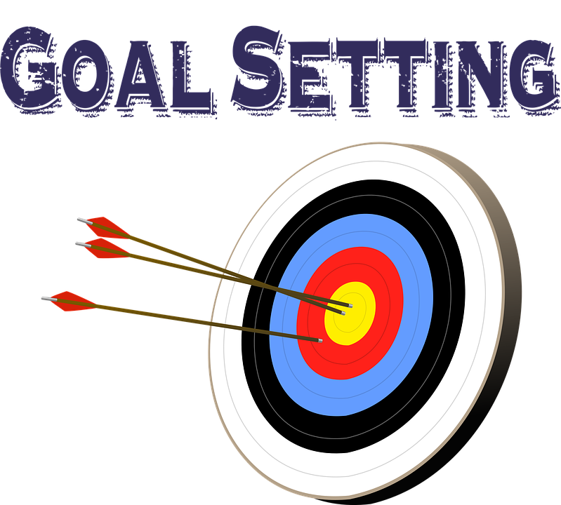
Let’s try one together.
Notes:
Tell students we will work on a goal that everyone can relate to. For example, it’s probably safe to say that all 5th graders would like to be promoted to the 6th grade.

Slide 9
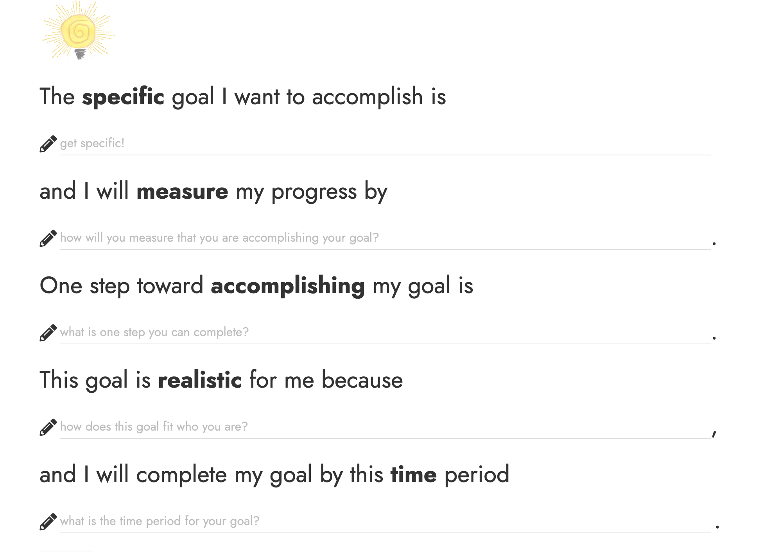
I would like to be promoted to sixth grade.
Notes:
You can talk through these options and get student response, also there is an example of possible responses on the next slide

Slide 10
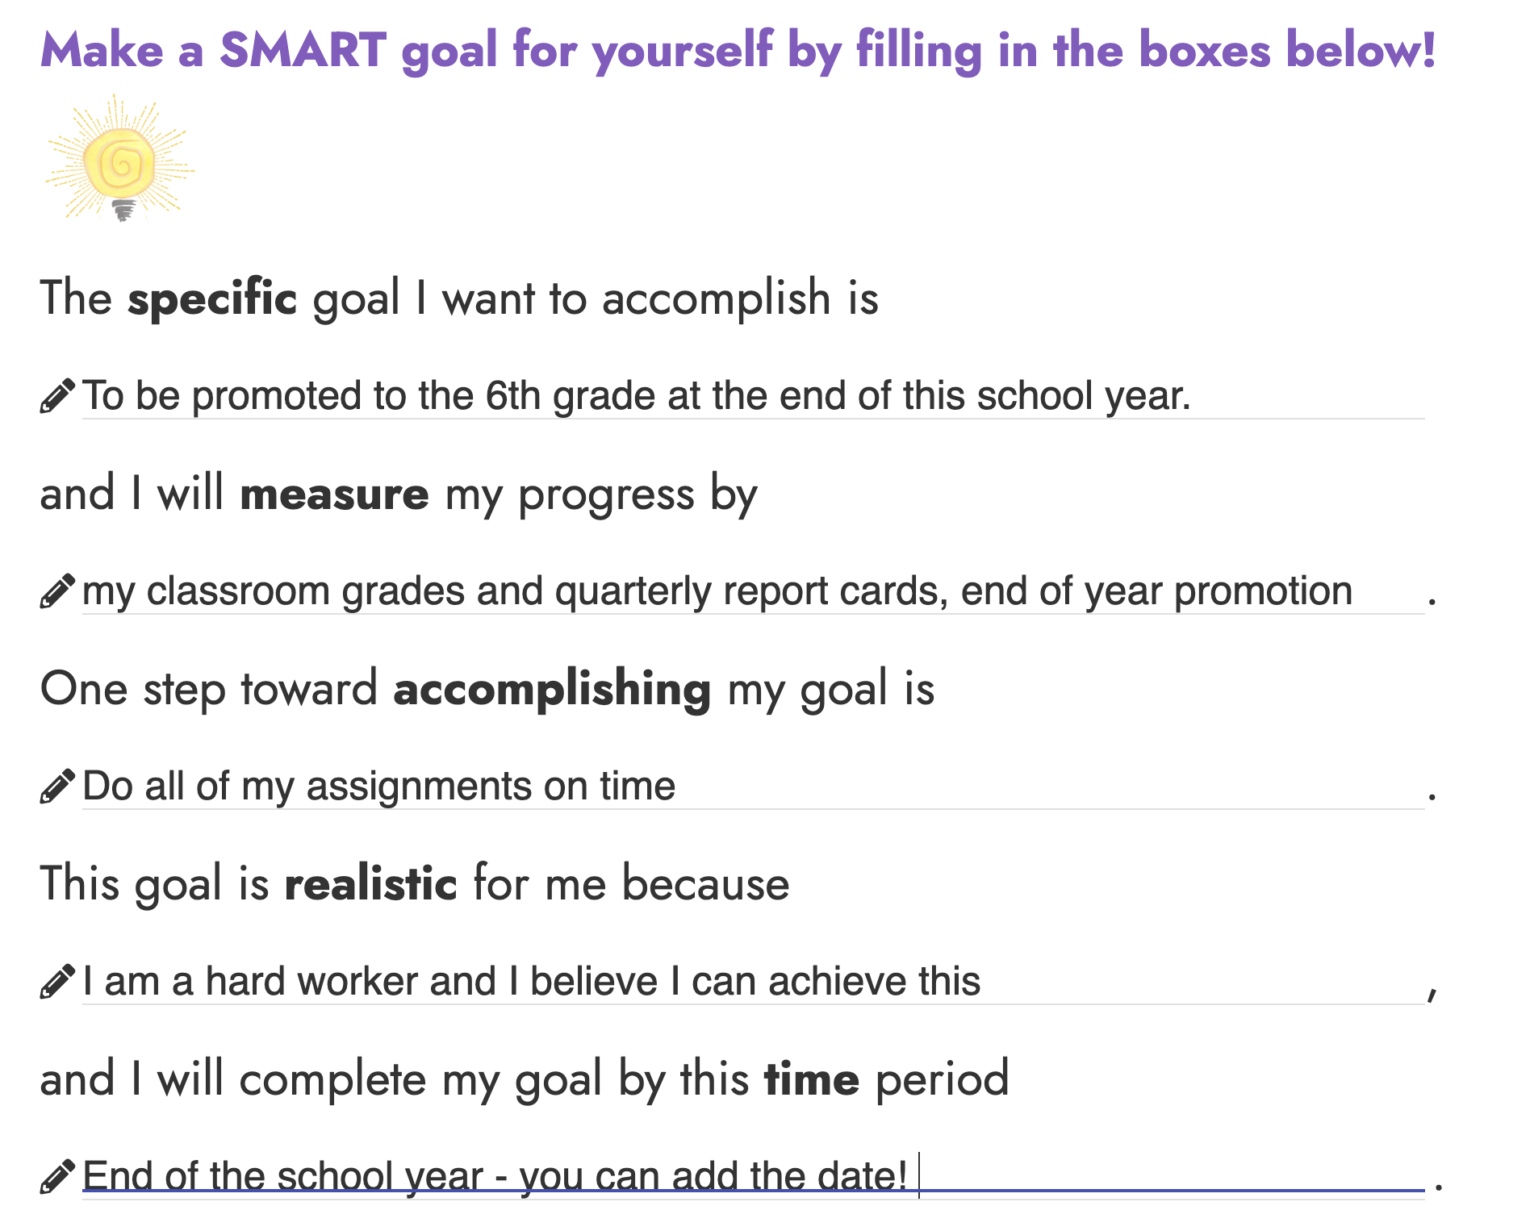
Example

Slide 11
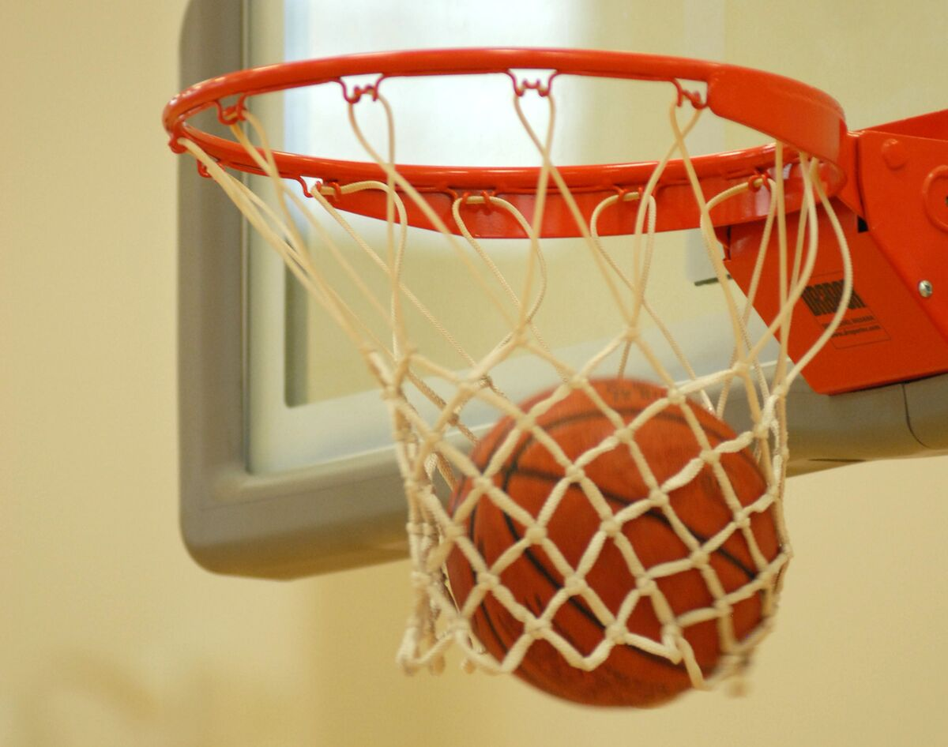
Activity
*Please see lesson plan
For activity details
This Photo by Unknown Author is licensed under CC BY-SA
Notes:
See lesson plan – using the basketball and hoop as a part of an object lesson demonstrate that the more steps we take toward our goal, the easier it is to reach.

Slide 12

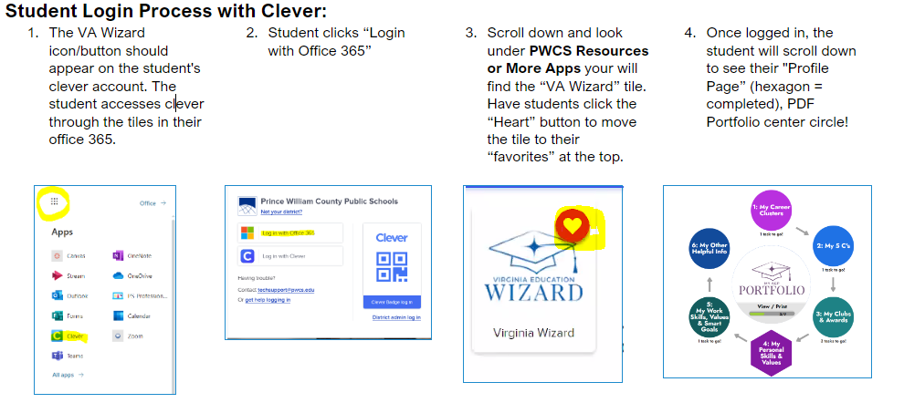
Log Into VA Wizard
Use Chrome Internet Browser
Notes:
School Counselor Demo: https://www.vawizard.org/wizard/home
Student Demo Account for Lesson on Smart Board: (CASE SENSATIVE)
Generic login: K5Wizard
Password: K5Wizard!
Troubleshooting Errors: (switch browsers chrome to edge or vice versa)
If your students have an issue when logging into VA Wizard with Clever (HTTP Status 500 internal server error) you will need to update Chrome to resolve the issue.
Here's how to update individual computers:
To update Google Chrome:
On your computer, open Chrome.
At the top right, click More .
Click Help. About Google Chrome.
Click Update Google Chrome. Important: If you can't find this button, you're on the latest version.
Click Relaunch.

Slide 13
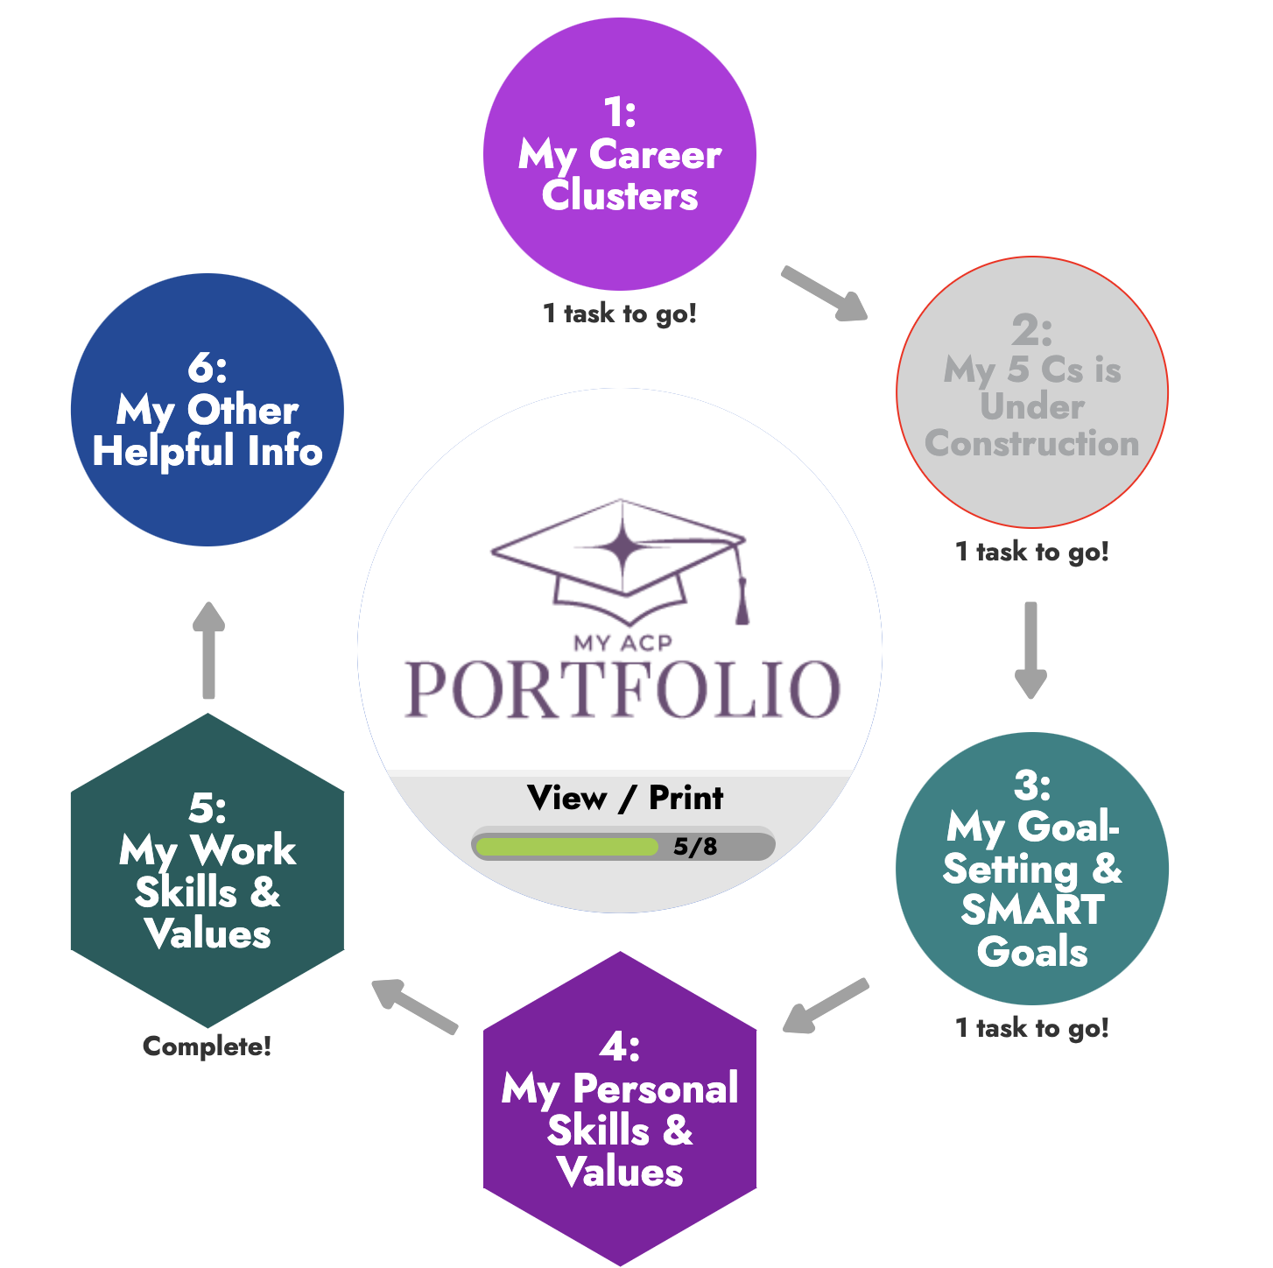
When you finish a module, the CIRCLE changes to a HEXAGON!
Click

Slide 14
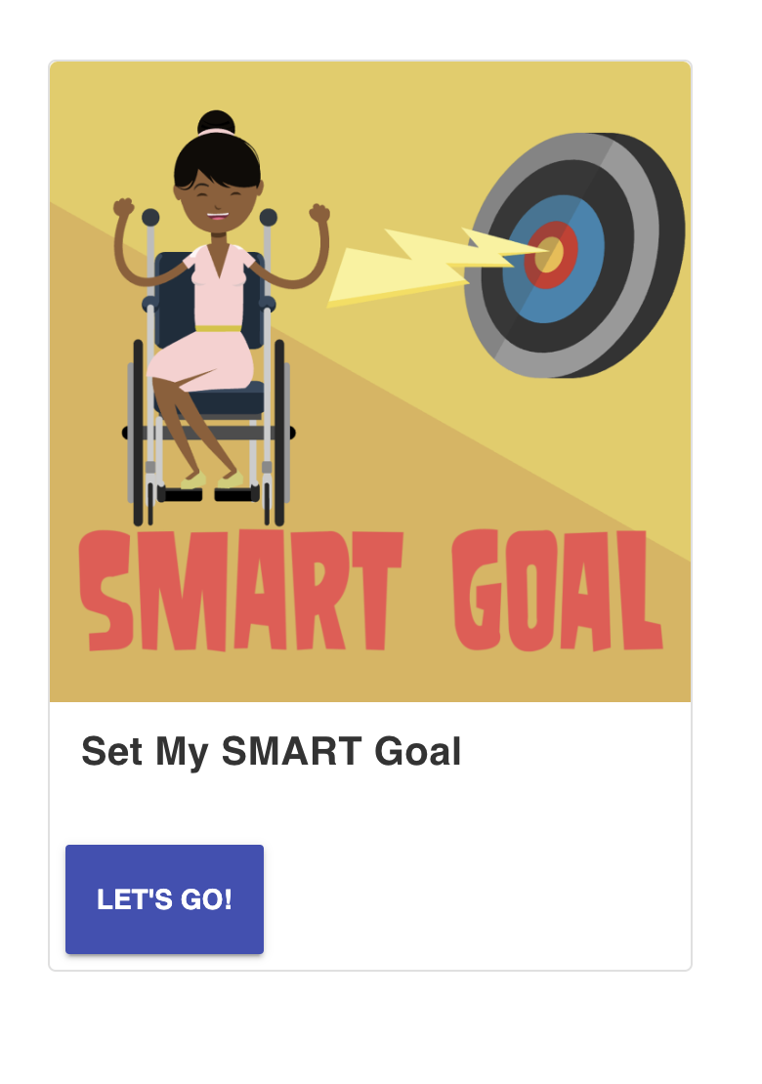
Click “Let’s Go!”
Second Step
5th Grade SMART Goal

Slide 15

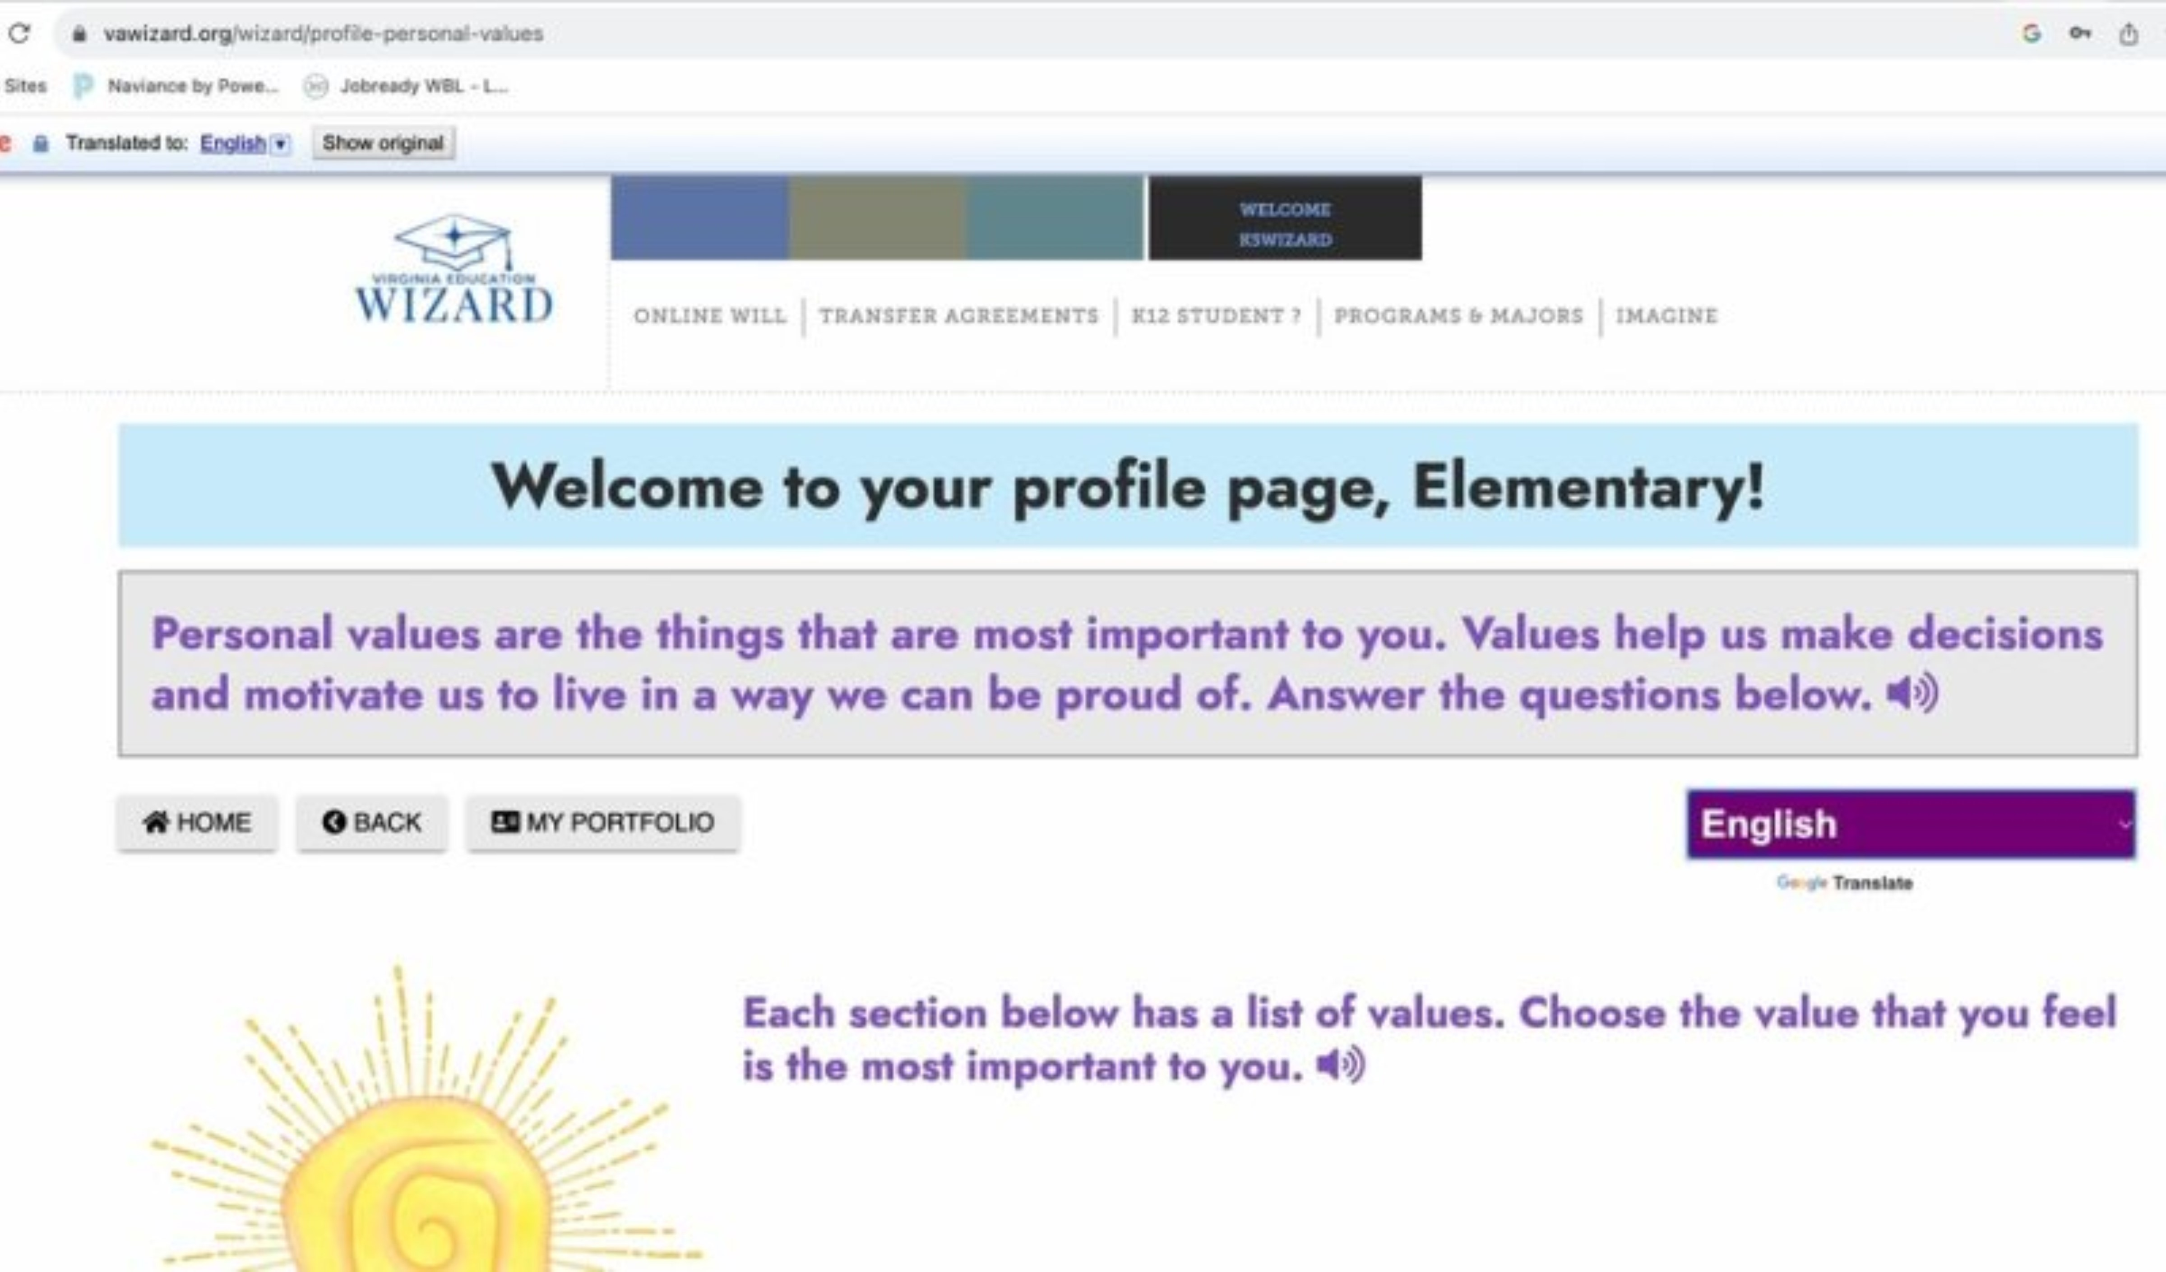
How to change the language in VA Wizard:
Notes:
Optional slide – your students will most likely be very familiar with VA Wizard by the 5th grade, but they are here if you feel they are needed or helpful

Slide 16

Example
Remember to SAVE when complete!

Slide 17

Learning Objectives
ASCA Mindsets and Behaviors
  B-LS 7. Long- and short-term academic, career and social/emotional goals
YOU DID IT!!!
Student will be able to:
  Set a personalized goal with all the components of a SMART goal.

