Slide 1
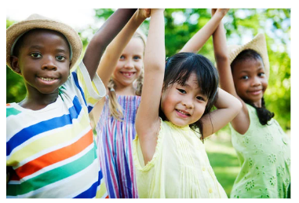
Friendship Unit K-1st
Notes:
Unit Cover Slide

Slide 2
Friendship Unit
Lesson #1: “I Do”
Friendship Foundations
Notes:
Greet students and introduce topic.
(2 Minutes)

Slide 3
Learning Objectives
Students will demonstrate an understanding of the key concepts of “friend” and friendship.”
Students will identify characteristics of a good friend/healthy friendship.
Students will gain exposure to preliminary conflict-resolution concepts/strategies and how to navigate challenging friendship dynamics.
Notes:
Go over objectives and provide examples.
(3 Minutes)

Slide 4
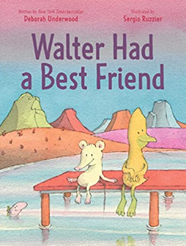
Agenda: What are we doing today?
I Do
Introduction - Story/ Book: Walter Had a Best Friend
Discussion: Key words/ concepts
Video: Berenstain Bears Trouble with Friends
Activity (Art In Counseling): Class Friendship Book
Key Words
Friend
Friendship
Key Concepts
How do we make friends?
What are some ways to be a good friend?
Notes:
Go over agenda for lesson and answer questions.
(3 minutes)

Slide 5
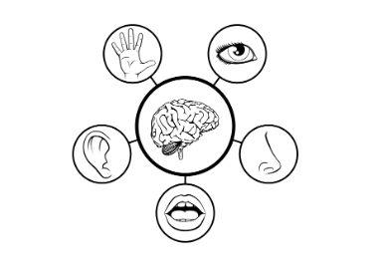
Lesson Expectations: 5 Senses
Eyes: On me!
Ears: Open and listening!
Lips: Zipped, closed, and quiet!
Hands: In your lap and to yourself!
Nose: Out of your neighbor’s business!
(As a class family, you do SUCH a good job taking care of others, during our lesson, you get to take a “break” and I will take care of everyone!)
Notes:
Go over expectations and provide examples.
(3 Minutes)

Slide 6
Discussion
Key Words
Friend - A person you trust and like to be around.
Friendship - Being friends with someone.
Key Concepts
How do we make friends?
What are some ways to be a good friend?
Notes:
(7 Minutes)- Discuss with group
Key Words- (2 Minutes)
Key Concepts (3 minutes)

Slide 7
Story/Book
Notes:
Read story and stop to process. (15 Minutes) **NO VIDEO LINK OF STORY AVAILABLE**

Slide 8
The Berenstain Bears Video: Trouble with Friends
Notes:
Show video and stop to process. (15 Minutes)

Slide 9
Brain Break Time!
Notes:
Brain Break

Slide 10
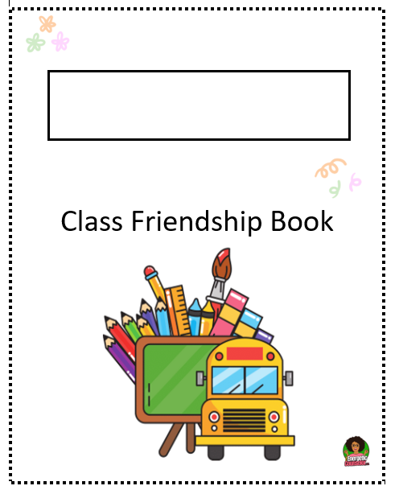
Activity
Class Friendship Book
Notes:
Directions: Class Friendship Book (10 Minutes)
Fill the classroom teacher’s name in the box on the cover page. *Go over what each page of the book means.*
Distribute one of the five pages, as evenly as possible, throughout the class.
Have students illustrate examples of each of the friendship qualities/ characteristics on the pages.
*For pre- readers, it may be helpful to group students or distribute the same pages in groups. This way, you can read and give instructions on what to illustrate to each group.

Slide 11
Closing
1) What was your favorite part of this lesson?
2) What will you remember about this lesson?
Notes:
Process/ Closing: (5 Minutes)
As time allows, have students share answers to the questions on the slide.
Encourage students to be your “newsletters and cheerleaders” and talk about, with their families, the Class Friendship Book they helped draw/create.
Encourage Students to share what they learned, about today’s lesson, with their families.

