Slide 1
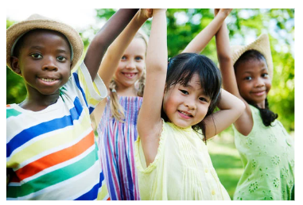
Friendship Unit 2nd-3rd
Lesson #1: “I Do”
Friendship Foundations
Notes:
Greet students and introduce topic.
(2 Minutes)

Slide 2
Lesson Expectations
Students will demonstrate an understanding of the key concepts of “friend qualities/characteristics” and conflict.”
Students will identify characteristics of a good friend/healthy friendship.
Students will gain exposure to preliminary conflict-resolution concepts/strategies and how to navigate challenging friendship dynamics.
Notes:
Go over expectations and provide examples.
(3 Minutes)

Slide 3
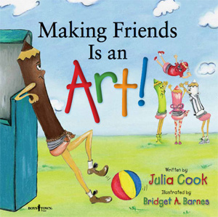
Agenda: What are we doing today?
I Do
Discussion: Key words/ concepts
Story/ Book: Making Friends Is an Art By: Julia Cook
Activity: Problem Solving Card Deck
Key Words
Friendship Qualities/ Characteristics
Conflict
Key Concepts
How do we make friends?
What are some ways to be a good friend?
Notes:
Go over agenda for lesson and answer questions.
(3 minutes)

Slide 4
Lesson Expectations
S: “Sitting Mountain” position! “Mountain Peak” (head) is high in the sky and “Mountain Valleys” (bottom and feet) are grounded.
L: Listening!
A: Attention! (This is different than listening.)
N: Nodding often to show engagement.
T: Not Talking unless I Tell you to and there will be Time for this!- Promise!
Notes:
3rd Grade
Go over expectations and provide examples.
(3 Minutes)

Slide 5
Discussion
Key Words
Friendship Qualities/ Characteristics
Conflict
Key Concepts
How do we make friends?
What are some ways to be a good friend?
Notes:
(7 Minutes)- Discuss with group
Key Words- (2 Minutes)
Key Concepts (3 minutes)

Slide 6
Story/ Book
Notes:
Read story and stop to process. (15 Minutes)

Slide 7
Brain Break Time!
Notes:
Brain Break

Slide 8
Activity
Problem Solving Card Deck
Even great friends may disagree from time to time. This is normal. Let’s learn about some ways to solve problems between friends with this activity!
Notes:
Problem Solving Card Deck (10 Minutes)
Directions:
Go over each problem solving strategy and explain specific instances where that strategy may be useful.
Have students fill their name into the blank and complete the blank card by drawing a picture or writing their favorite problem- solving strategy.
If there is time, have students cut the cards out and staple them together in a “book” form.
Encourage students to put these in a safe place to use anytime!

Slide 9
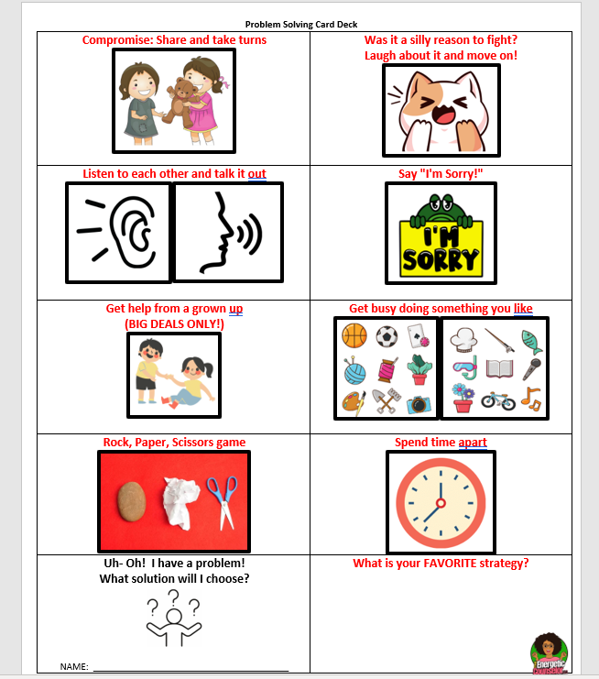

Slide 10
Closing
1) What was your favorite part of this lesson?
2) What will you remember about this lesson?
Notes:
Process/ Closing: (5 Minutes)
As time allows, have students share answers to the questions on the slide.
Encourage Students to share what they learned with their families.

Slide 11
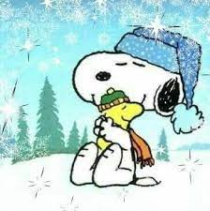
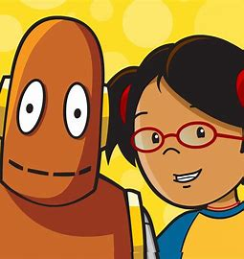
Extras
Winter Friendship Hokey Pokey
(see next slide)
BrainpopJr on Clever.
Type in Friends
Watch video – 4:26

Slide 12
The Winter Friendship Hokey Pokey
You put your right mitten in,
You take your right mitten out.
You put your right mitten in,
And you shake it all about.
You wave at all your friends and turn yourself around,
That's what friendships about!
(Repeat with left mitten, right boot, left boot, warm hat, & snowsuit)

Slide 13
Brain Break Time!
Notes:
Brain Break

