Slide 1
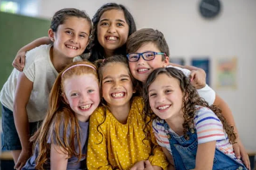
Friendship Unit 4th-5th
Lesson #1: “I Do”
Friendship Foundations
Notes:
Greet students and introduce topic.
(2 Minutes)

Slide 2
Student objectives:
Demonstrate an understanding of the key concepts of “loyalty” and “conflict” as they relate to friendship.
Identify characteristics of a good friend/ healthy friendship.
Gain exposure to preliminary conflict- resolution concepts/ strategies and how to navigate challenging friendship dynamics.

Slide 3
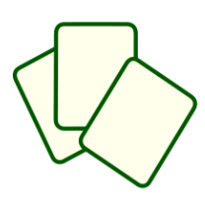
Agenda: What are we doing today?
I Do
Story/ Book: Trouble Talk By: Trudy Ludwig
Discussion: Key words/ concepts
Activity: Problem Solving Card Deck
Key Words
Conflict
Loyalty
Key Concepts
How do you cope/ deal with conflict between you and your friends?
Why is loyalty an important part of friendship?
Notes:
Go over agenda for lesson and answer questions.
(3 minutes)

Slide 4
Lesson Expectations
S: “Sitting Mountain” position! “Mountain Peak” (head) is high in the sky and “Mountain Valleys” (bottom and feet) are grounded.
L: Listening!
A: Attention! (This is different than listening.)
N: Nodding often to show engagement.
T: Not Talking unless I Tell you to and there will be Time for this!- Promise!
Notes:
Go over expectations and provide examples.
Use the ones on this slide or insert your own classroom expectations on the previous slide.
(3 Minutes)

Slide 5
Discussion
Key Words
Conflict
Loyalty
Key Concepts
How do you cope/ deal with conflict between you and your friends?
Why is loyalty an important part of friendship?
Notes:
(7 Minutes)- Discuss with group
Key Words- (3.5 Minutes)
Key Concepts (3.5 minutes)

Slide 6
Story
Notes:
Read story and stop to process. (15 Minutes)
**No video available**

Slide 7
Activity
Problem Solving Card Deck
Even great friends may disagree from time to time. This is normal. Let’s learn about some ways to solve problems between friends with this activity!
Notes:
Problem Solving Card Deck (10 Minutes)
Directions:
Go over each problem solving strategy and explain specific instances where that strategy may be useful.
Have students fill their name into the blank and complete the blank card by drawing a picture or writing their favorite problem- solving strategy.
Have students cut the cards out and staple them together in a “book” form.
Encourage students to put these in a safe place to use anytime! *Leaving a few extra sets with the classroom teacher and encourage the classroom teacher to hold students accountable by asking them “What strategy do you plan to use?” when reporting problems with peers/ friends.

Slide 8
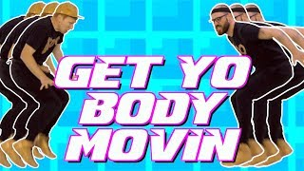

Slide 9
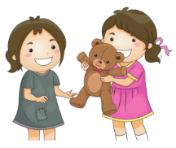
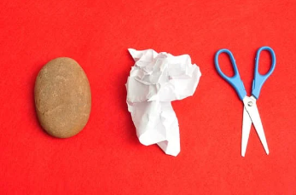
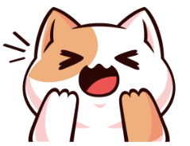
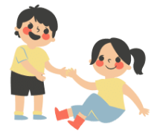

Slide 10
Closing
1) What was your favorite part of this lesson?
2) What will you remember about this lesson?
Notes:
Process/ Closing: (5 Minutes)
As time allows, have students share answers to the questions on the slide.
Encourage students to be your “newsletters and cheerleaders” and share their books with their families.
Encourage Students to share what they learned with their families.

