Slide 1
WHAT TO DO WHEN YOU ARE HOME ALONE

Slide 2
GOT RULES? It is important to set up family rules!
Does your family have a rule for each following situation?
Using the telephone:______
Calling to confirm you are home safely:______
Answering the door:______
Cooking in the kitchen:______
Using the computer:______
Having Friends over:______
Playing outside:_______
Watching TV:_______
Taking care of siblings:_______
Taking care of pets:_______

Slide 3
Can you spot any HAZARDS

Slide 4
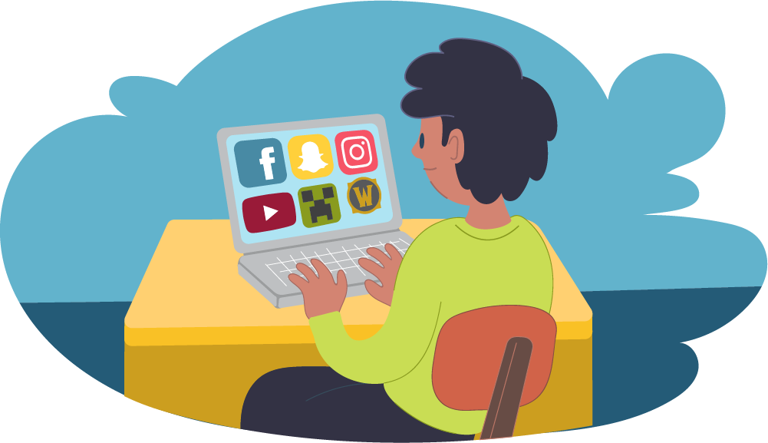
INTERNET SAFETY: TRUE OR FALSE Move the block to reveal the answer.
NEVER AGREE TO MEET AN ONLINE “FRIEND” IN PERSON. TRUE
IT’S OKAY TO RESPOND TO MESSAGES THAT ARE MEAN. FALSE
INFORM YOUR PARENTS IF YOU EXPERIENCE BULLYING ONLINE. TRUE
DO NOT OPEN EMAILS WITH ATTACHEMENTS FROM AN UNKNOWN SENDER. TRUE
I CAN DOWNLOAD ANYTHING WITHOUT ASKING MY PARENTS FALSE
IF SOMEONE ASKS TO MEET YOU, TELL YOUR FAMILY IMMEDIATELY. TRUE
TURN YOUR COMPUTER OFF IF ANYTHING HAPPENS TO MAKE YOU UNCOMFORTABLE AND TELL YOUR FAMILY. TRUE
I CAN SHARE MY PASSWORD WITH MY CLOSE FRIENDS FALSE

Slide 5
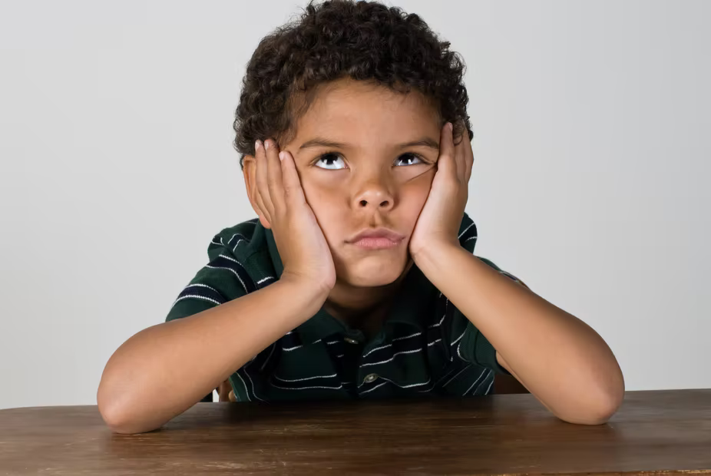
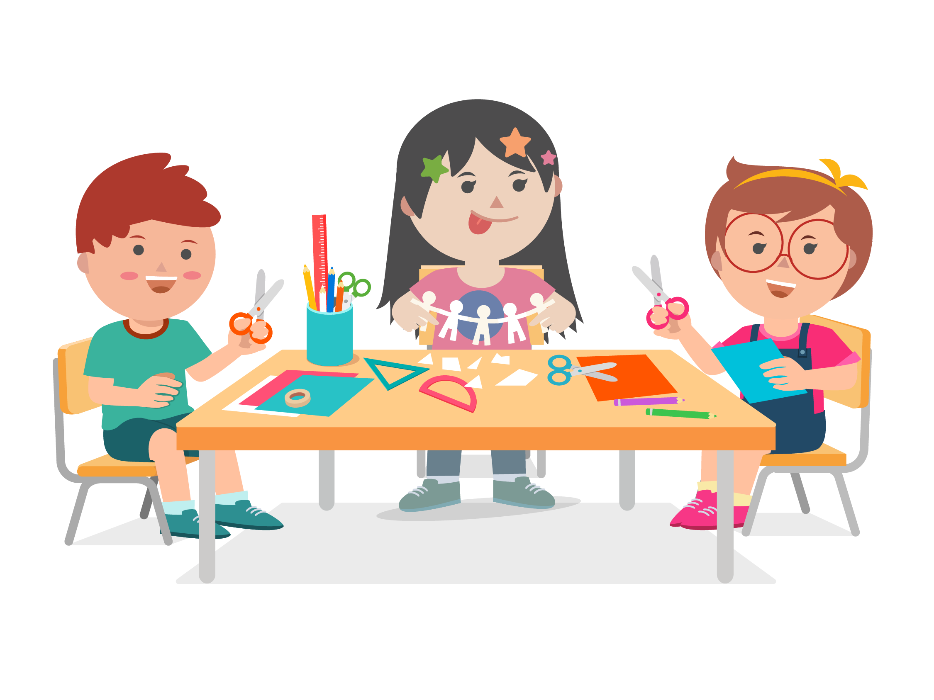
What about BOREDOM?!?
What are some things that you can do while you are at home?
Listen to music
Do a hobby: play an instrument, sports card collection, building models
Brush your pet or teach them a new trick
Read a book
Make a puppet with a sock, bag, or glove
Start a scrapbook with photos
Make up a funny song with a familiar tune
PLay a board/card game
Plan a birthday party

Slide 6
Let’s find out how much you know about FIRST AID.
HOW WOULD YOU HANDLE THE FOLLOWING SITUATIONS?
*move each rectangle to reveal the answer.

Slide 7
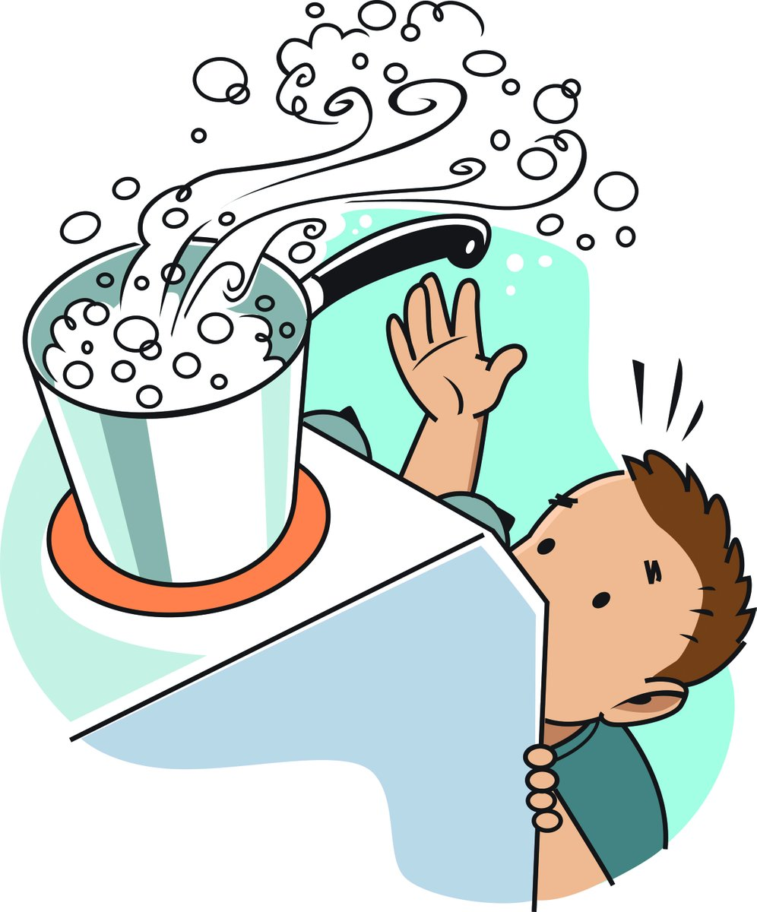
SCENARIO 1 You are boiling water for Mac N’Cheese. You accidentally knocks the pot and the boiling water spills on your arm. What would you do if it is a minor burn?
Run cool water over the area for up to 15 minutes.
Apply pain reliever gel/cream on it.
Clean up any water on the floor.
Be sure to tell one of the grownups in your family.

Slide 8
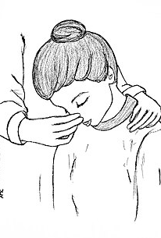
SCENARIO 2 You and your brother are playing together and your nose starts to bleed. What would you do?
Sit upright in a chair or on your lap, then tilt your head slightly forward.
Leaning back can cause blood to go down the back of the throat.
Gently pinch the soft part of the nose with a tissue or clean washcloth for about 10 minutes.

Slide 9
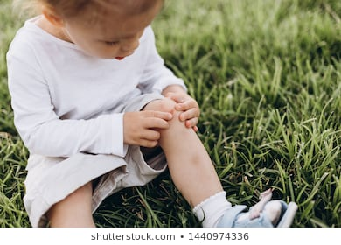
SCENARIO 3 Your sister is running outside and falls on the sidewalk. Her knee is scraped and bleeding. What would you do?
Make sure your hands are clean.
Then, Wash the scrape gently with water.
Apply antibiotic ointment
Apply a bandage

Slide 10
Scenario 4 You are washing dishes and the soap squirts up in your eye.
If a liquid chemical is in the eye, quickly rinse the eye with water for 15 minutes.
Call for help.
If dust or dirt gets in the eye, blink a couple of times to try and remove it. DO NOT rub your eye! If something is in the eye, rubbing can scratch it.
Call for help if the eye is still irritated.

Slide 11
WANT TO MAKE A FIRST AID KIT?

Slide 12
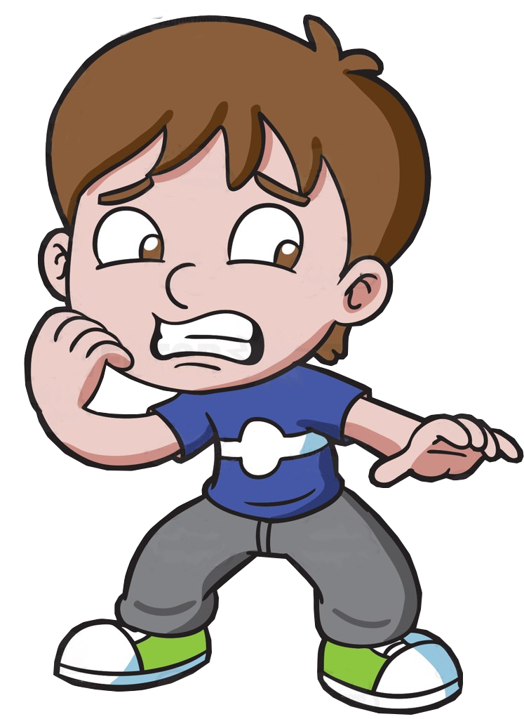
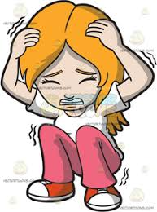
WHAT DO YOU DO IN AN EMERGENCY SITUATION?
CALL 9.1.1

Slide 13
WHEN TO CALL 9.1.1?
When you scrape your knee False
When someone is unconscious (not able to wake up) True
When someone is choking True
When your sister/brother has a minor burn on their leg False
When someone breaks into your house True
When there is a fire True
When someone falls down and not able to move True
When someone has trouble breathing True
*Be sure to let your parents know about any of these situations above.

Slide 14
HOW TO CALL 9.1.1?
*dial 9.1.1 on your phone and be ready to give the following information.
The emergency operator will ask the following questions..
What is the emergency/ what happened?
Where are you/ where do you live?
Who needs help/ who is with you?
Be ready to give the following information.
Your name
Your home address
What happened
Be sure to stay connected with the person on the phone.
They are on their way to help you.
What’s my address?
What’s my phone number?

Slide 15
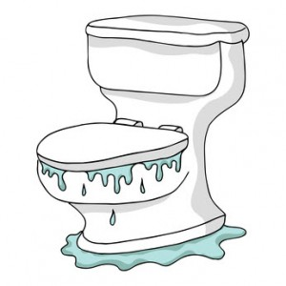
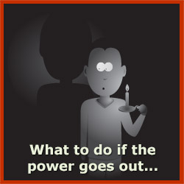
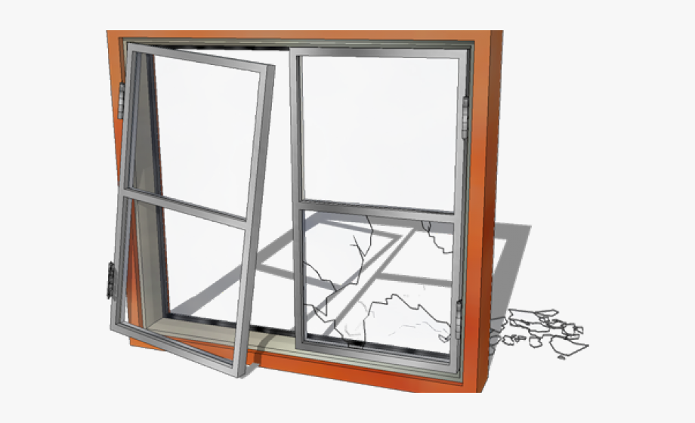
BE READY FOR ANYTHING! MATCH THE PROBLEM WITH THE ANSWER.
Non: Do not change the bulb, this has electrical danger. Turn on another light and tell your family when they get home.
Pipe breaks
Toilet overflows
A light bulb burns out
Electricity goes out
You smell gas
Broken window
Mini: Find the main water valve (Ask your parents where it is), turn it to the right in the off position and call parents.
Mini: Put your shoes on, sweep the glass into a corner, cover the window with cardboard or a blanket and call parents.
Maxi: Get out of the house and call 911.
Mini: Find a flashlight to use, NEVER light candles, this is a fire hazard. Call parents if phone working.
Mini: Shut off the water to the toilet(Ask your parents where it is), try to unstop it with a plunger, turn on the water and flush. If it still is not working, turn off the water and call parents. Clean up any water with old towels.

