Slide 1
Career Exploration/ Awareness Unit K and 1st
Lesson #1: “I Do”
Goal Setting
Notes:
Greet students and introduce topic.
(2 Minutes)

Slide 2
Agenda: What are we doing today?
Introduction:
Agenda
Lesson Expectations
Story/ Video:
7 Habits of Happy Kids:
Begin with the End in Mind
“Goob and the Bug Collecting Kit”
Skill/Practice: Worksheet/ Activity: Setting Goals Can be a PICKLE!
Discussion: Share goals!
Agenda: What are we Doing Today?
Notes:
Go over agenda for lesson and answer questions.
(3 minutes)

Slide 3
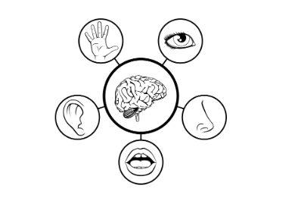
Lesson Expectations: 5 Senses
Eyes: On me!
Ears: Open and listening!
Lips: Zipped, closed, and quiet!
Hands: In your lap and to yourself!
Nose: Out of your neighbor’s business!
(As a class family, you do SUCH a good job taking care of others, during our lesson, you get to take a “break” and I will take care of everyone!)
Notes:
Go over expectations and provide examples.

Slide 4
Career Exploration/ Awareness Unit
Notes:
What does “career” mean?

Slide 5
Introduction: Story/ Video
7 Habits of Happy Kids:
Begin with the End in Mind
“Goob and the Bug Collecting Kit”
Notes:
Discussion/ Guiding Questions: (10 minutes) *Stop and start throughout the video/ story.
What is a goal?
What does Goob want?
What does to do te get what he wants?
What does it mean to EARN something?
What happened to Jumper? Why?

Slide 6
Brain Break!

Slide 7
Activity- Goal Setting Practice
Setting Goals Can be a PICKLE!
Notes:
Setting Goals Can be a PICKLE! (15 Minutes)
Read directions aloud and complete the top (sweet pickle) section and the bottom (sour pickle) section one at a time. Encourage students to color their pictures. Allow 5 minutes of work for each section. (15 minutes) *2.5 minutes for directions and five minutes of work time in each section Tip: Play some fun music during independent work time!

Slide 8
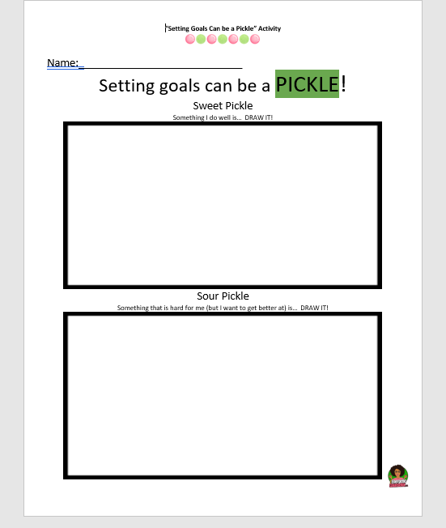
Activity- Goal Setting Practice
Setting Goals Can be a PICKLE!
Notes:
Setting Goals Can be a PICKLE! (15 Minutes)
Read directions aloud and complete the top (sweet pickle) section and the bottom (sour pickle) section one at a time. Encourage students to color their pictures. Allow 5 minutes of work for each section. (15 minutes) *2.5 minutes for directions and five minutes of work time in each section Tip: Play some fun music during independent work time!

Slide 9
Discussion
Share!:
What was your sweet pickle? (Strength)
Share!:
What was your sour pickle?
(Goal)
Notes:
Discussion: (5 Minutes)
As time allows, have students share answers to these questions.

Slide 10
Closing
1) What was your favorite part of this lesson?
2) What will you remember about this lesson?
Notes:
Process/ Closing: (5 Minutes)
As time allows, have students share answers to the questions on the slide.
Encourage students to be your “newsletters and cheerleaders” and share what they learned with their families.

