Slide 1

My interests, skills and abilities
Second grade Career Exploration Lesson using VA Career Wizard

Slide 2

Learning Objectives
Identify personal skills, interests and abilities.
Define skills, interests and abilities and understand how these relate to careers.

Slide 3
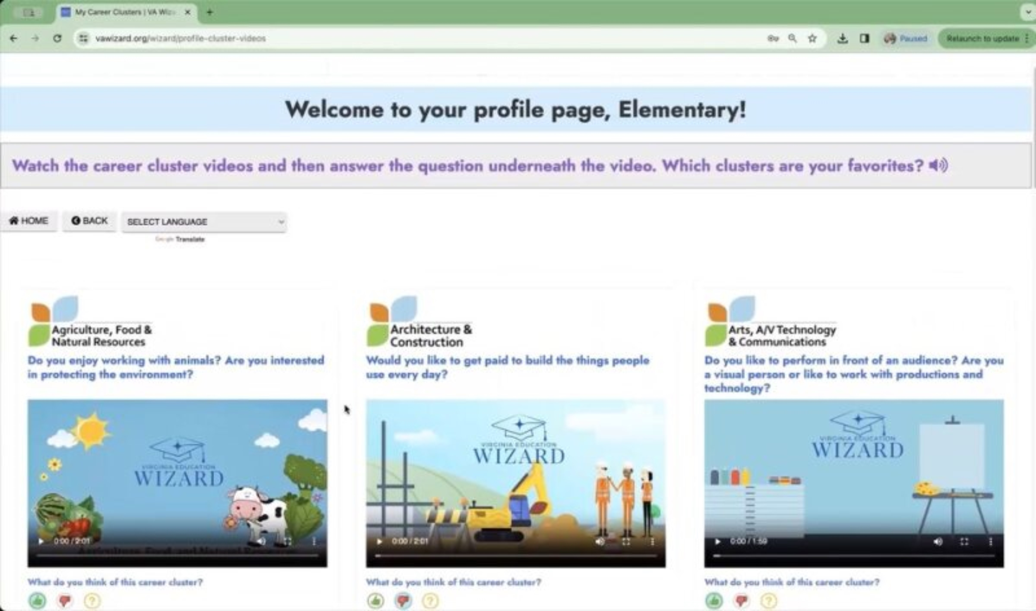
What is VA Wizard?
Optional 7 min video while students get logged in
Notes:
This slide is optional – but you may show students the video to introduce VA Wizard if that is helpful

Slide 4


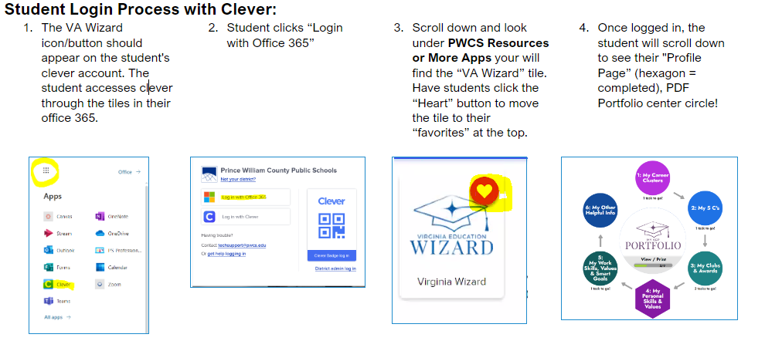
Log Into VA Wizard
Use Chrome Internet Browser
Notes:
School Counselor Demo: https://www.vawizard.org/wizard/home
Student Demo Account for Lesson on Smart Board: (CASE SENSATIVE)
Generic login: K5Wizard
Password: K5Wizard!
Troubleshooting Errors: (switch browsers chrome to edge or vice versa)
If your students have an issue when logging into VA Wizard with Clever (HTTP Status 500 internal server error) you will need to update Chrome to resolve the issue.
Here's how to update individual computers:
To update Google Chrome:
On your computer, open Chrome.
At the top right, click More .
Click Help. About Google Chrome.
Click Update Google Chrome. Important: If you can't find this button, you're on the latest version.
Click Relaunch.

Slide 5
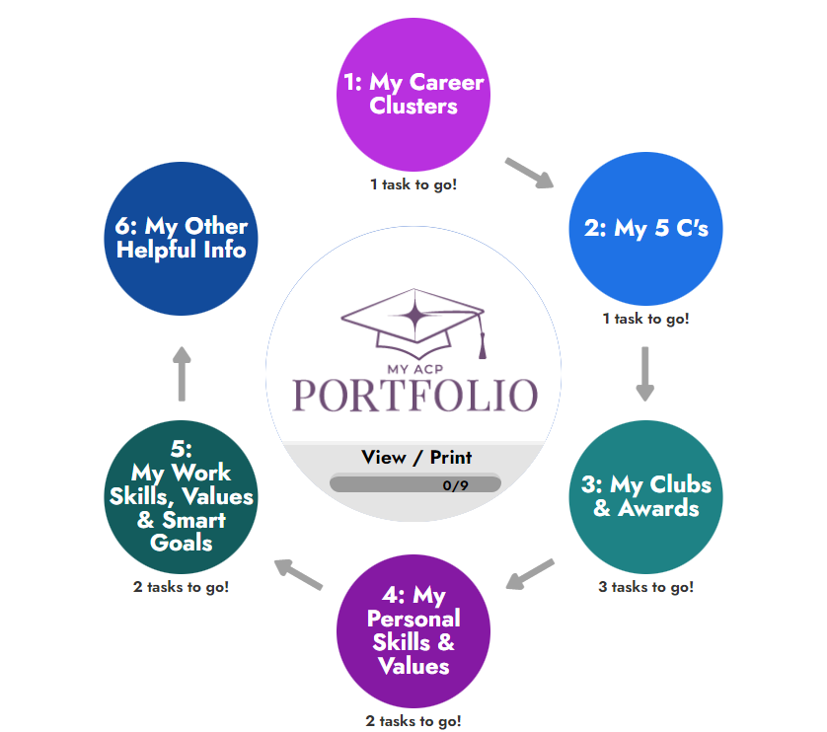
Log in

Slide 6
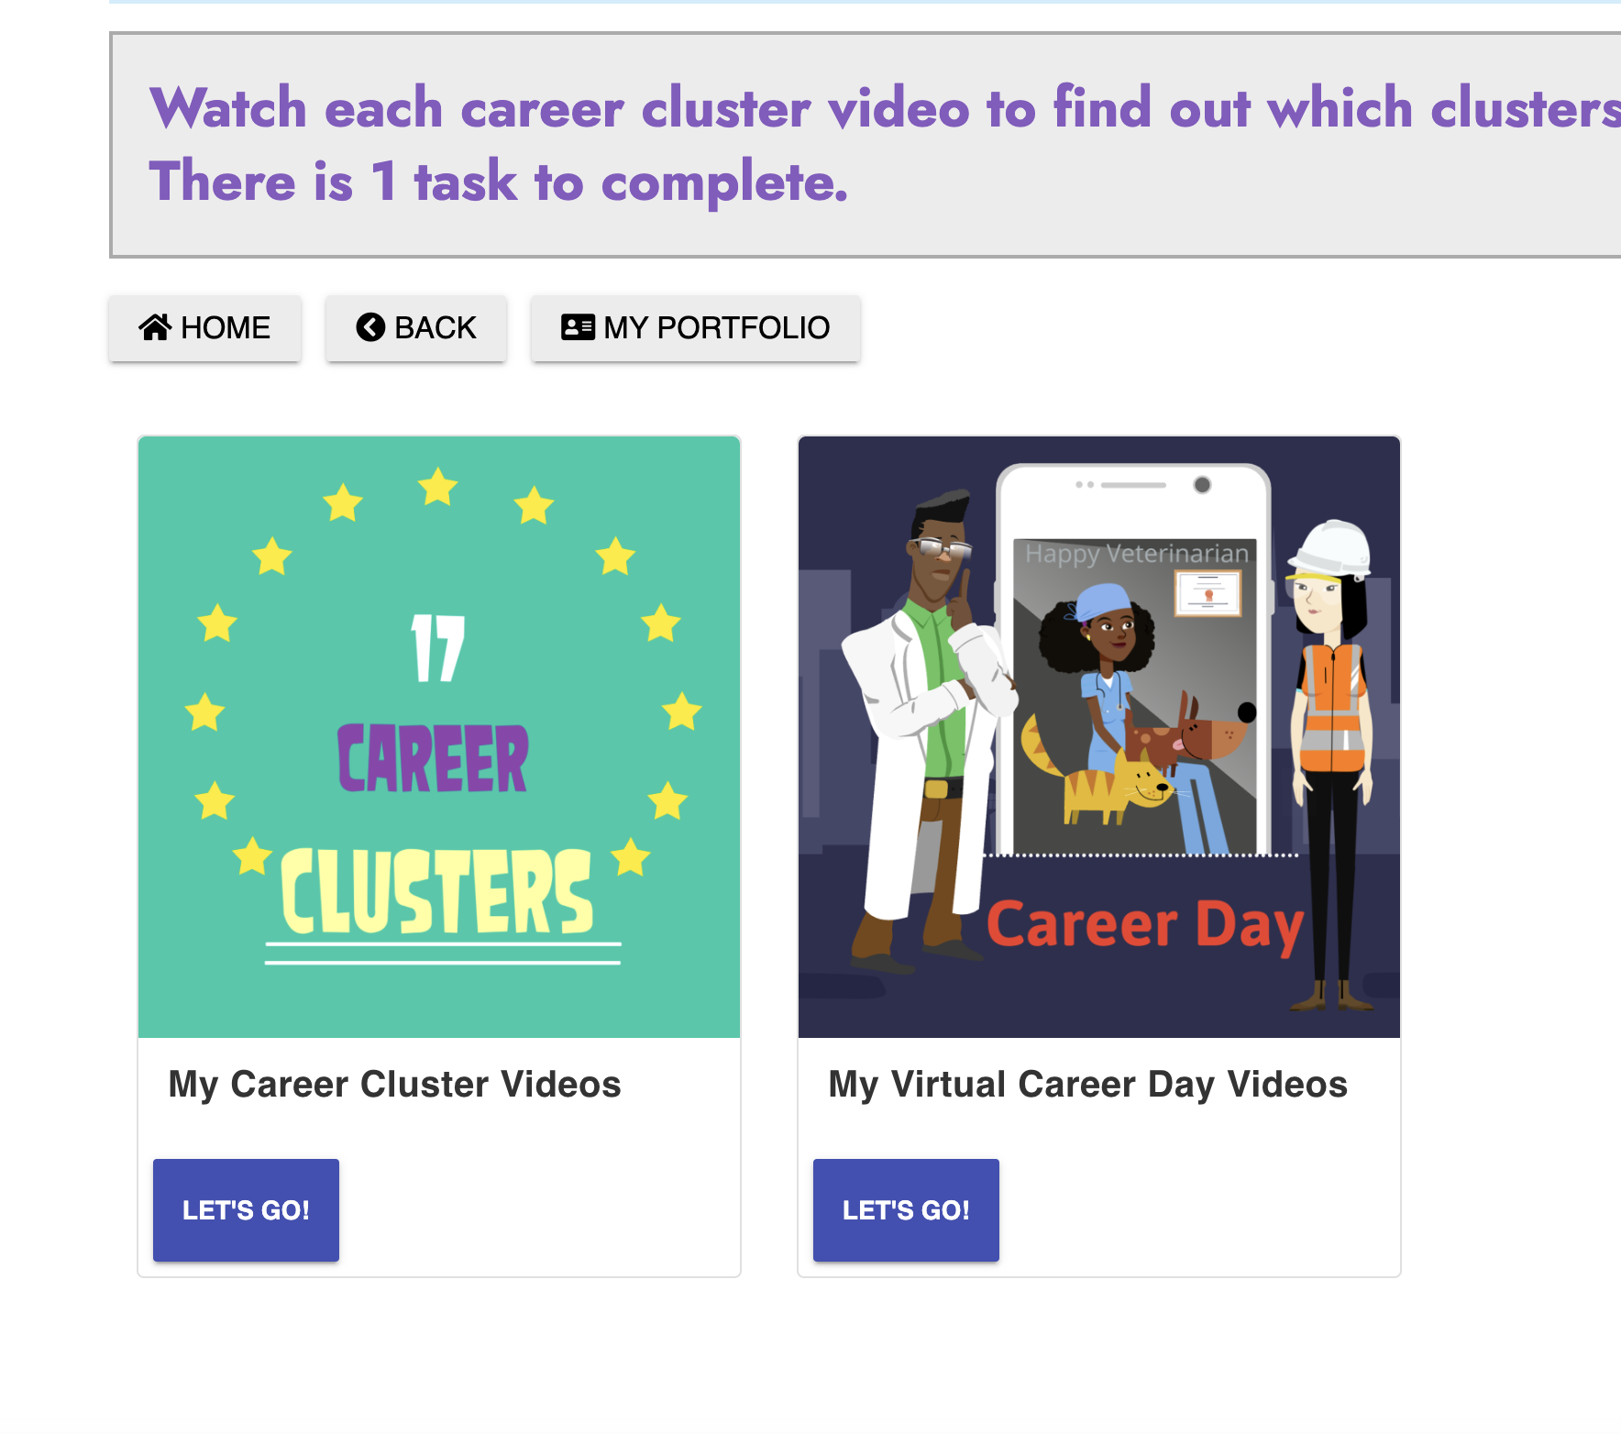
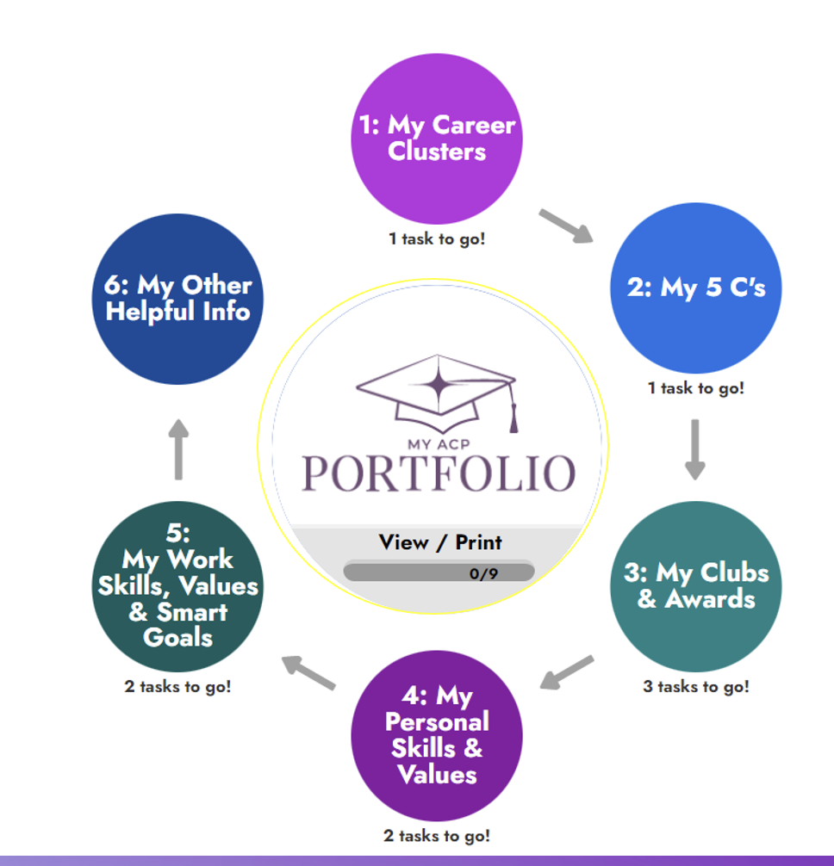
How to access videos
1. Click on my career clusters.
2. Click on “Let’s Go” for 17 Career Clusters.
Notes:
It may be easiest to play the video on the SMART board and have each student play the video on their screen with the speakers muted – they can only answer the question if the video has played through.

Slide 7

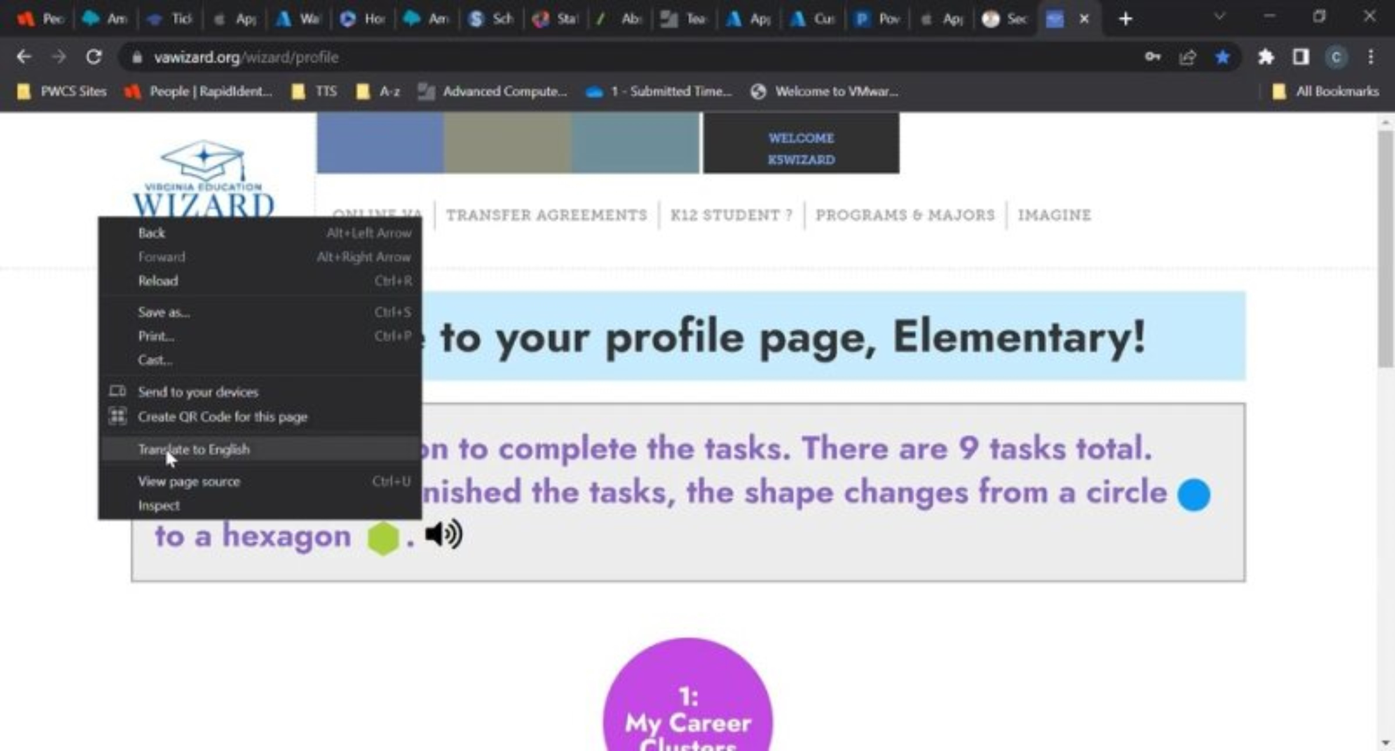

How to change the language in VA Wizard:
Video is only spoken in English
Notes:
Optional slide – your students will most likely be very familiar with VA Wizard by the 5th grade, but they are here if you feel they are needed or helpful

Slide 8
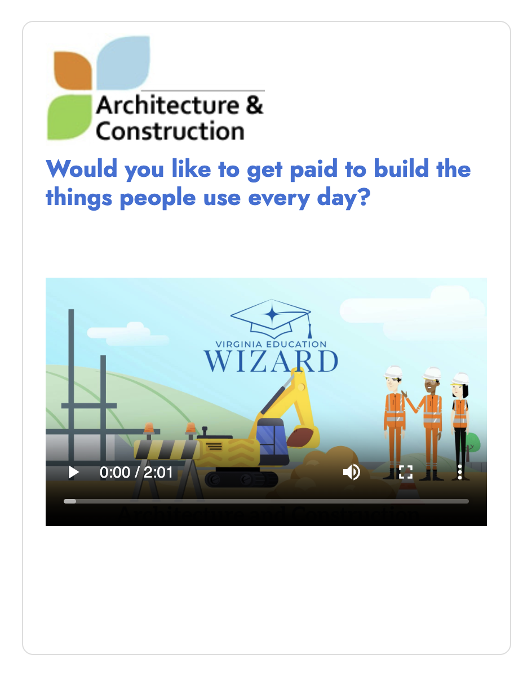

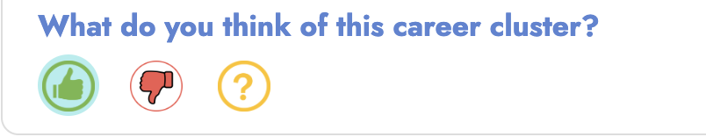
Practice time!
Let’s watch this one together and answer the question!
Now try one more, together!
Remember to answer the question!

Slide 9
What are interests?
An interest is something that you like; something that gets your attention.
Let’s find out some of the interests of our class.

Slide 10
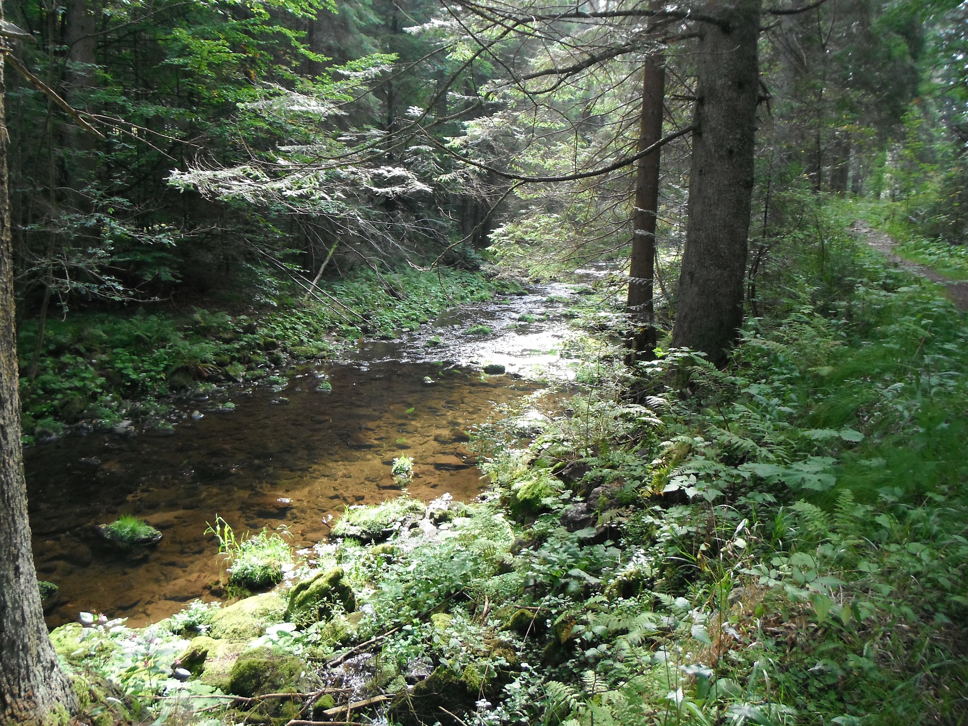

Left side Right side
Being outside in nature
Staying indoors
Notes:
Ask students to walk to the side of the room for the thing that interests them. If neither interest them, they may remain in the middle (neutral area). Have a couple of students share what exactly about that choice interests them

Slide 11


Left side right side
This Photo by Unknown Author is licensed under CC BY-NC-ND
Music
Sports

Slide 12

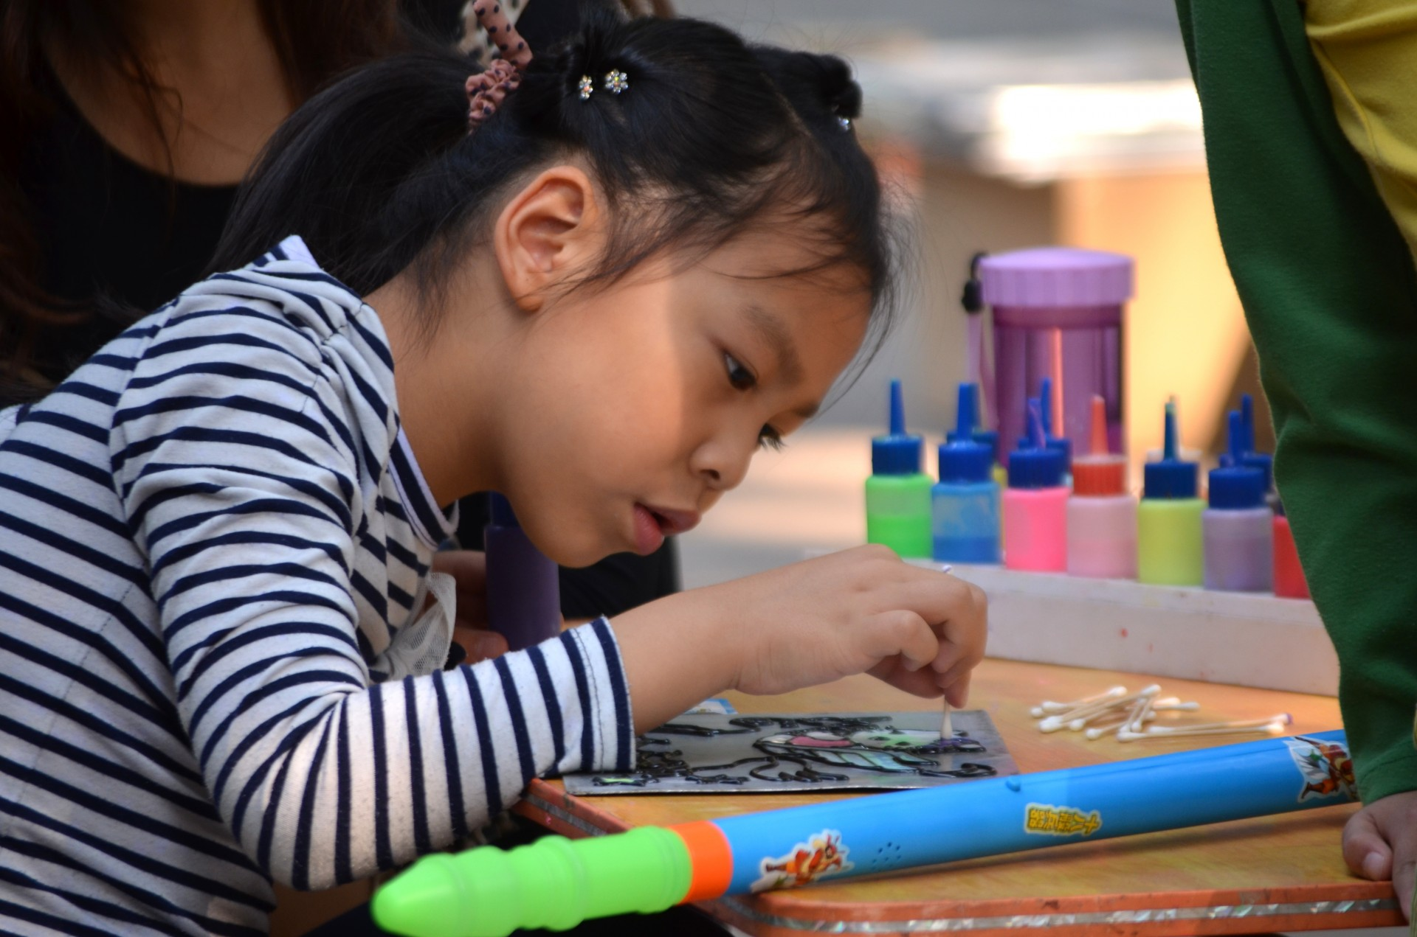
Left side right side
Watching TV shows or movies
Creating art projects

Slide 13

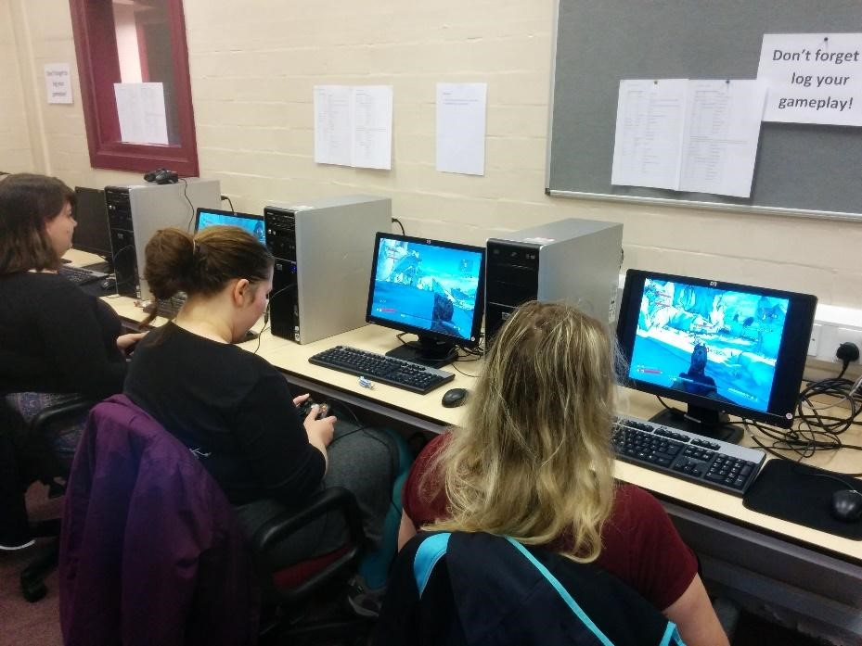
Left side right side
Reading a book
This Photo by Unknown Author is licensed under CC BY
Using Technology

Slide 14
How might our interests impact our career choices?
Notes:
Give some examples: If am interested in nature, I may consider a career that has me outdoors (landscape architect, park ranger, construction, protecting the environment). Remind students that this was just a small sample, but they can each explore their own interests as they become aware of them

Slide 15
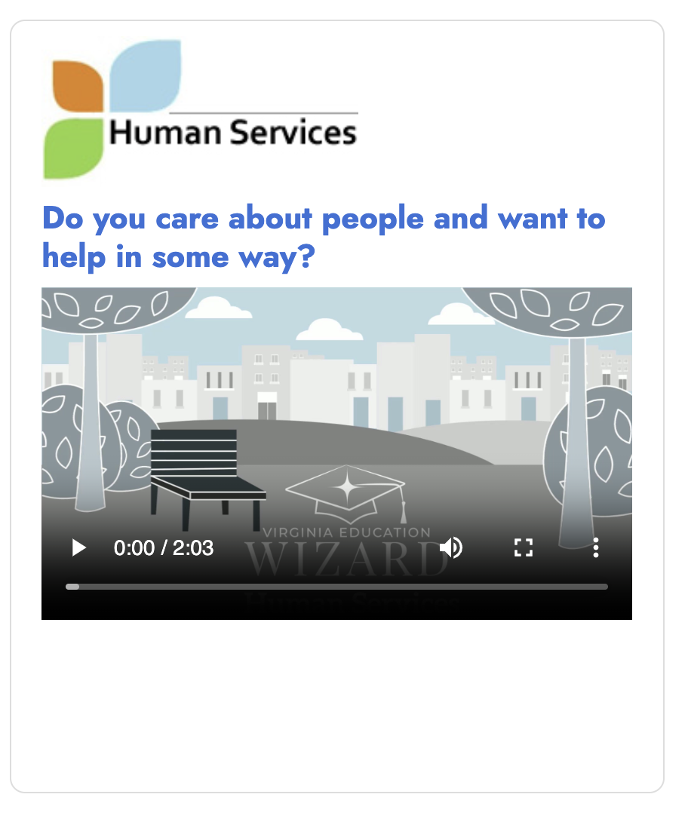
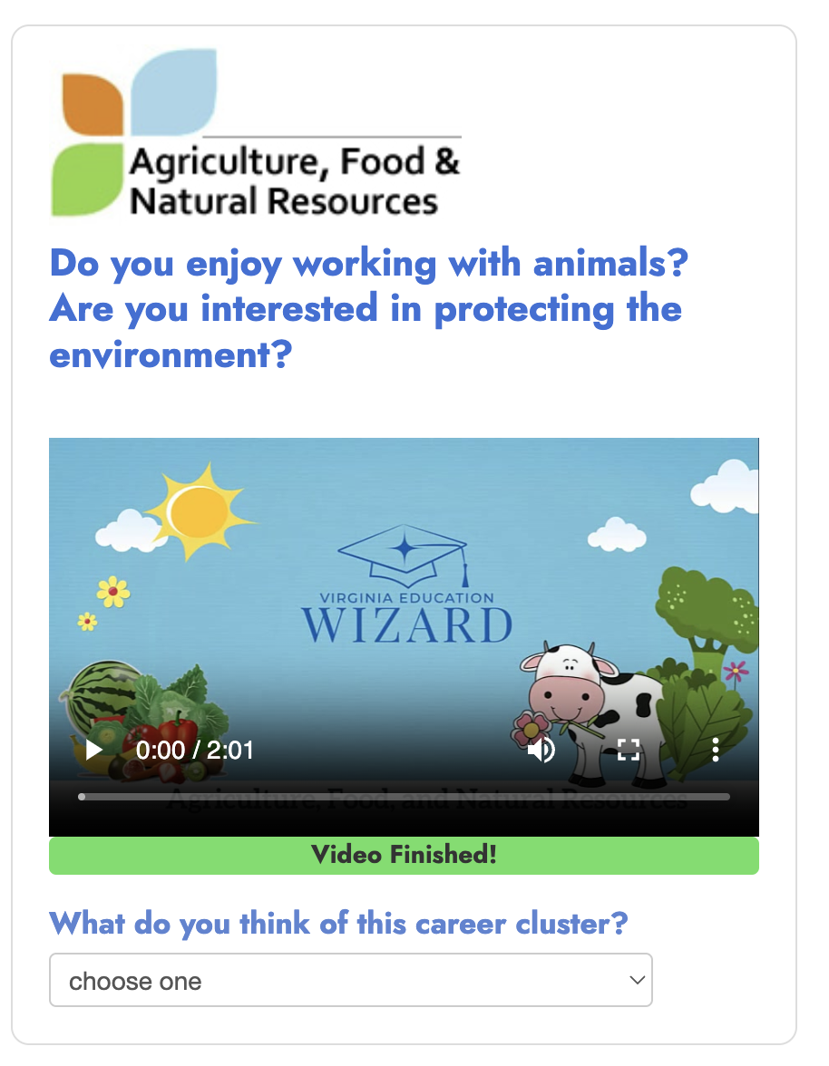
Career Cluster Videos
Notes:
Ask students to watch the 1st career clusters video, agriculture, food and natural resources and then answer the question below the video – you can play on the SMART board but every student will still need to play through the video on their computer in order to get the question prompt. Follow with the Human Services video

Slide 16
What are skills?
Skills are things you are able to do, but they are things that you can learn and develop with time and practice.
  Example – handwriting, you have good handwriting now, but if we compared that to when you were 4… you have learned and developed it over time. The more you use this skill, the better you will become at it.
  Let’s do another class activity to find out some of our skills.

Slide 17

Fist of 5
5- I have this skill.
3 – I’m working on it .
1- I do not have this skill.
This Photo by Unknown Author is licensed under CC BY-SA

Slide 18
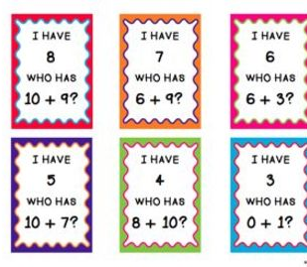
Addition facts
Fist of 5:
5- I have this skill.
3 – I’m working on it .
1- I do not have this skill.
This Photo by Unknown Author is licensed under CC BY-NC-ND

Slide 19






Athletic skill
Fist of 5:
5- I have this skill.
3 – I’m working on it .
1- I do not have this skill.
This Photo by Unknown Author is licensed under CC BY-NC

Slide 20

Listening without interrupting
Fist of 5:
5- I have this skill.
3 – I’m working on it .
1- I do not have this skill.
This Photo by Unknown Author is licensed under CC BY-NC

Slide 21

Solving conflict
Fist of 5:
5- I have this skill.
3 – I’m working on it .
1- I do not have this skill.
This Photo by Unknown Author is licensed under CC BY-NC-ND

Slide 22

How might our skills impact our career choices?

Slide 23
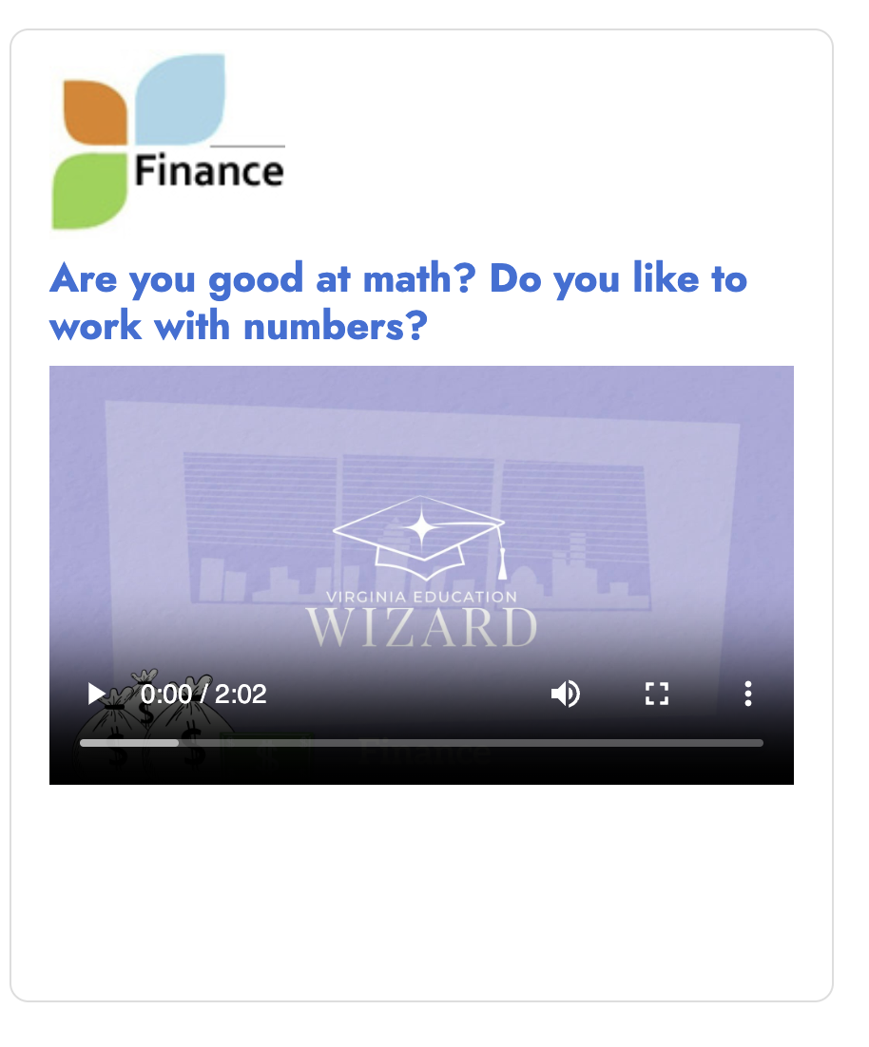
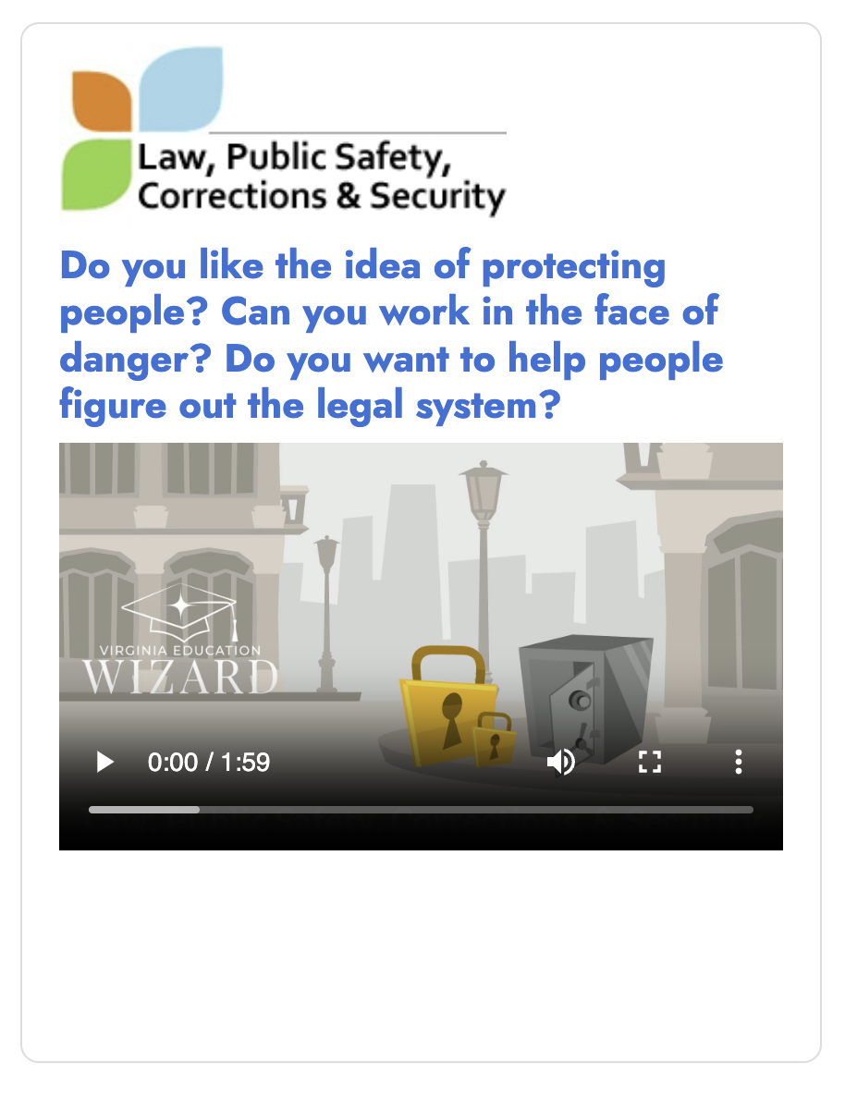
Career Cluster Videos
Notes:
Ask students to watch the 1st career clusters video, finance and then answer the question below the video – you can play on the SMART board but every student will still need to play through the video on their computer in order to get the question prompt

Slide 24

Abilities
What is an ability?

Slide 25
Abilities
What is an ability?
  Something you are able to do physically or mentally.
  Many abilities are innate, and while they can be improved with practice and instruction (like a skill), an ability usually comes naturally to you.
  What are some abilities we have in our classroom?

Slide 26

Stand up if you have this ability
Leadership

Slide 27

Stand up if you have this ability
Good Communication
Notes:
Do you communicate ideas clearly, do you enjoy speaking to others. Can you put your ideas into words that make sense to others

Slide 28

Stand up if you have this ability
MUSICAL ABILITY –SINGING OR PLAYING AN INSTRUMENT.

Slide 29

Stand up if you have this ability:
Running fast.
This Photo by Unknown Author is licensed under CC BY-SA-NC

Slide 30

Stand up if you have this ability
Working well with your hands – creating or building things.

Slide 31

How might our abilities impact our career choices
Running Fast
Working with Your Hands
Musical
Leadership
Communication
This Photo by Unknown Author is licensed under CC BY-SA-NC
Notes:
If you have the ability to lead others, you might enjoy a career in politics, or business. If you have musical abilities you may enjoy a career in composing, writing or performing music.

Slide 32
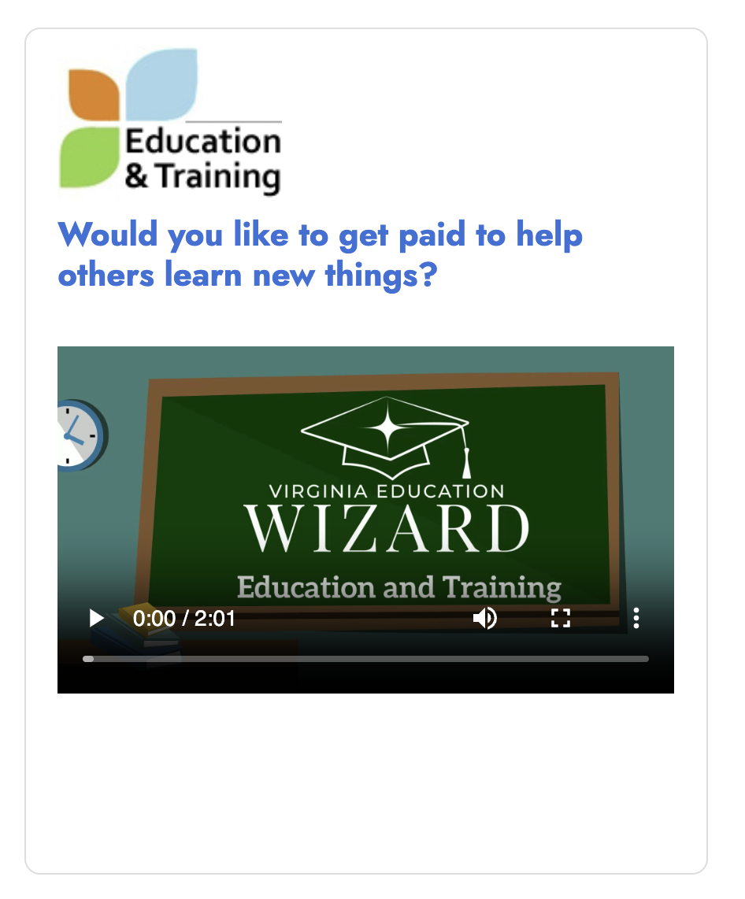
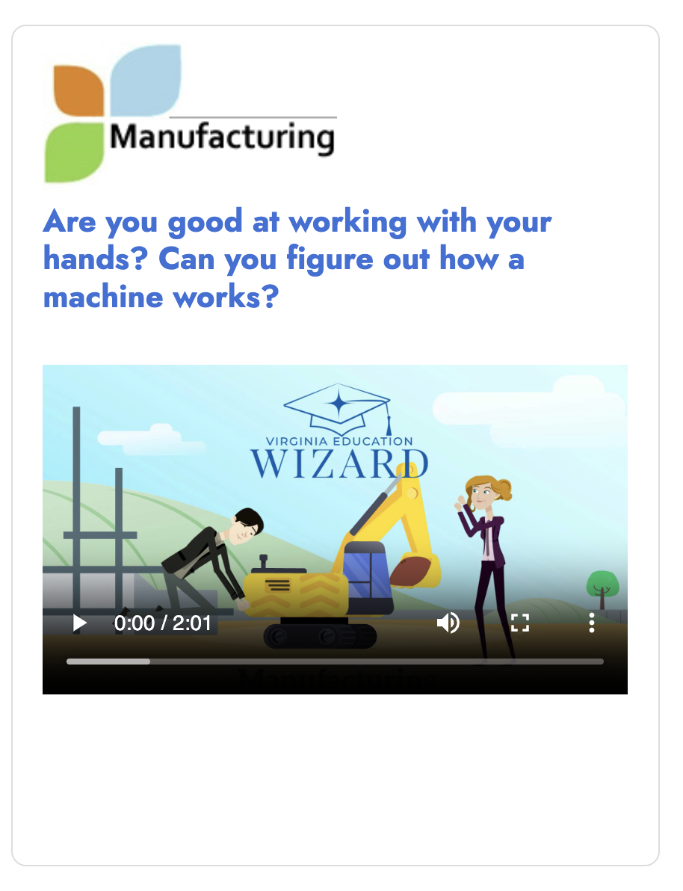
Career Cluster Videos
Notes:
Ask students to watch the 1st career clusters video, manufacturing and then answer the question below the video – you can play on the SMART board but every student will still need to play through the video on their computer in order to get the question prompt

Slide 33

Let’s review!
Interests
Abilities
Skills
Notes:
Ask students to define or give an example of the vocabulary for today’s lesson. Thumbs up for understanding after each one.

Slide 34
Learning Objectives
Identify personal skills, interests and abilities.
Define skills, interests and abilities and understand how these relate to careers.

