Slide 1

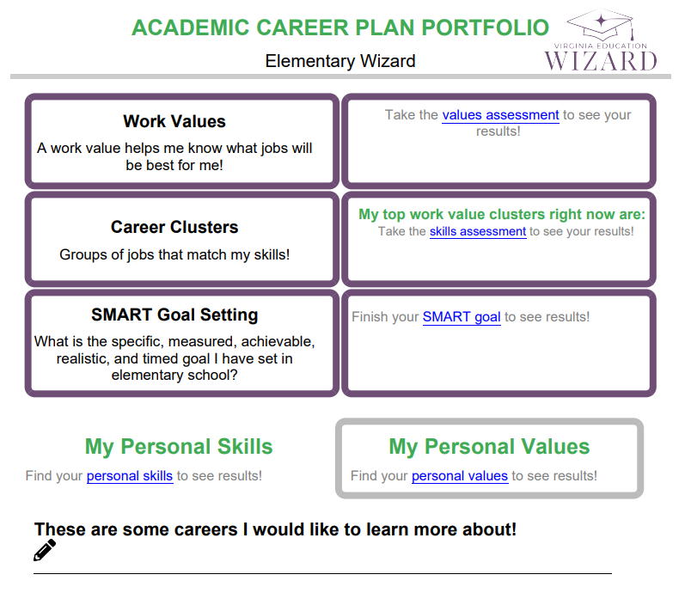
What is an Academic Career Plan Portfolio?
You are the author, and you get to:
Record your interests.
Explore careers.
Better know yourself through values, skills, and goals.

Slide 2
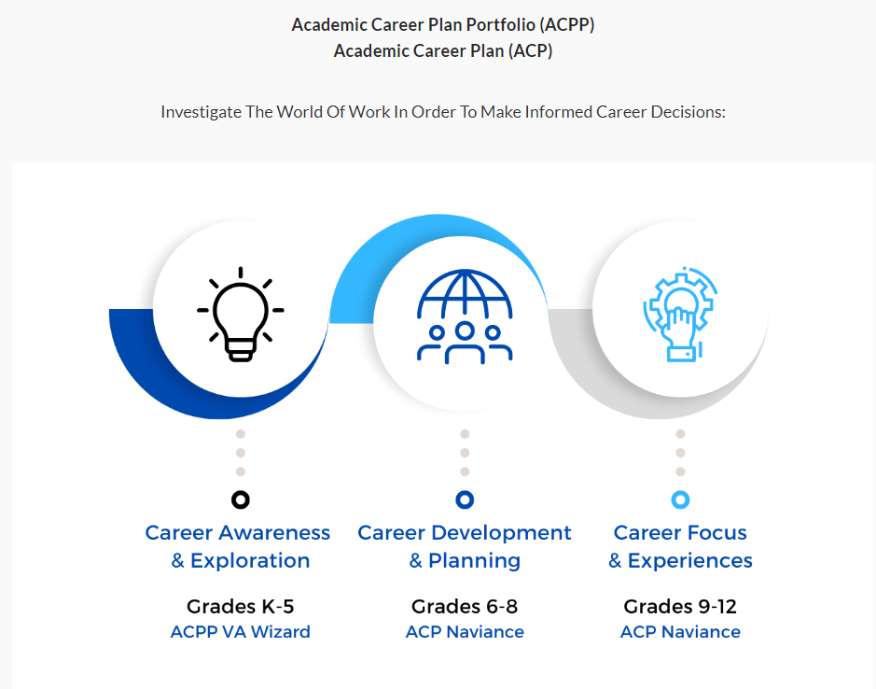
Elementary Middle High

Slide 3


Learning Intention:
We are learning to how to build a Career Portfolio
Success Criteria:
I know I have learned it when I can:
1 | Identify Strengths and areas of interest to build our careers
2 | Identify our values to build our careers
3 | Identify our skills to build our careers

Slide 4
VA Wizard
Academic Career Plan Portfolio

Slide 5
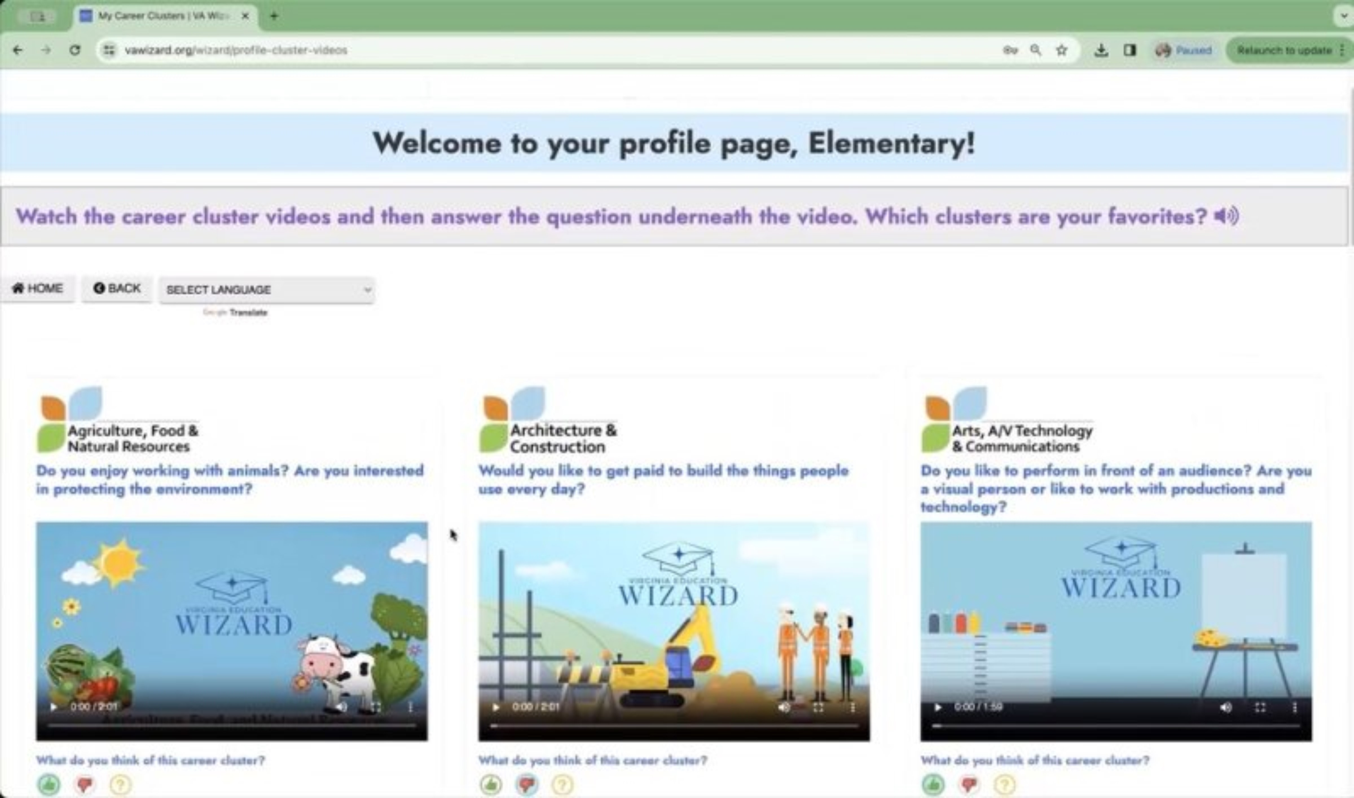
What is VA Wizard?
Optional 7 min video while students get logged in
Notes:
This slide is optional – but you may show students the video to introduce VA Wizard if that is helpful

Slide 6

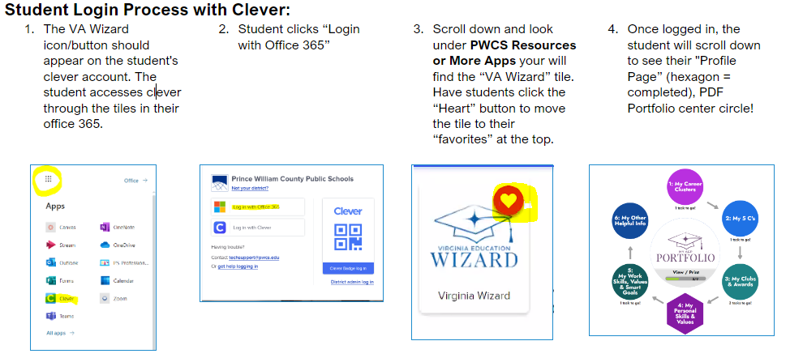
Log Into VA Wizard
Use Chrome Internet Browser
Notes:
School Counselor Demo: https://www.vawizard.org/wizard/home
Student Demo Account for Lesson on Smart Board: (CASE SENSATIVE)
Generic login: K5Wizard
Password: K5Wizard!
Troubleshooting Errors: (switch browsers chrome to edge or vice versa)
If your students have an issue when logging into VA Wizard with Clever (HTTP Status 500 internal server error) you will need to update Chrome to resolve the issue.
Here's how to update individual computers:
To update Google Chrome:
On your computer, open Chrome.
At the top right, click More .
Click Help. About Google Chrome.
Click Update Google Chrome. Important: If you can't find this button, you're on the latest version.
Click Relaunch.

Slide 7
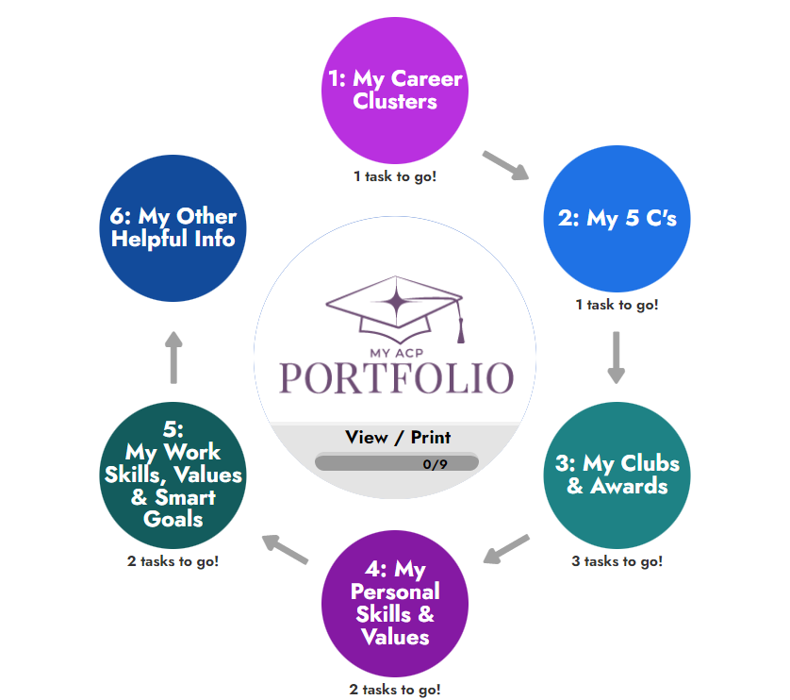
Log In!

Slide 8

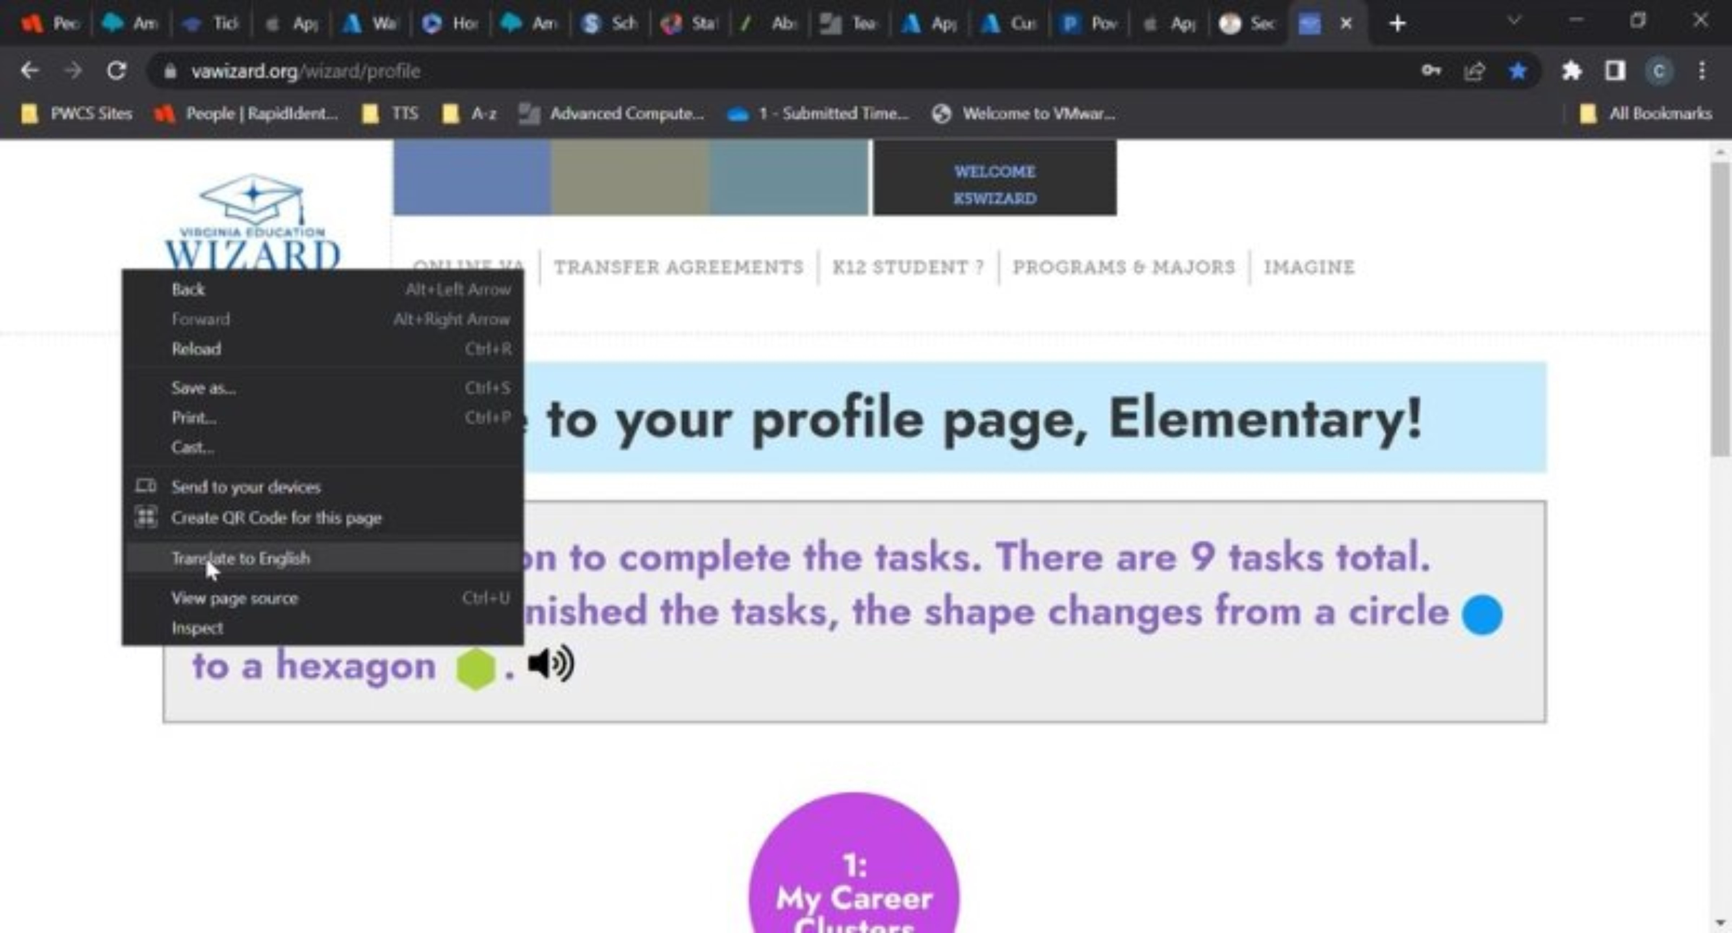

How to change the language in VA Wizard:
Notes:
Optional slide – your students will most likely be very familiar with VA Wizard by the 5th grade, but they are here if you feel they are needed or helpful

Slide 9

Work Values and Work Skills Lesson

Slide 10
Learning Objectives
Student will be able to:
Identify their personal skills in relation to work.
Identify their values in relation to work.
Compare the career clusters that match their skills with the career clusters that match their values.

Slide 11
Learning Intention

Slide 12
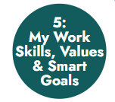
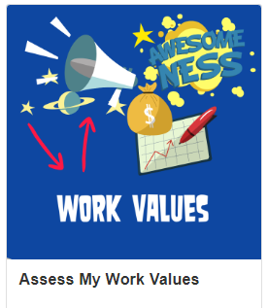
Fifth Grade Work VALUES
Part 1: Work Values
Values- Things that are important to you, help you make decisions and motivate you.
Work Values- Things that make you happy about your work.

Slide 13

Fifth Grade
Work SKILLS
Part 2: Work Skills
Skills- Things I'm good at or want to learn about.
Work Skills: Things that you are good at or want to learn more about, things you are curious about.

Slide 14
Compare and Contrast Your Results
Similarities? Differences?
Surprised about... Excited about …
Curious about...

Slide 15
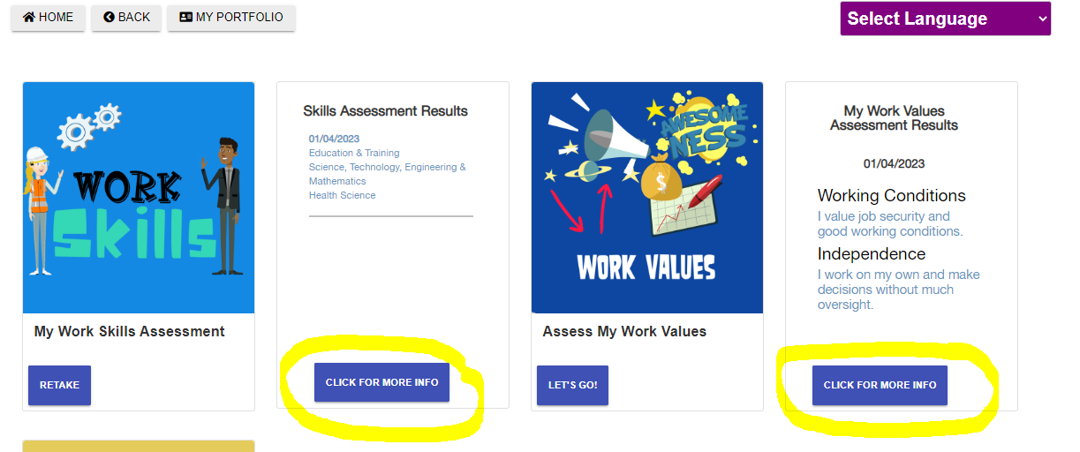
Additional Ways to Review Your Results and Search Careers:

Slide 16

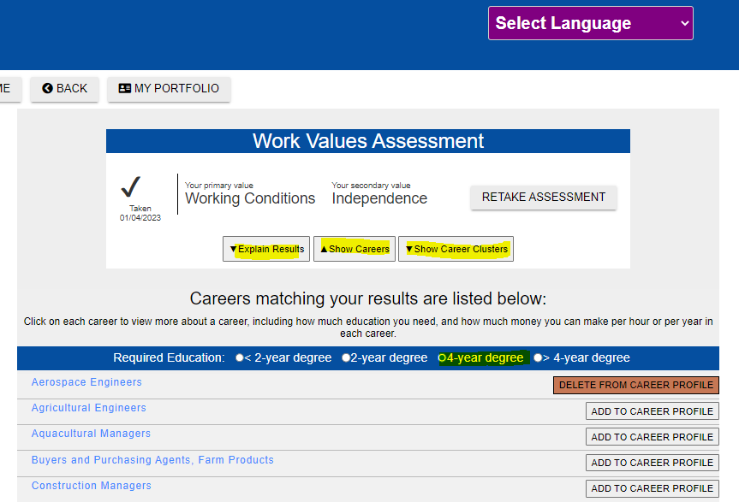
Review Your Results and Search Careers:
View Careers or Clusters
Change education level to expand results
"Add to career profile" to save anything that is interesting
Remember that these are only ideas! You are still the expert on you!
Not all careers are listed and that’sokay!

Slide 17
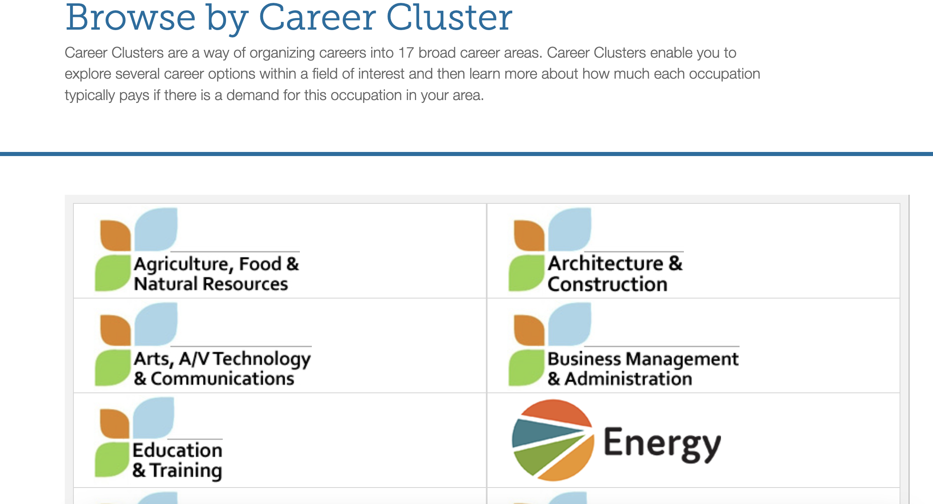

Slide 18
Learning Objectives
Student will be able to:
Identify their personal skills in relation to work.
Identify their values in relation to work.
Compare the career clusters that match their skills with the career clusters that match their values.

