Slide 1

VA Wizard
Academic Career Plan Portfolio

Slide 2
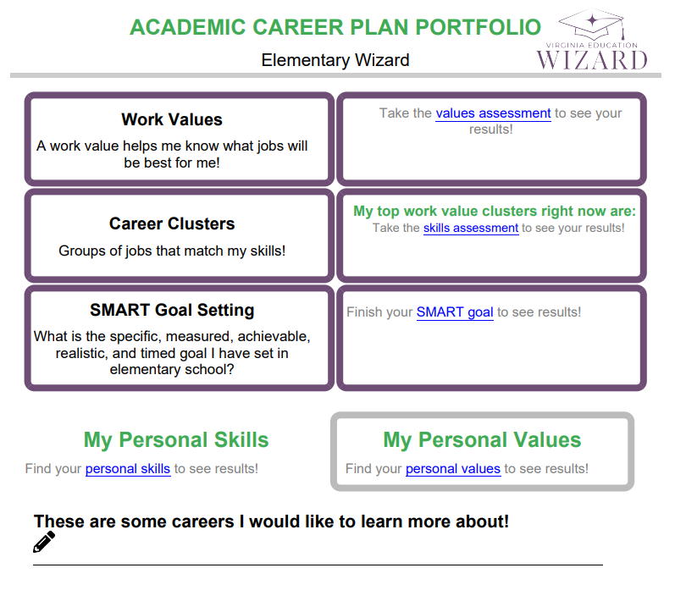
What is an Academic Career Plan Portfolio?
You are the author, and you get to:
Record your interests.
Explore careers.
Better know yourself through values, skills, and goals.

Slide 3
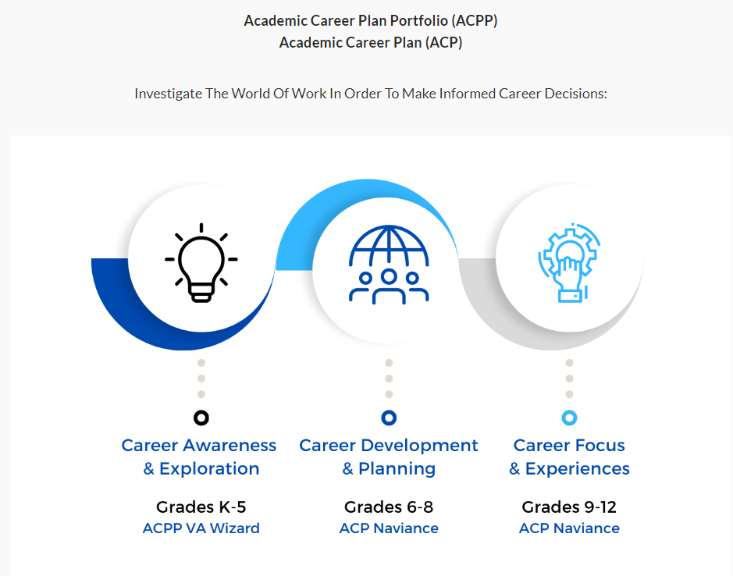
Elementary Middle High

Slide 4
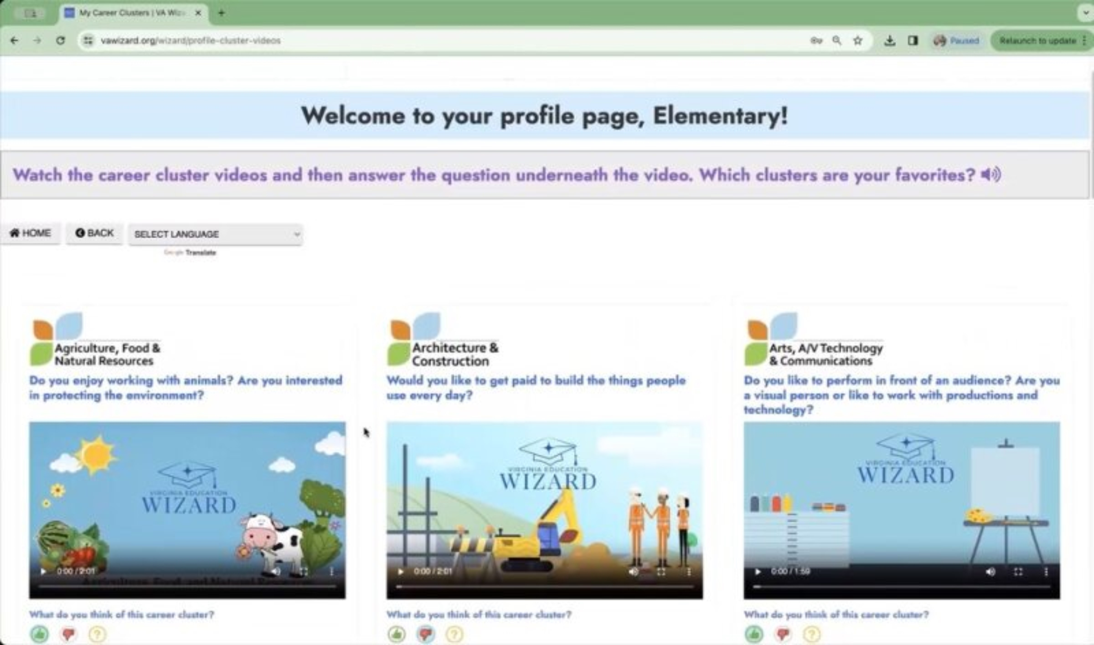
What is VA Wizard?
Optional 7 min video while students get logged in
Notes:
This slide is optional – but you may show students the video to introduce VA Wizard if that is helpful

Slide 5

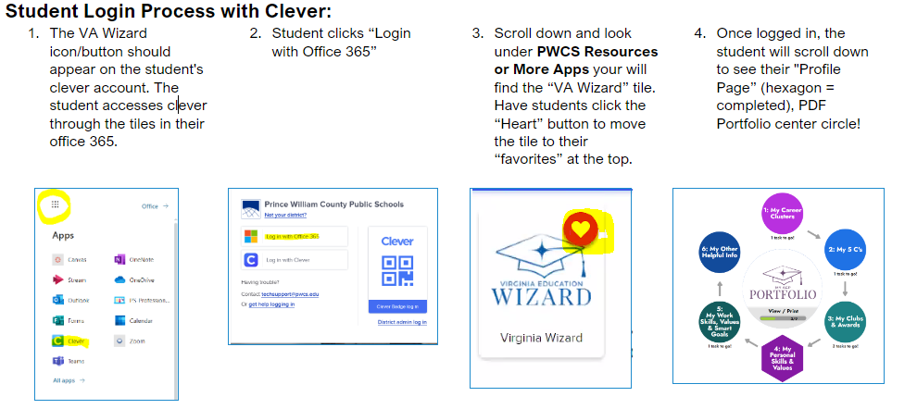
Log Into VA Wizard
Use Chrome Internet Browser
Notes:
School Counselor Demo: https://www.vawizard.org/wizard/home
Student Demo Account for Lesson on Smart Board: (CASE SENSATIVE)
Generic login: K5Wizard
Password: K5Wizard!
Troubleshooting Errors: (switch browsers chrome to edge or vice versa)
If your students have an issue when logging into VA Wizard with Clever (HTTP Status 500 internal server error) you will need to update Chrome to resolve the issue.
Here's how to update individual computers:
To update Google Chrome:
On your computer, open Chrome.
At the top right, click More .
Click Help. About Google Chrome.
Click Update Google Chrome. Important: If you can't find this button, you're on the latest version.
Click Relaunch.

Slide 6
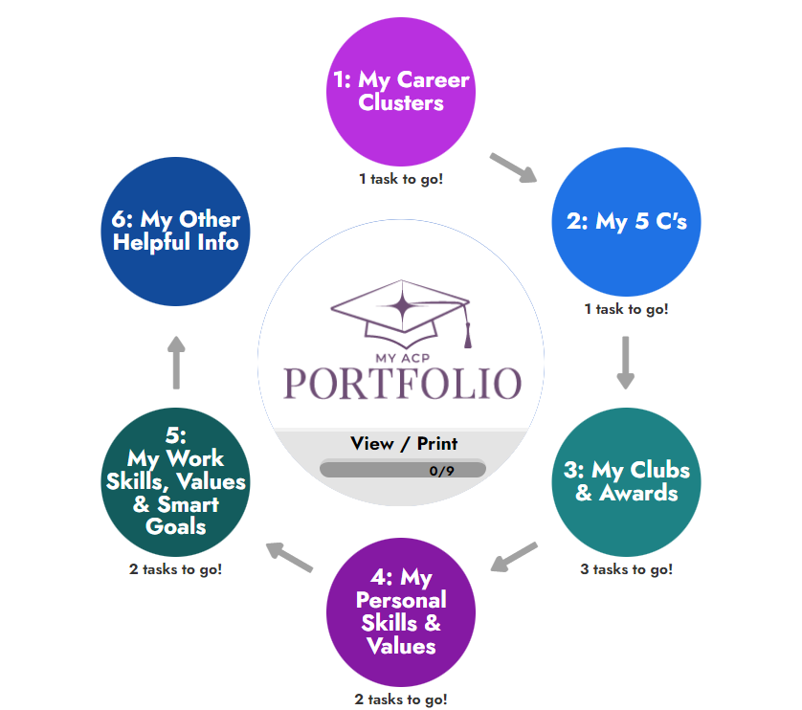
Log In

Slide 7

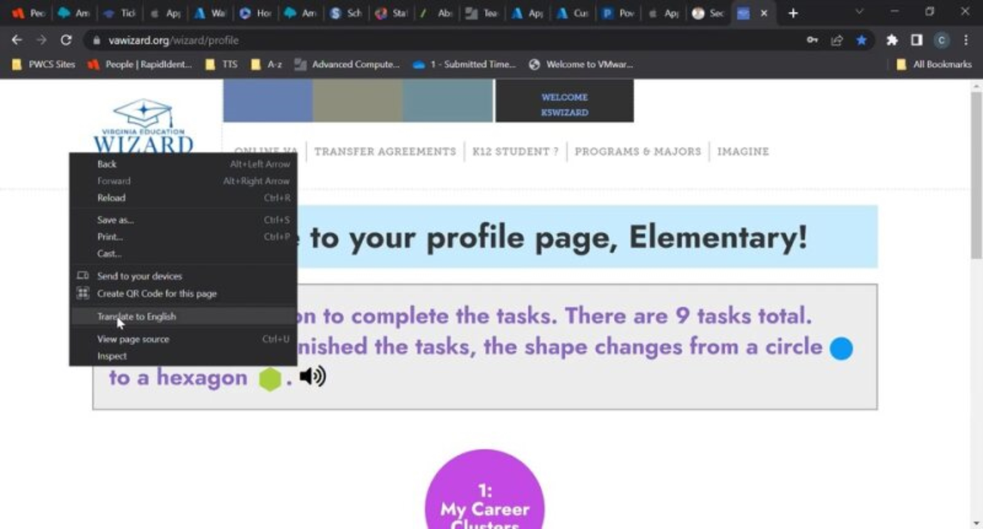

How to change the language in VA Wizard:
Notes:
Optional slide – your students will most likely be very familiar with VA Wizard by the 5th grade, but they are here if you feel they are needed or helpful

Slide 8

Learning Objectives
Student(s) will:
Identify personal skills and values and connect those with career choices.
Create a long-term and short-term goal.

Slide 9

What is a skill?

Slide 10
Skill
Something that you are able to do well.
Can be learned and improved upon with instruction and practice.

Slide 11



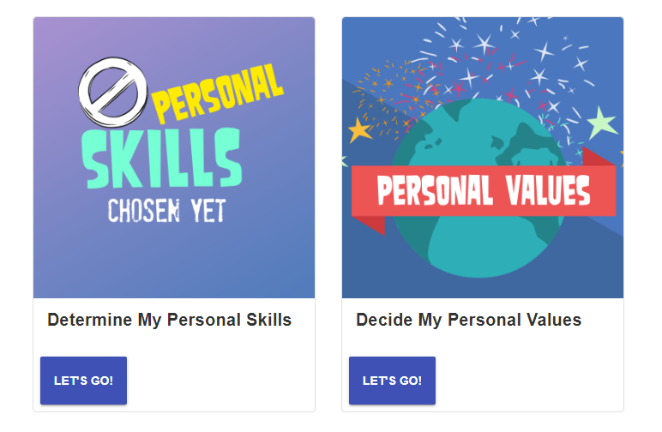

Fourth Grade Personal Skills & Values
Part 1:
Skills- Things I'm good at or want to learn about.
Values- Things that are important to you, help you make decisions, and motivate you.

Slide 12
Turn and Talk
What skill is your favorite?
What skill would you like to work on?

Slide 13
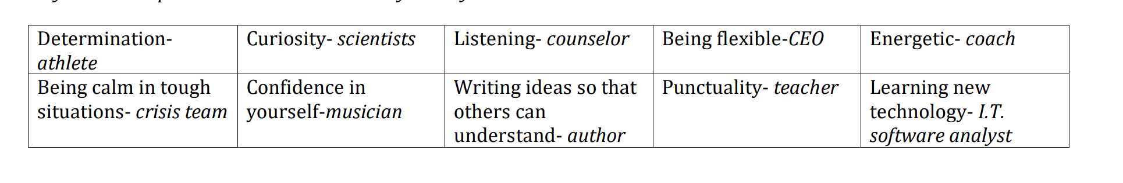
Here are some examples of how skills might relate to careers – can you think of others?

Slide 14
What is a value?

Slide 15
Value
Something that one holds dear.
Informs our decisions and choices.

Slide 16
Fourth Grade Personal Skills & Values
Values- Things that are important to you, help you make decisions and motivate you.

Slide 17

Our values can impact the goals we set for ourselves. Our skills are necessary to reach our goals, so they can equally impact our goals.

Slide 18

What is a goal?
Something that you want to accomplish.

Slide 19
What is a goal?
Short term goal:
Long term goal:
Finish reading this book by the end of the week.
Make the travel soccer team by the end of 5th grade.

Slide 20
Practice and Share Out
Your group will be sharing an example of a long-term or short-term goal.

Slide 21

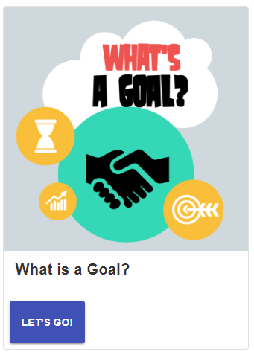
Fourth Grade Goal Setting
Part 2:
SHORT term goal- Something you can accomplish soon (within days). Ex. Finishing my homework by Friday.
LONG term goal- something you can accomplish that takes more time (weeks/months). Ex. Learning to dribble the basketball with your left hand.

Slide 22
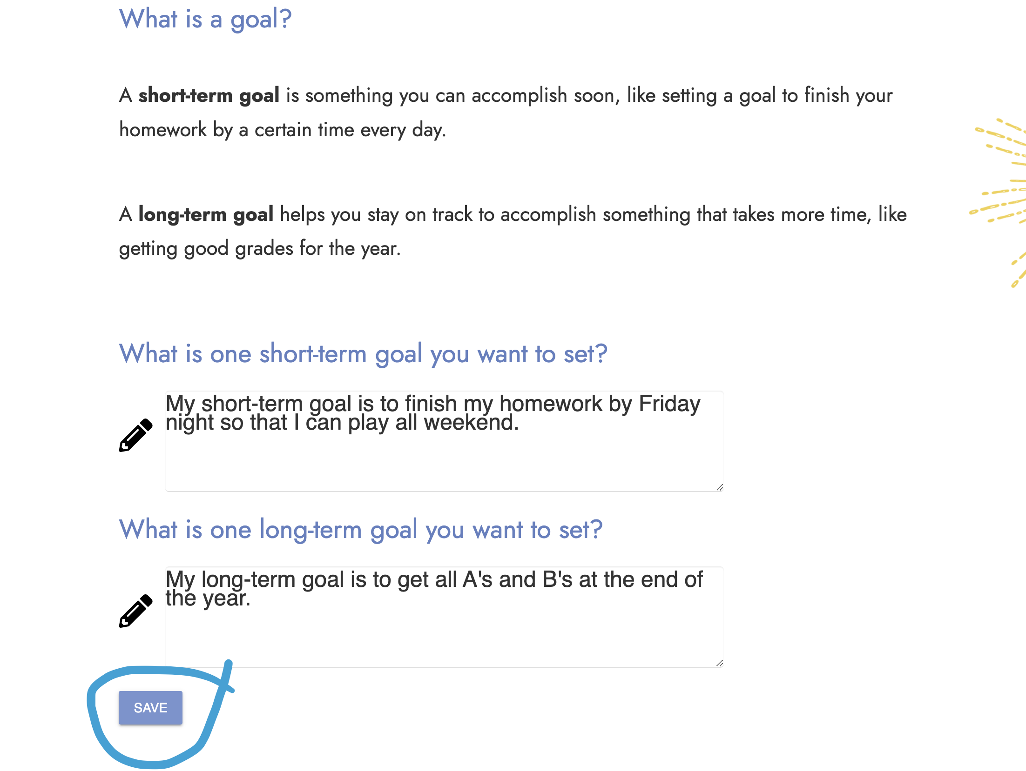
Type your Short Term and Log Term Goal
SAVE!

Slide 23
Learning Objectives
Student(s) will:
Identify personal skills and values and connect those with career choices.
Create a long-term and short-term goal.

