Slide 1
Note to the Counselor
Part 2 of 2 for 3rd graders 23-24 school year

Slide 2

VA Wizard
Academic Career Plan Portfolio

Slide 3
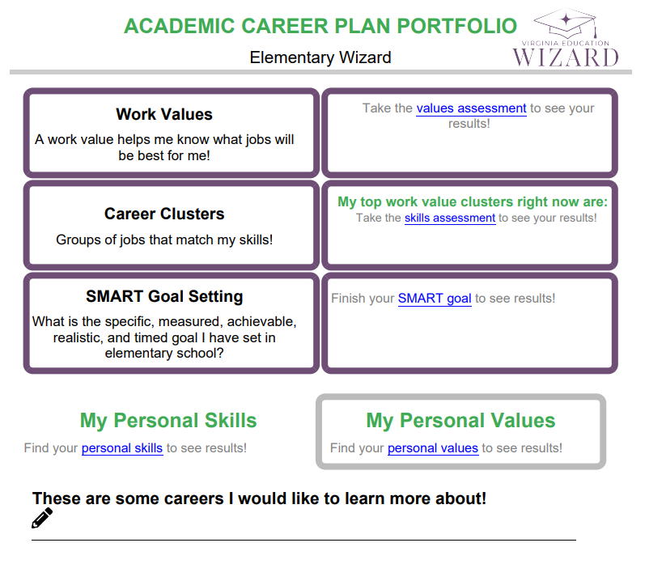
What is an Academic Career Plan Portfolio?
You are the author and you get to:
Record your interests.
Explore careers.
Better know yourself through values, skills, and goals.

Slide 4
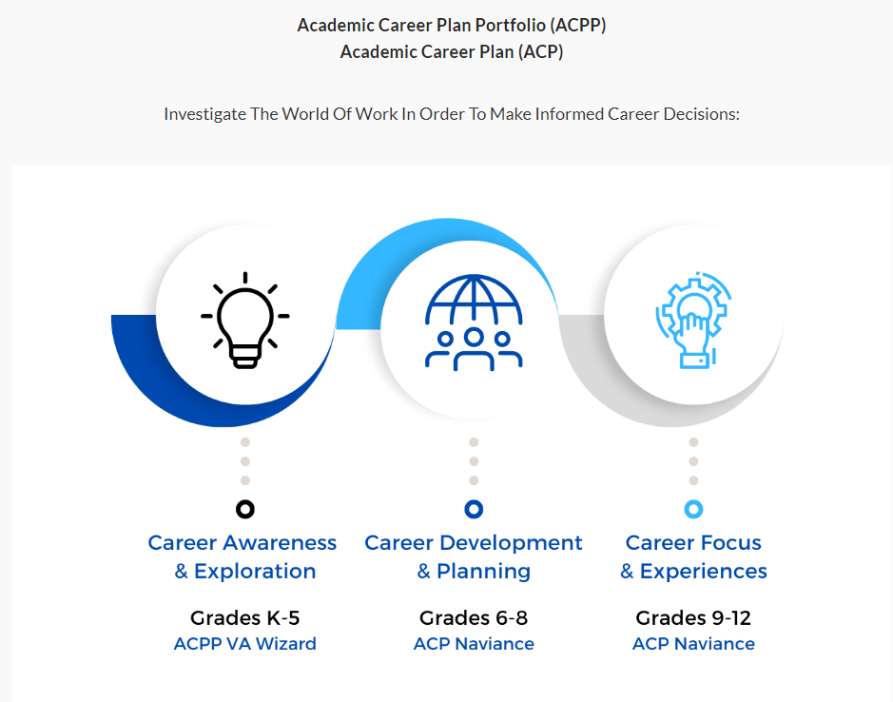
Elementary Middle High

Slide 5

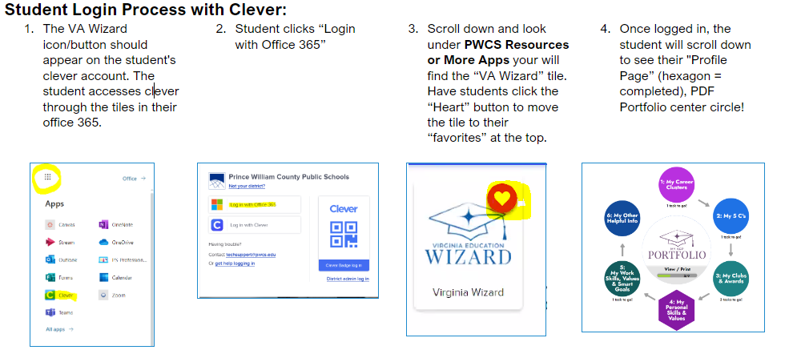
Log Into VA Wizard
Use Chrome Internet Browser
Notes:
School Counselor Demo: https://www.vawizard.org/wizard/home
Student Demo Account for Lesson on Smart Board: (CASE SENSATIVE)
Generic login: K5Wizard
Password: K5Wizard!
Troubleshooting Errors: (switch browsers chrome to edge or vice versa)
If your students have an issue when logging into VA Wizard with Clever (HTTP Status 500 internal server error) you will need to update Chrome to resolve the issue.
Here's how to update individual computers:
To update Google Chrome:
On your computer, open Chrome.
At the top right, click More .
Click Help. About Google Chrome.
Click Update Google Chrome. Important: If you can't find this button, you're on the latest version.
Click Relaunch.

Slide 6
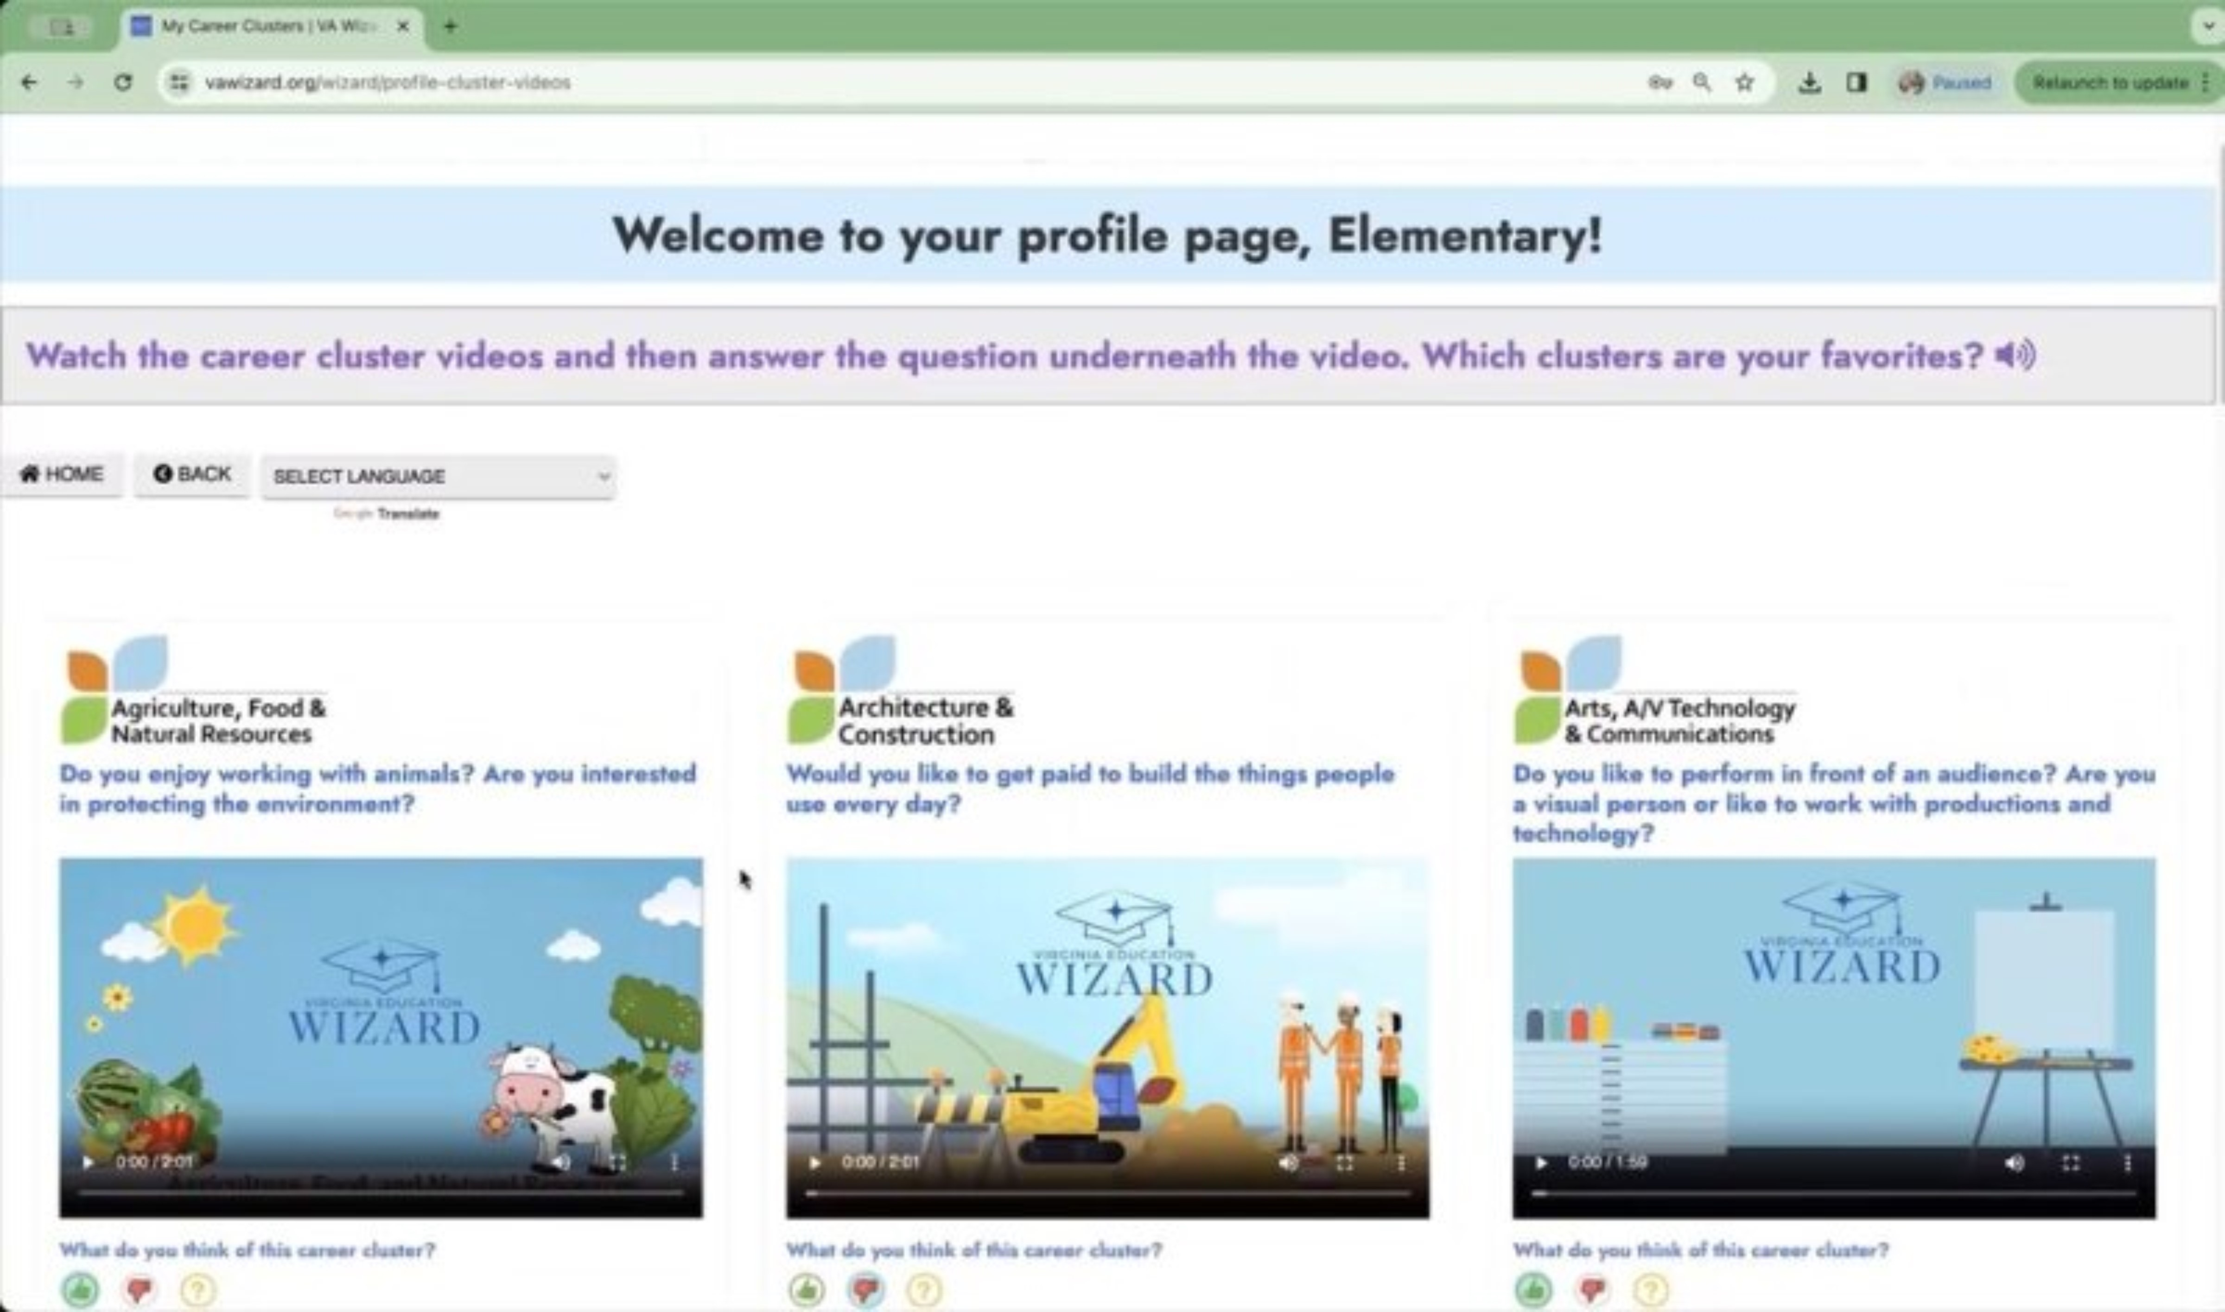
What is VA Wizard?
Optional 7 min video while students get logged in
Notes:
This slide is optional – but you may show students the video to introduce VA Wizard if that is helpful

Slide 7

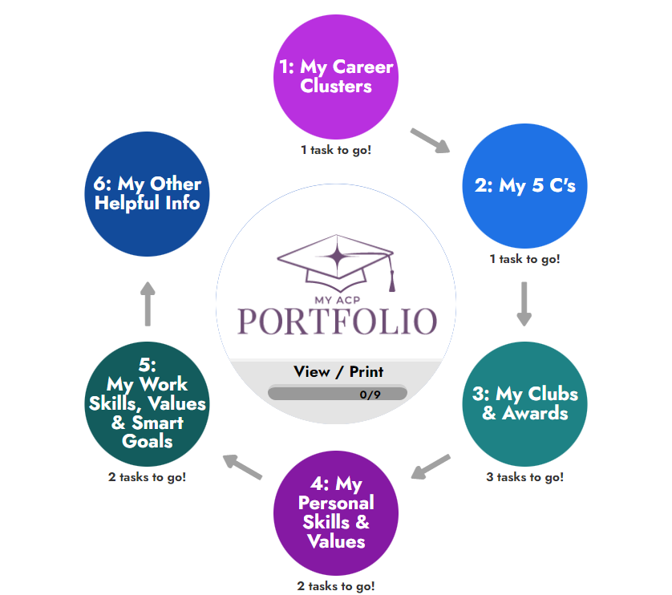
Log In

Slide 8

Learning Objectives
Student(s) will:
Understand why careers are grouped into clusters and what clusters are.
Identify which of the nine clusters in this lesson they most like and why.

Slide 9

Third Grade
Career Clusters
What are clusters?
A number of things grouped together that are similar.

Slide 10
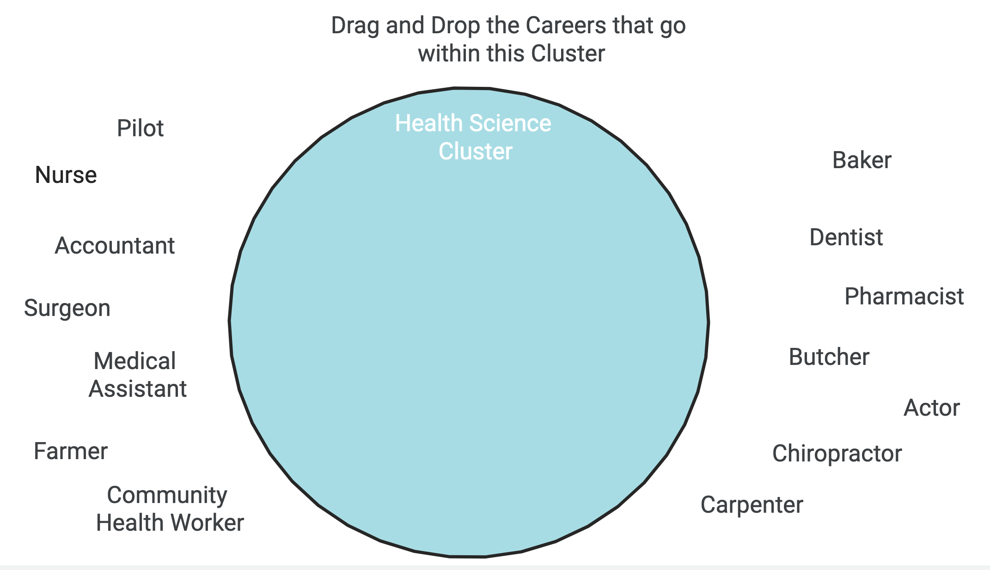
Career Cluster Drag and Drop Activity
Drag and Drop Activity

Slide 11


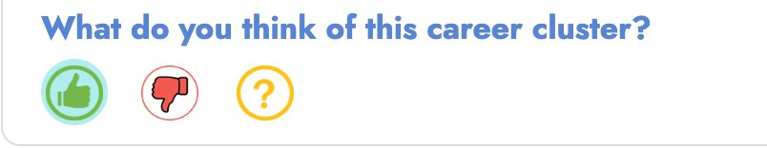
Third Grade Career Clusters
Career Clusters Videos
Rate each video after we watch it!

Slide 12

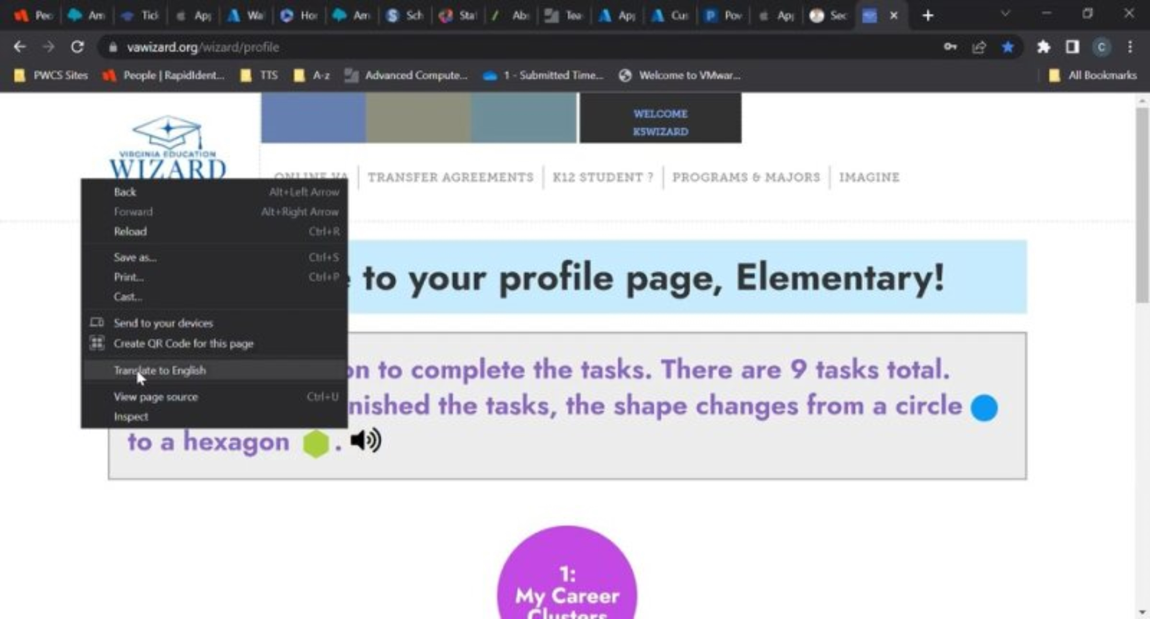

How to change the language in VA Wizard:
Video voice will stay in English
Notes:
Optional slide – your students will most likely be very familiar with VA Wizard by the 5th grade, but they are here if you feel they are needed or helpful

Slide 13
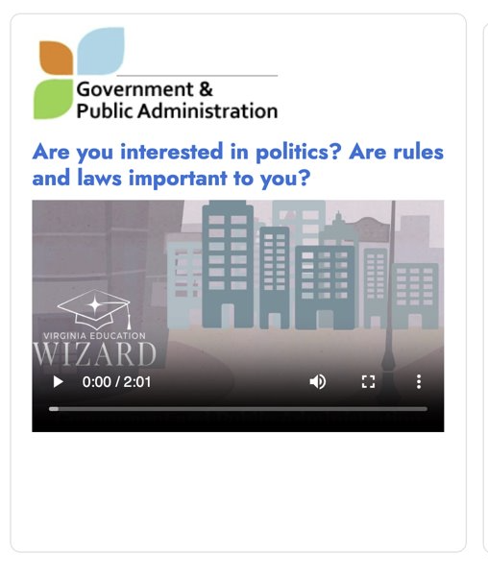
We will watch these together as a class!
Let's try one now!
Did you like this career cluster?
Answer on your screen!

Slide 14
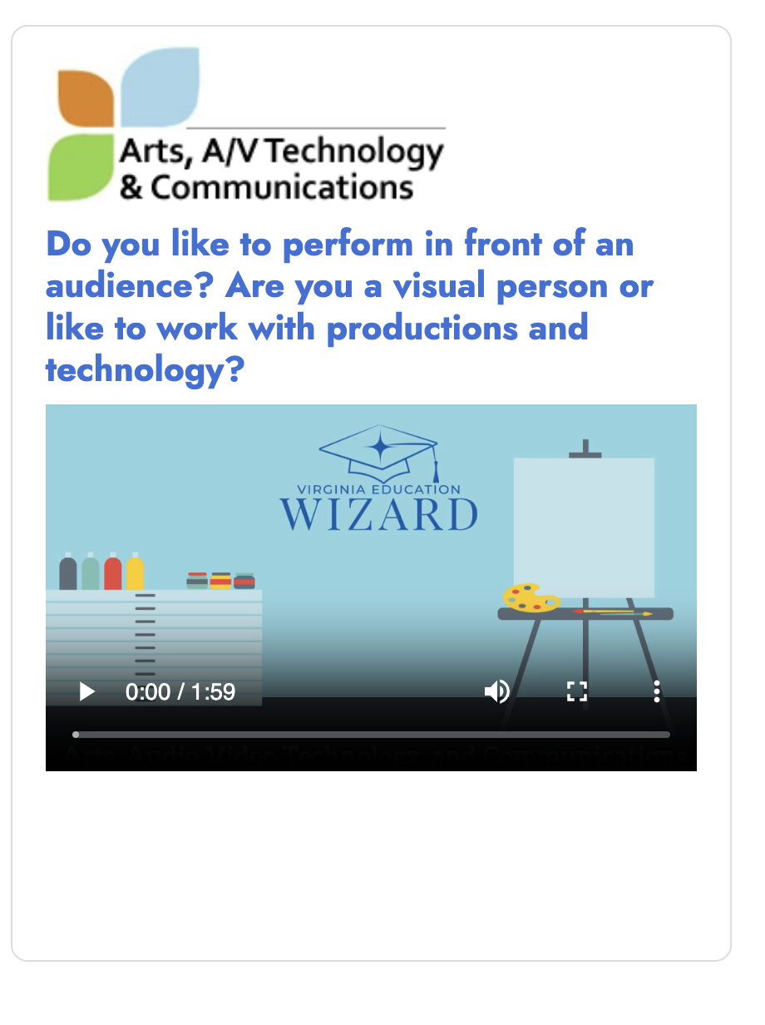
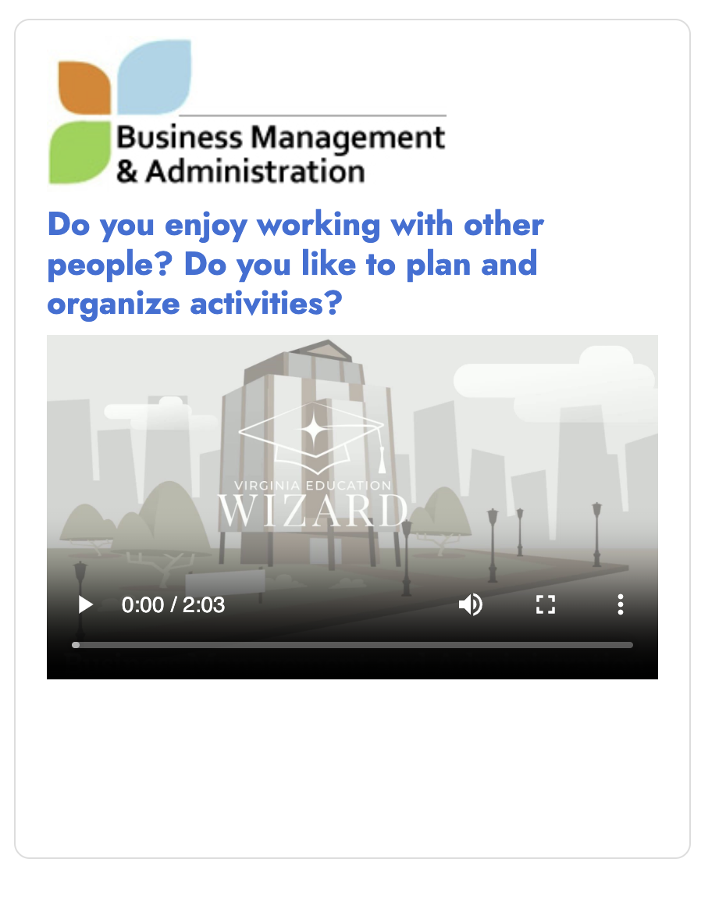
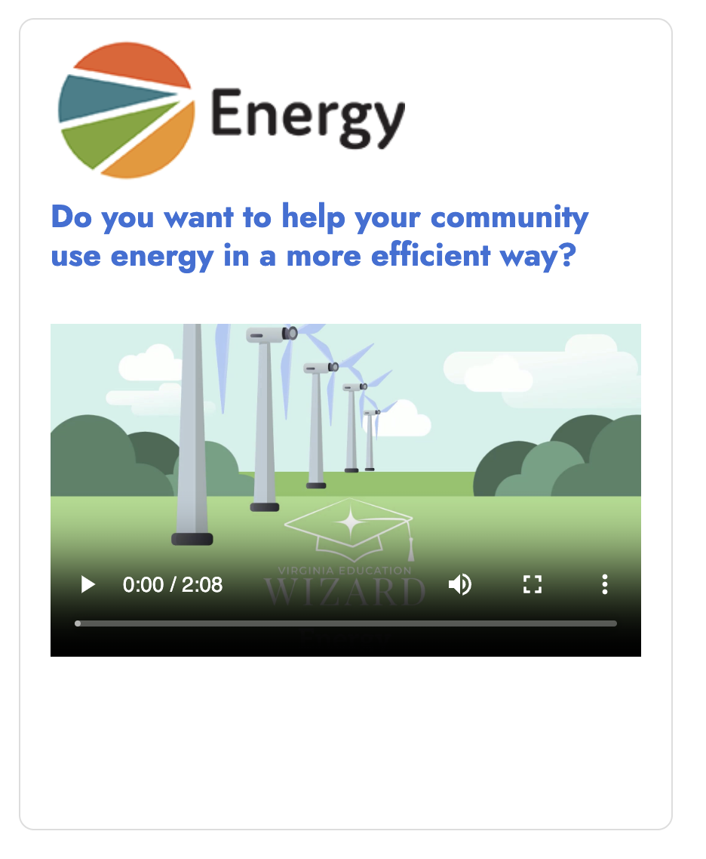
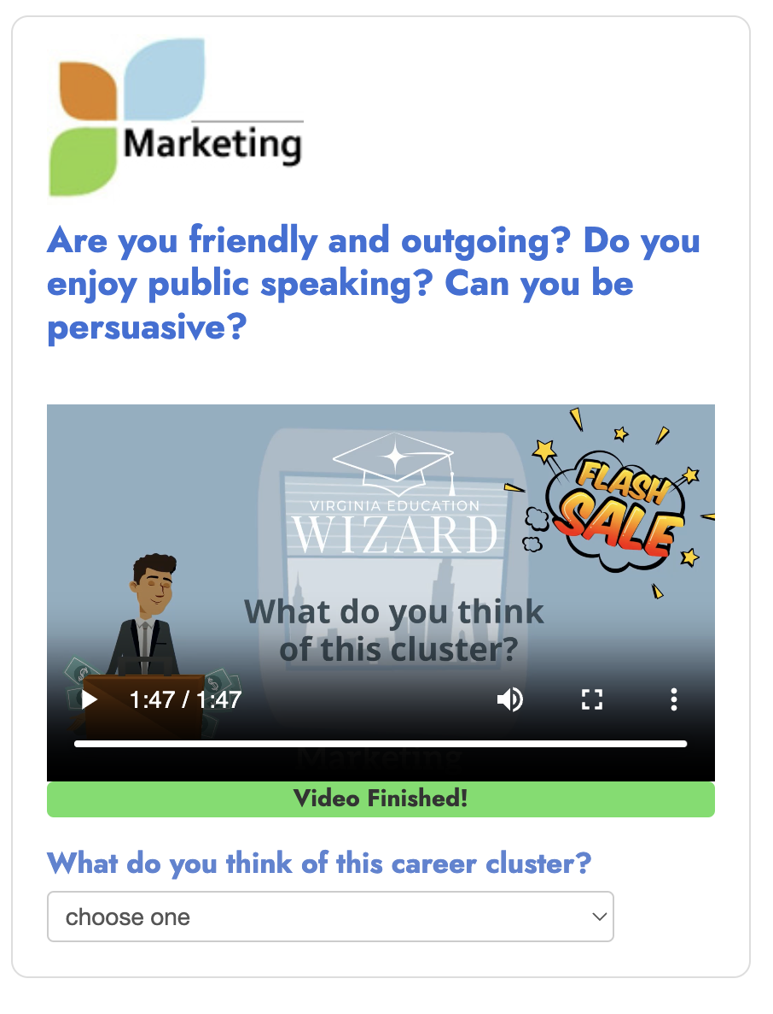
1
We will watch each video together!
2
3
4
Rate the career cluster!

Slide 15

Four Corners Activity
Go to the numbered space in the room that matches the career cluster that you are most interested in:
Arts, A/V, Technology and Communications.
Business Management.
Energy.
Marketing.

Slide 16
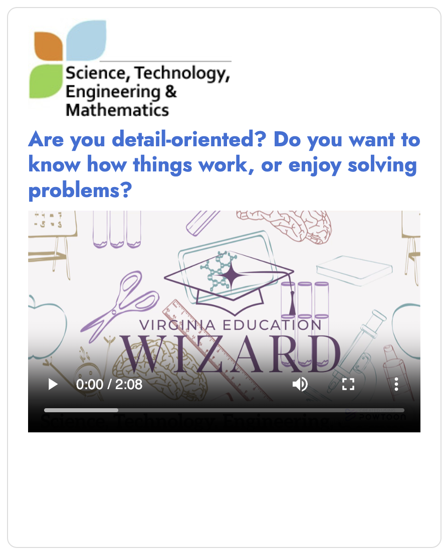
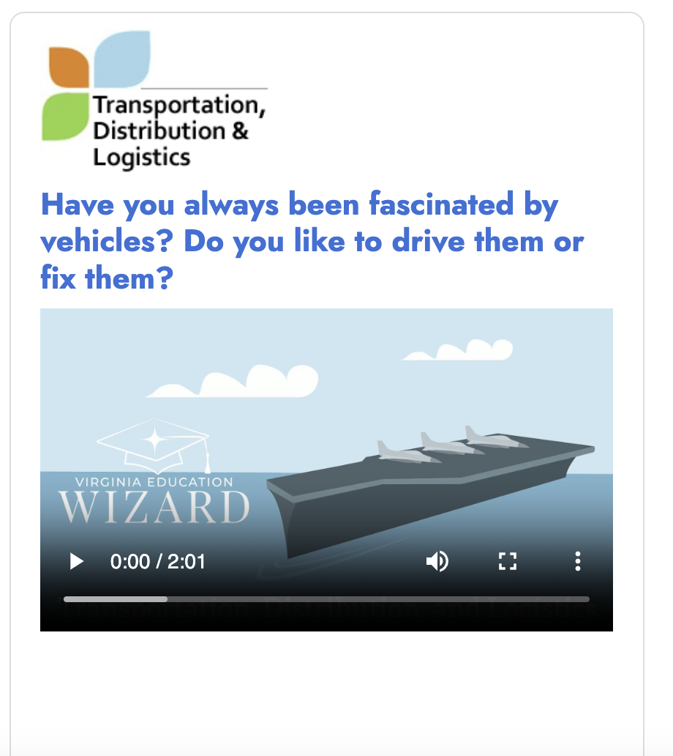

Let's learn about these career clusters!
Science, Technology, Engineering and Mathematics.
Transportation Distribution and Logistics.
Hospitality and Tourism.
Information Technology.
We will watch each video together!

Slide 17
Four Corners Activity
Go to the numbered space in the room that matches the career cluster that you are most interested in:
Science, Technology, Engineering and Mathematics.
Transportation Distribution and Logistics.
Hospitality and Tourism.
Information Technology.

Slide 18
What did we learn?
I understand why careers are grouped into clusters and what clusters are.
I identified careers that I am interested in, didn’t like, or am unsure about.

