Slide 1
School Counseling VA Wizard Career Lesson-Kindergarten and First

Slide 2
Learning Targets
Today we/I will be learning about careers.
We will/I will do this by participating in our school counseling career lesson.
We’ll/I’ll know I’m successful by being able to identify two careers.

Slide 3
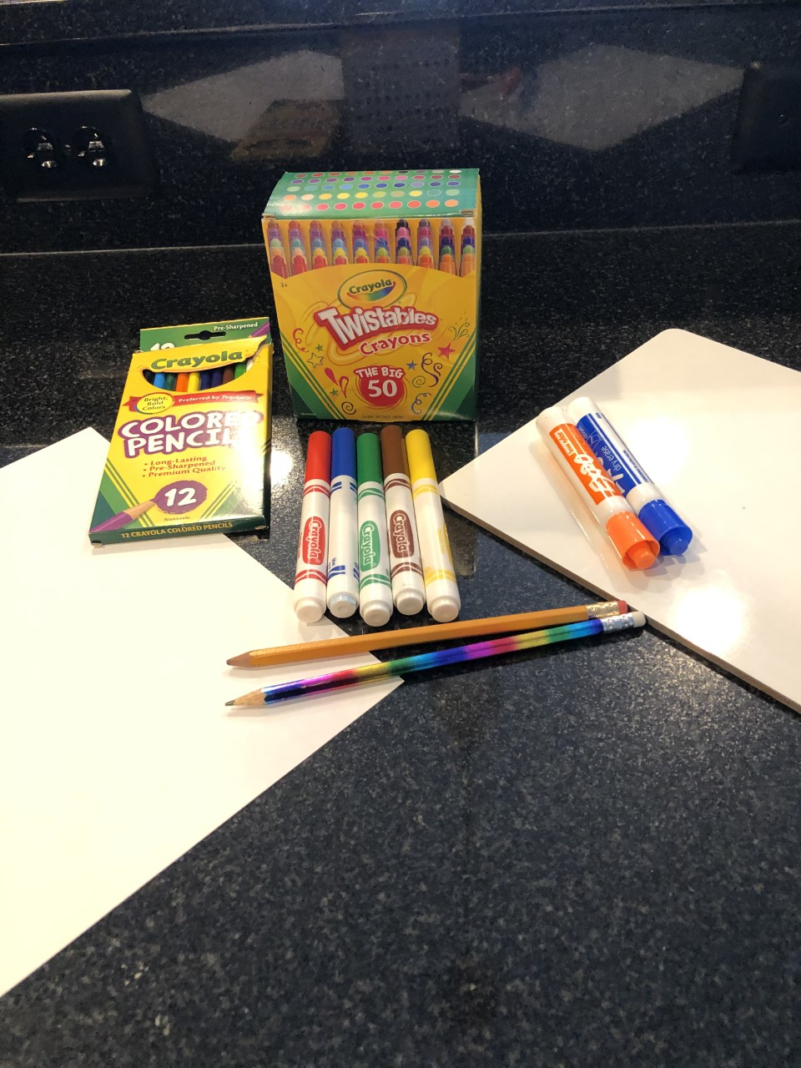
Materials

Slide 4
Turn and talk, with a partner, about what you remember about the word “career.” *Share out*
Notes:
Discussion:
1) Discuss what students know about careers. Remind students it is OK if they do not remember or are not sure. This might be the first time they are hearing this word.

Slide 5
What are some careers you know about (here are a few)?
Police
Fire fighter
Mail carrier
Medical worker
Garbage collector
Educator
Barber/Beautician
Mechanic
Farmer
Truck Driver
Landscaper
Electrician
Plumber
Chef
Soldier
Food service worker
Scientist
Builder
Road construction crew

Slide 6
What are some careers you know about? *Images from Bing*

Slide 7
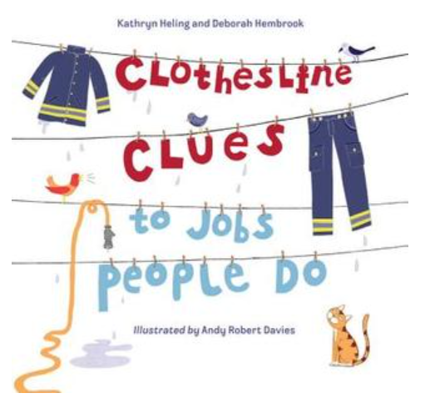
Read the book or let’s view the story on the next slide Author: Kathryn Heling and Deborah Hembrook Illustrator: Andy Robert Davies Publisher: Charlesbridge
Notes:
*

Slide 8
Let’s hear the story: (read out loud or show video)

Slide 9
Brain Break!

Slide 10
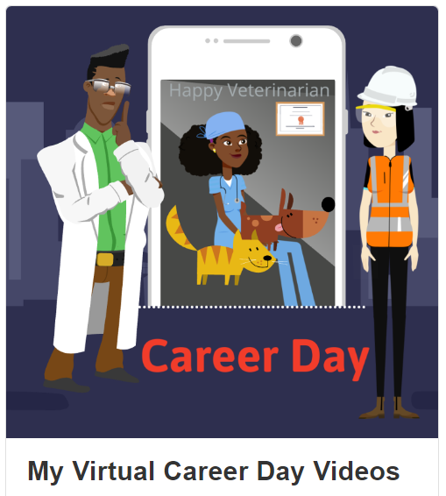
Let’s Watch VA Wizard Career Videos
Notes:
Discussion:
1) Go over videos students watched and discuss.

Slide 11
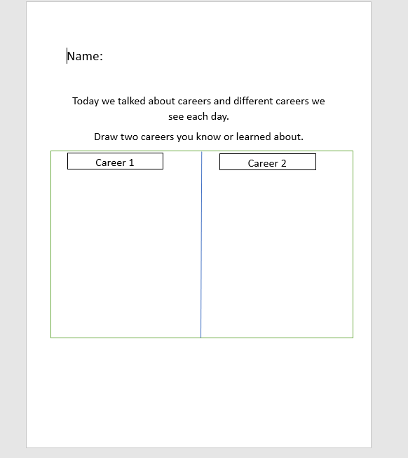
Reflection Activity: Question & Answer
Draw two careers you know about (through family, friends, neighbors, and/or the videos we watched).
*Share out*
Notes:
Discussion:
1) Discuss careers students are aware of.

Slide 12
Review of Lesson and Questions

