Slide 1
Academic Confidence Building Unit
Lesson #2: “We Do”
Organization/Study Skills
Notes:
Greet students and introduce topic.
(2 Minutes)

Slide 2
Lesson Objectives
Review growth mindset and relevant connections work/ study skills necessary for student success.
Explore work/ study skills that lead to student success.
Identify personal academic strengths.
Notes:
Go over expectations and provide examples.
Use this slide to insert your own classroom expectations or use the ones on the next slide.
(3 Minutes)

Slide 3
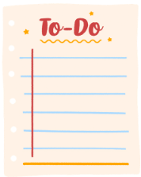
Agenda: What are we doing today?
Introduction:
Agenda
Lesson Expectations
Skill/Practice/ Activity: Supernatural Study Skills
Activity: Mojo Growth Mindset Videos #2 - #5 and
discussion questions.
Closing: Snowball Fight
Notes:
Go over agenda for lesson and answer questions.
(3 minutes)

Slide 4
Lesson Expectations
S: “Sitting Mountain” position! “Mountain Peak” (head) is high in the sky and “Mountain Valleys” (bottom and feet) are grounded.
L: Listening!
A: Attention! (This is different than listening.)
N: Nodding often to show engagement.
T: Not Talking unless I Tell you to and there will be Time for this!- Promise!
Notes:
Go over expectations and provide examples.
Use the ones on this slide or insert your own classroom expectations on the previous slide.
(3 Minutes)

Slide 5
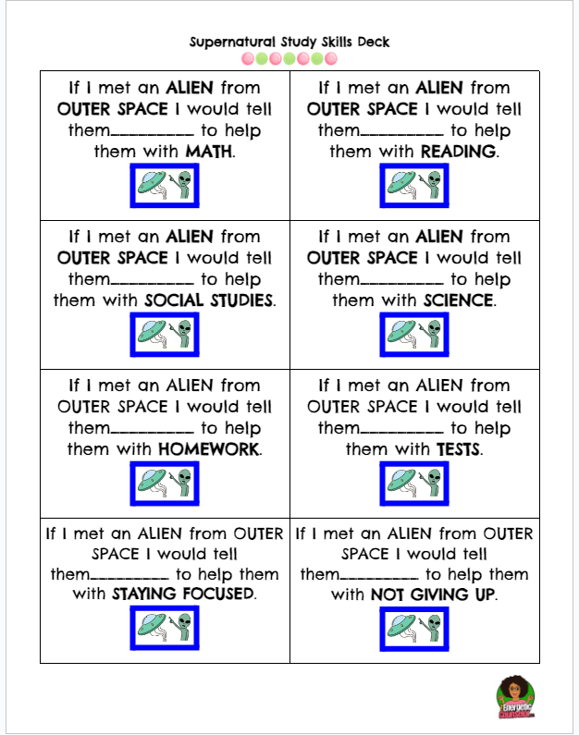
Activity 1: Study Skills Deck
Notes:
Pass out a study skills card to each student. Try to give students sitting in the same group a different card each. Give them some time to talk to each other about what they would say if they met an alien from outer space.

Slide 6
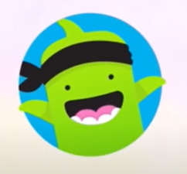
Activity 2: Growth Mindset Videos & Discussion
Mojo Growth Mindset Videos #2
Mojo Growth Mindset Videos #3
Mojo Growth Mindset Videos #4
Mojo Growth Mindset Videos #5
https://ideas.classdojo.com/b/growth-mindset
Notes:
Watch videos and stop to process/highlight key points. Use discussion questions at the end of each video.

Slide 7
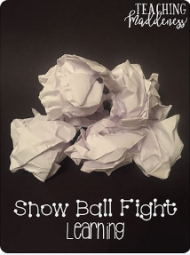
Activity 3 – Closing/Snowball Fight
Write one thing you find challenging to do on your piece of paper. DO NOT WRITE YOUR NAME ON THE PAPER.
Notes:
Have students write one thing they find challenging on a half-sheet of paper. Please remind them not to put their name on the paper.
Next, have the students come to an area in the room where they can form a circle. Have them bring their paper.
Then, have them crumple their paper. Count 1, 2, 3 ….snowball fight! The kids will throw their papers at each other softly.
Have the students pick up a snowball and read what it says in their head.
Next, go around the room and have each kid read what was written on the snowball.
You may have students find the student who read their snowball statement at the end of the activity or collect them for your own data.

Slide 8
Closing
1) What was your favorite part of this lesson?
2) What will you remember about this lesson?
Notes:
Process/ Closing: (5 Minutes)
As time allows, have students share answers to the questions on the slide.
Encourage students to be your “newsletters and cheerleaders” and share what they learned with their families.

