Slide 1
Academic Confidence Building Unit K-1st
Lesson #2: “We Do”
Work/ Study (Listening) Skills
Notes:
Greet students and introduce topic.
(2 Minutes)

Slide 2
Learning Objectives
Students will identify and practice good listening skills.
Students will explore the connection between listening skills and student success.
Notes:
Go over objectives and provide examples.
(3 Minutes)

Slide 3
Agenda: What are we doing today?
Introduction:
Agenda
Lesson Expectations
Story/ Video: Howard B. Wigglebottom Learns to Listen
Review/ Quick Check for Understanding
Skill/Practice: Worksheet/ Activity- Howard B. Wigglebottom Listening Activity
Close
Notes:
Go over agenda for lesson and answer questions.
(3 minutes)

Slide 4
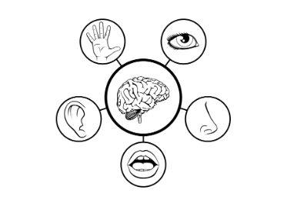
Lesson Expectations: 5 Senses
Eyes: On me!
Ears: Open and listening!
Lips: Zipped, closed, and quiet!
Hands: In your lap and to yourself!
Nose: Out of your neighbor’s business!
(As a class family, you do SUCH a good job taking care of others, during our lesson, you get to take a “break” and I will take care of everyone!)
Notes:
Go over expectations and provide examples.
(3 Minutes)

Slide 5
Introduction: Story First, what does it mean to listen?
Notes:
Ask students to share out what it means to listen. Read story and stop to process/ highlight key points (including different ways we can be a good listener). (15 Minutes)

Slide 6
Review of Story
What happened when Howard did not listen? When Howard did not listen _____________________.
What happened when Howard did listen? When Howard did listen ______________________________.
Which one do you think has Howard feeling happier and why? The choice Howard was happier with was _____________________ because __________________________.
Notes:
Review story with students.

Slide 7
Check for Understanding
Notes:
Play the “check for understanding” video. Allow students to respond to the prompts/ questions, in the video, aloud.

Slide 8
Brain Break Time!
Notes:
Brain Break

Slide 9
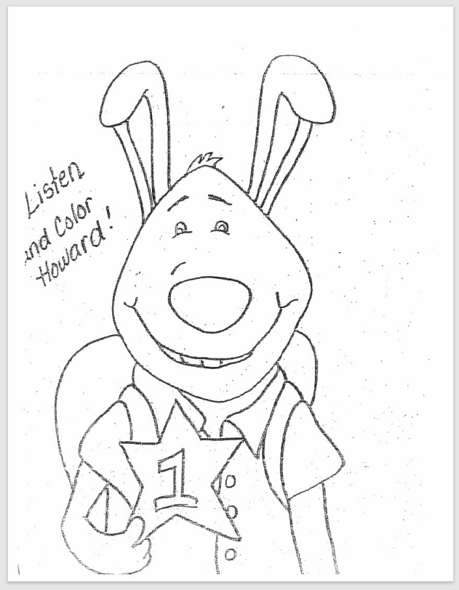
Activity: Howard Listening Coloring Activity
Notes:
Howard Listening Coloring Activity (13-15 Minutes)
Directions:
Pass out a coloring sheet to each student. Explain that you are going to read a poem that will explain some silly ways to color Howard.
Tell students that they will need to use their BEST listening skills to get all the details.
Read the poem aloud and repeat each line twice.
As time allows, allow students extra time to color the rest of the sheet.

Slide 10
Activity: Howard Listening Coloring Activity
Howard Listening Poem
Did you ever hear of Howard the bunny,
Who had a yellow nose that looked kinda funny?
He was the coolest rabbit if you know what I mean,
One eye was orange and the other was green.
Blue ears stood up on the top of his head,
So he could listen to everything his teacher said.
He was the best listener I have ever seen,
And for that earned a #1 star that was green.
Everyone noticed Howard and he gained lots of fame,
Now somewhere on your paper, I should see your name!
Notes:
Howard Listening Coloring Activity (13-15 Minutes)
Directions:
Pass out a coloring sheet to each student. Explain that you are going to read a poem that will explain some silly ways to color Howard.
Tell students that they will need to use their BEST listening skills to get all the details.
Read the poem aloud and repeat each line twice.
As time allows, allow students extra time to color the rest of the sheet.

Slide 11
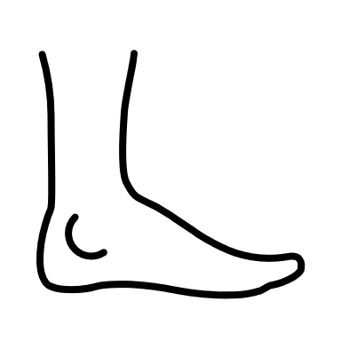
Listening Activity
Let’s play “Howard B . Wigglebottom says” to see how well you can listen…
Raise your hand
Wiggle your ears
Blink your eyes
Stand up (do not say “Howard B. Wigglebottom says” for this one)
Stand up (now start saying again “Howard B. Wigglebottom says”)
Shake your right foot
Clap your hands
Sit down
Notes:
Share with students we are going to have another listening activity. Set-up activity like “Simon Says” game.

Slide 12
Closing
1) What was your favorite part of this lesson?
2) What will you remember about this lesson?
Notes:
Process/ Closing: (5 Minutes)
As time allows, have students share answers to the questions on the slide.
Encourage students to be your “newsletters and cheerleaders” and share what they learned with their families.

